Slide 1
Mix It Up: Case Management Data & Document Assembly
TIG 2013

Slide 2
Presenters: Dina Nikitaides, Illinois Legal Aid Online Sheila Fisher, North Penn Legal Services

Slide 3
Agenda
ILAO LegalServer & HotDocs Integration Project
NPLS CMS & Desktop HotDocs Integration Project
Outcome of ILAO Project
Outcome of NPLS Project

Slide 4
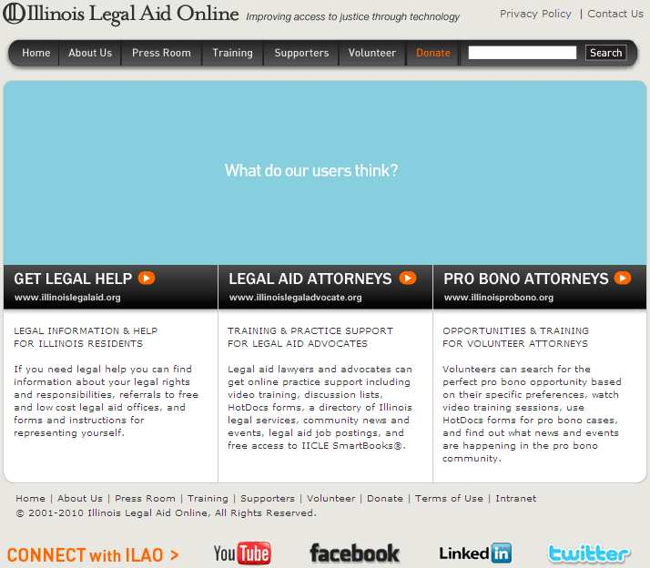
ILAO: A Different Legal Aid Org
Formed in 2001 at Chicago-Kent; independent in 2005
State-wide technology center for legal services
Funded through state & federal grants/contracts, foundations, Illinois lawyers, law firms and private donors

Slide 5
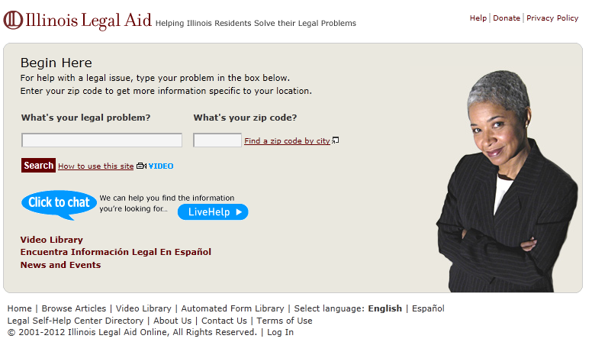
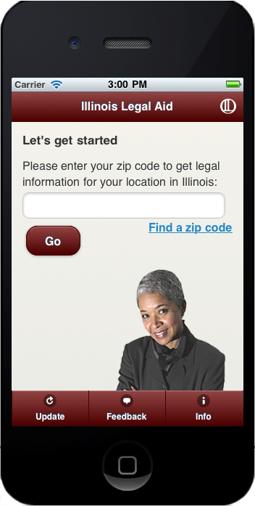
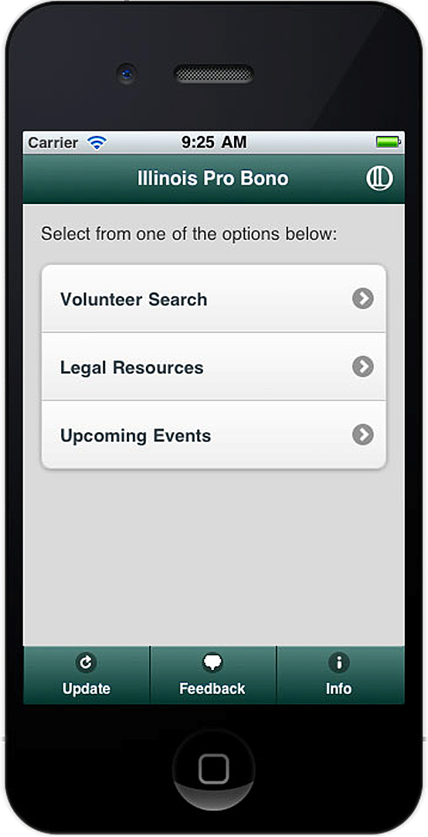
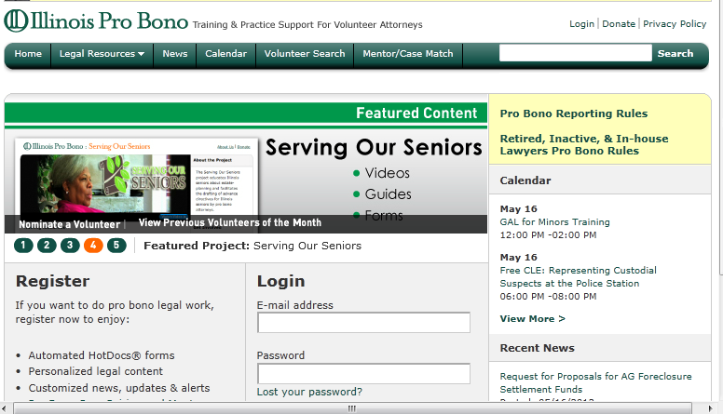
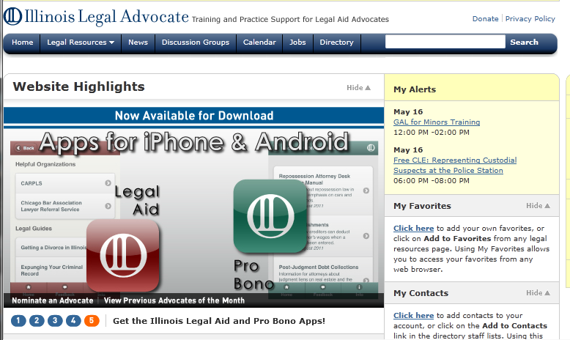
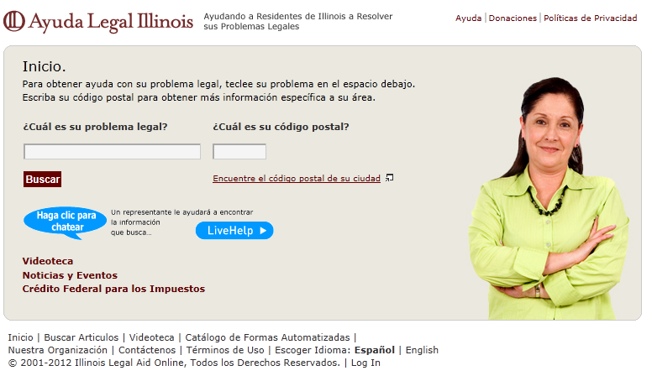
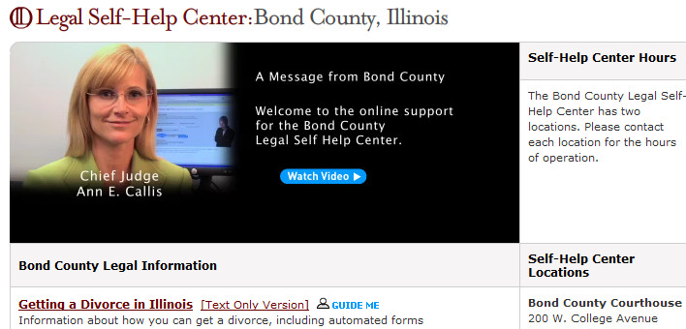
Increasing Access to Justice
Mission: To increase access to justice for low-income and vulnerable Illinois residents through the innovative use of technology
Method: 4 statewide websites, 2 mobile apps, & 98 self-help centers across IL

Slide 6
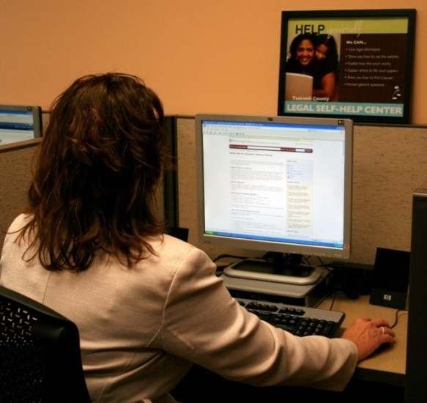
Delivering Justice: Two Avenues
Support Advocates
2200+ pieces of content in 33 different legal areas
14 HotDoc Packets = 100+ legal documents
Educate & Empower Public
2500+ pieces of content in 32 different legal areas
66 Automated Documents

Slide 7
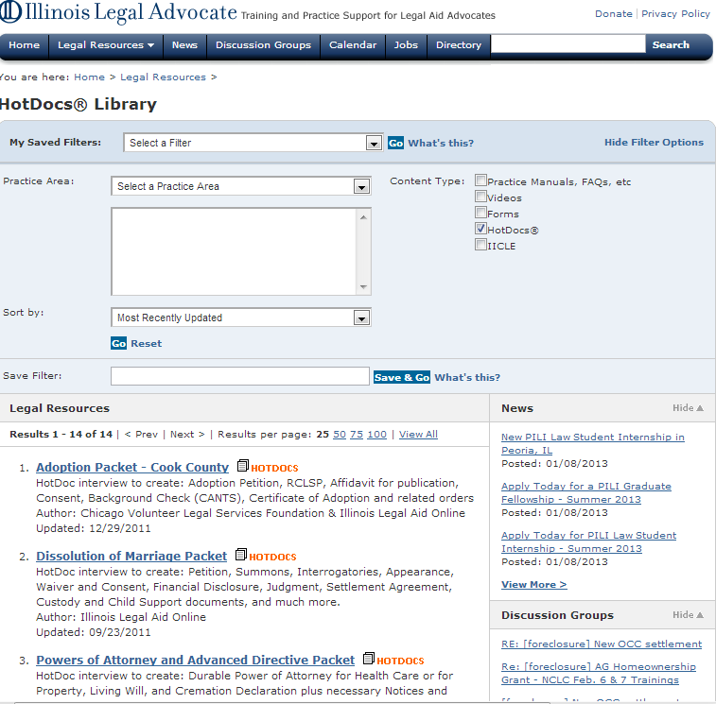
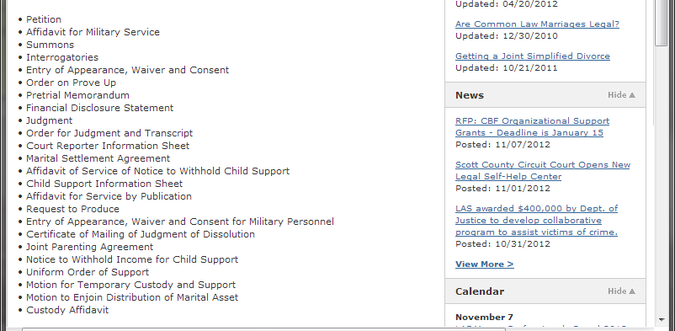
Advocate HotDocs Interviews
HotDocs produce range of documents including pleadings, motions, notices, for each case type

Slide 8
LegalServer/HotDocs Integration Project
2009 TIG project
Grant Partners: LAF Chicago, ILAO, PBN & PSTI
Purpose: Improve document generation process & create substantial time-saving benefits
For Who: All legal aids using LegalServer CMS can connect to this system for free and access ILAO created HotDocs on LHI

Slide 9
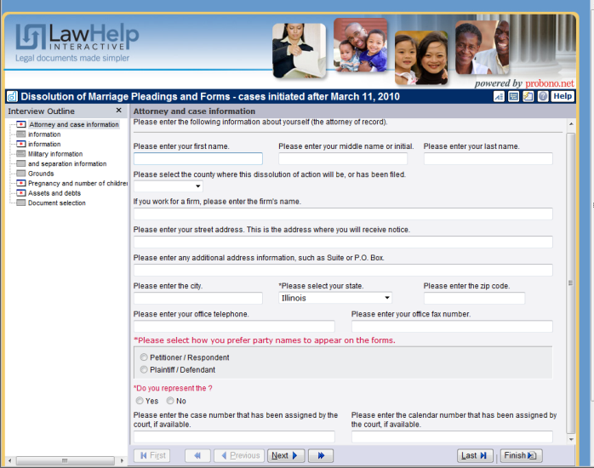
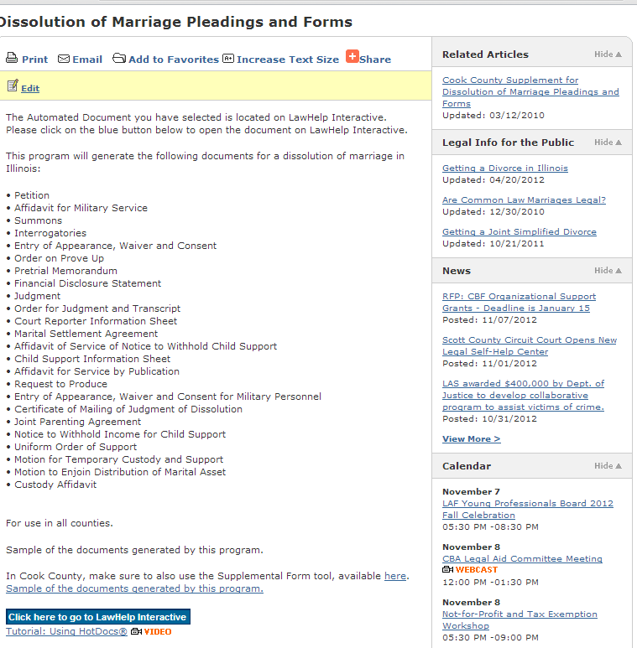
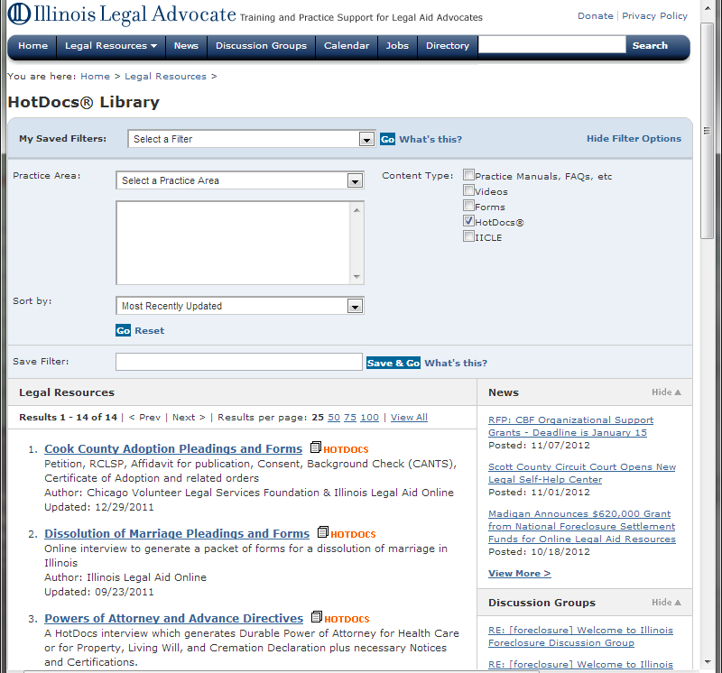
Typical HotDocs Process
1
4
2
3
5

Slide 10
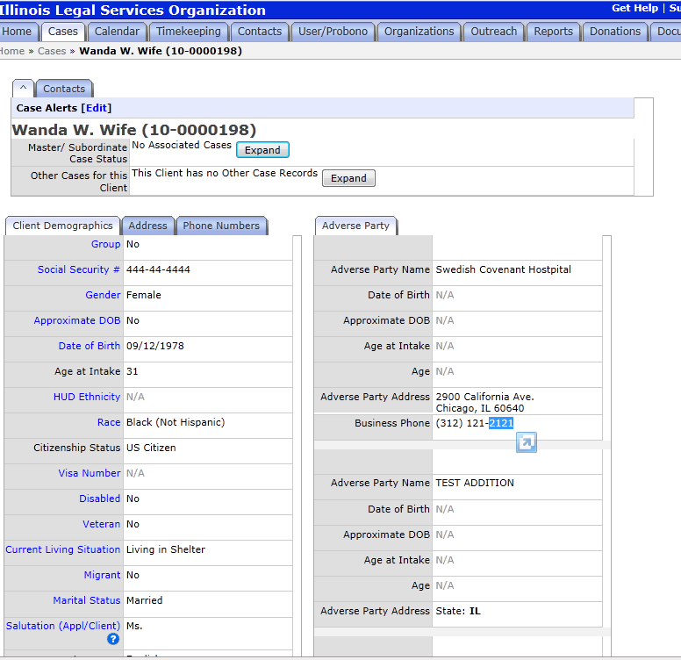
New LegalServer/HotDocs Process
1
2
LegalServer data transfers to HotDoc
3

Slide 11
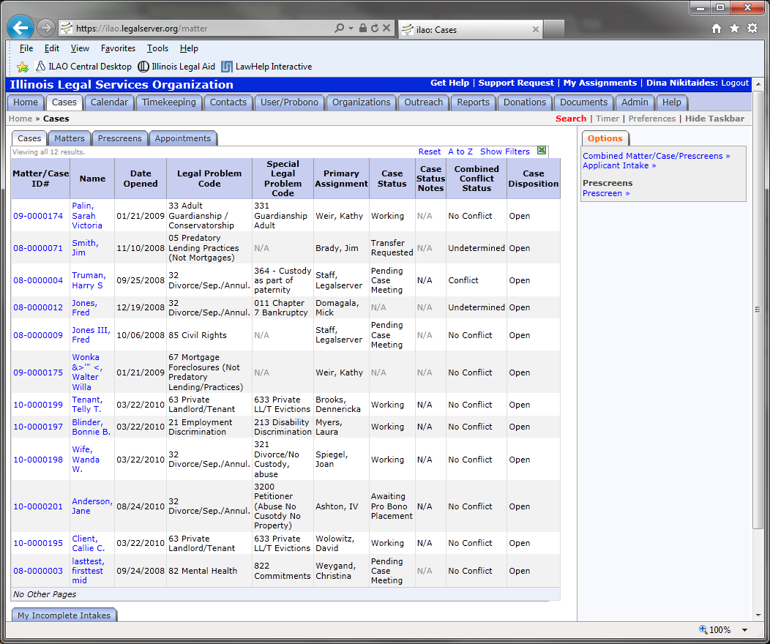
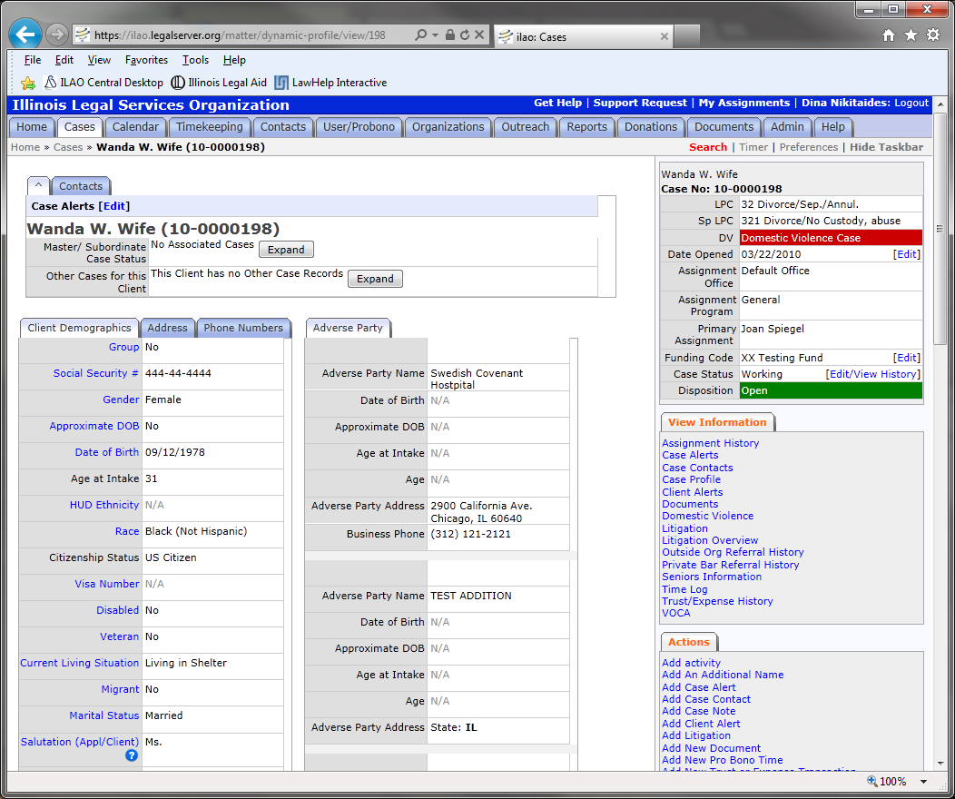
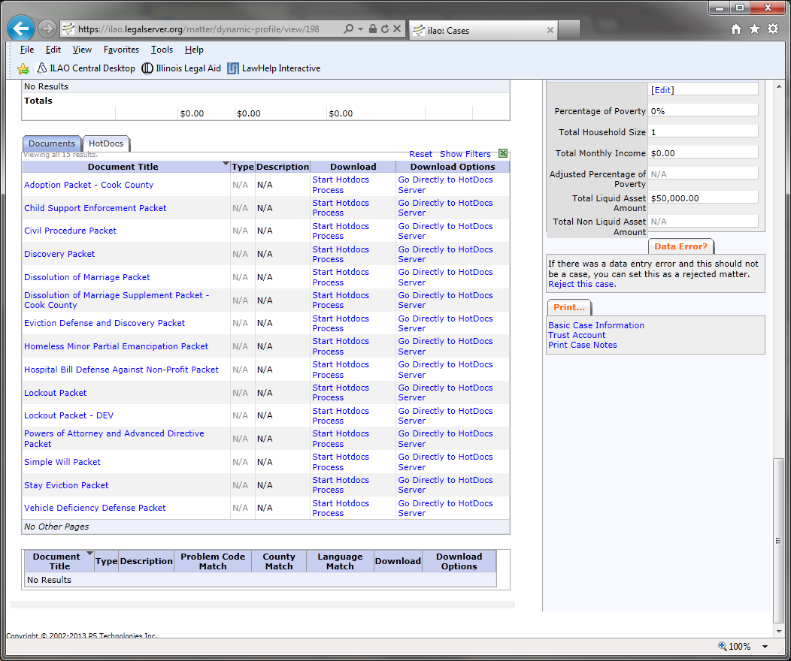
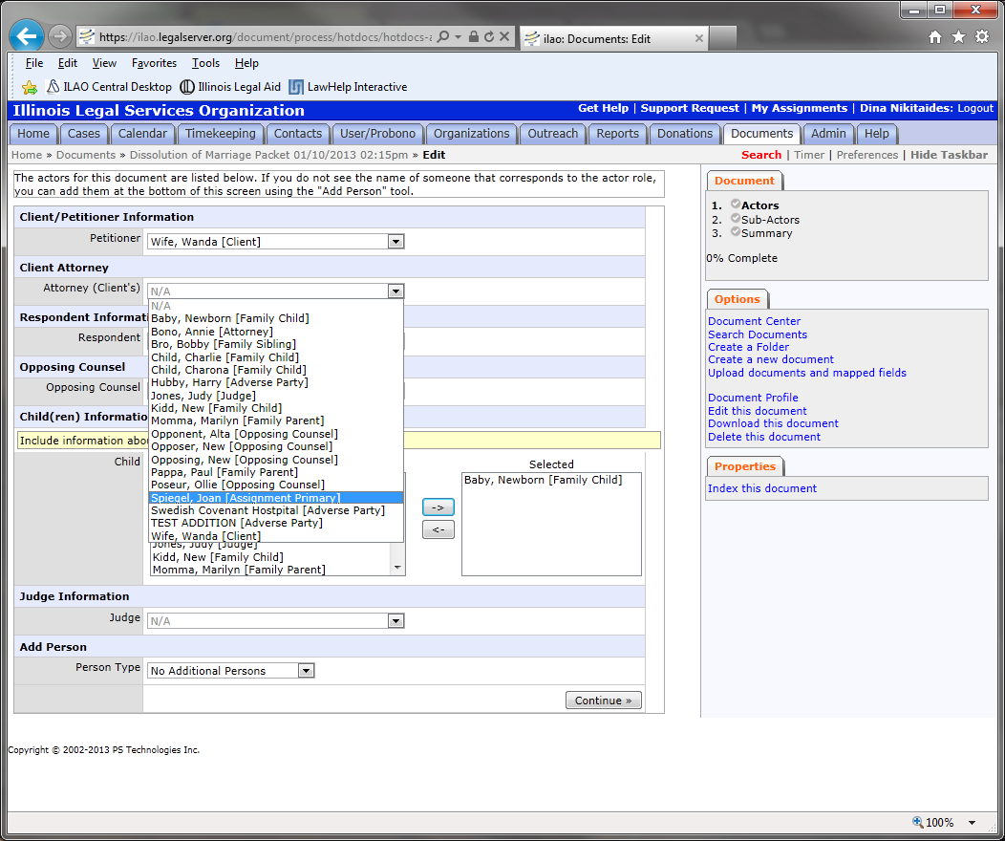
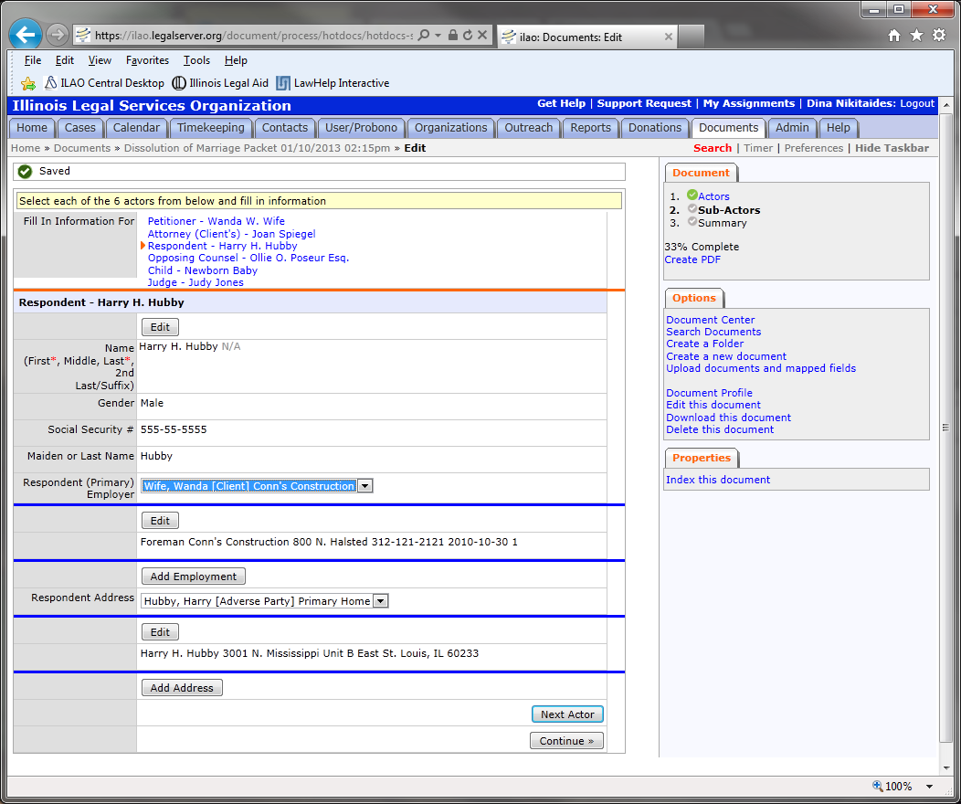
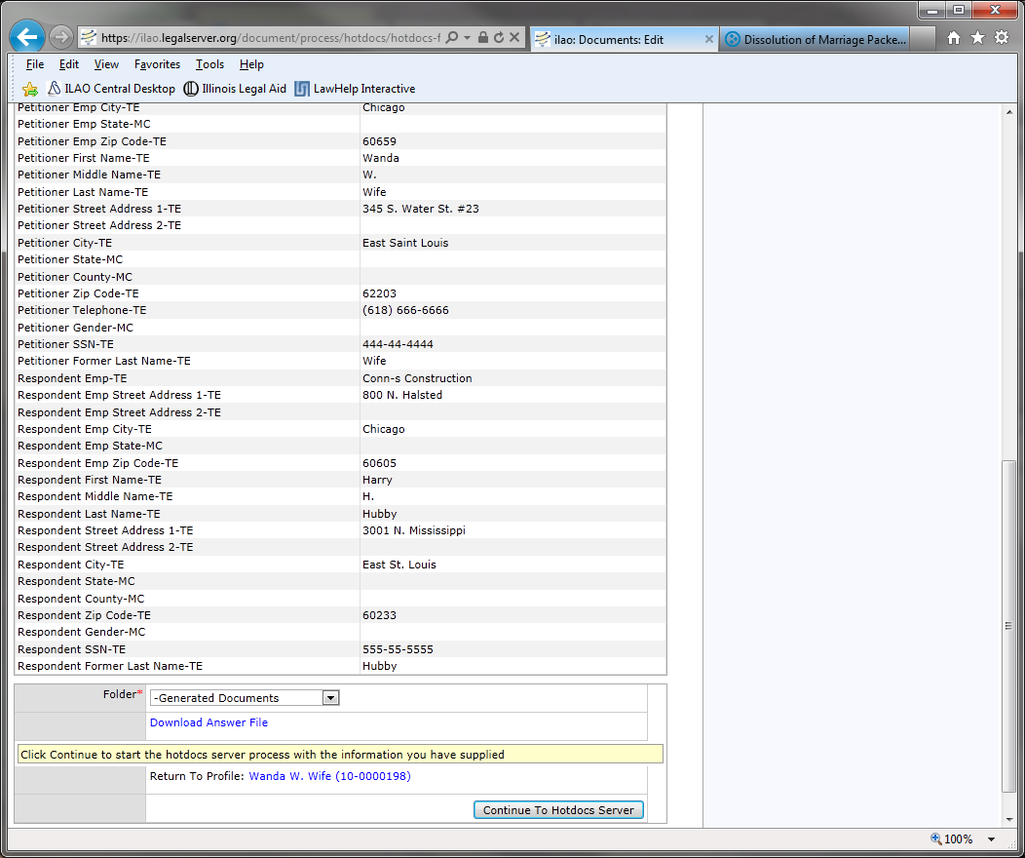
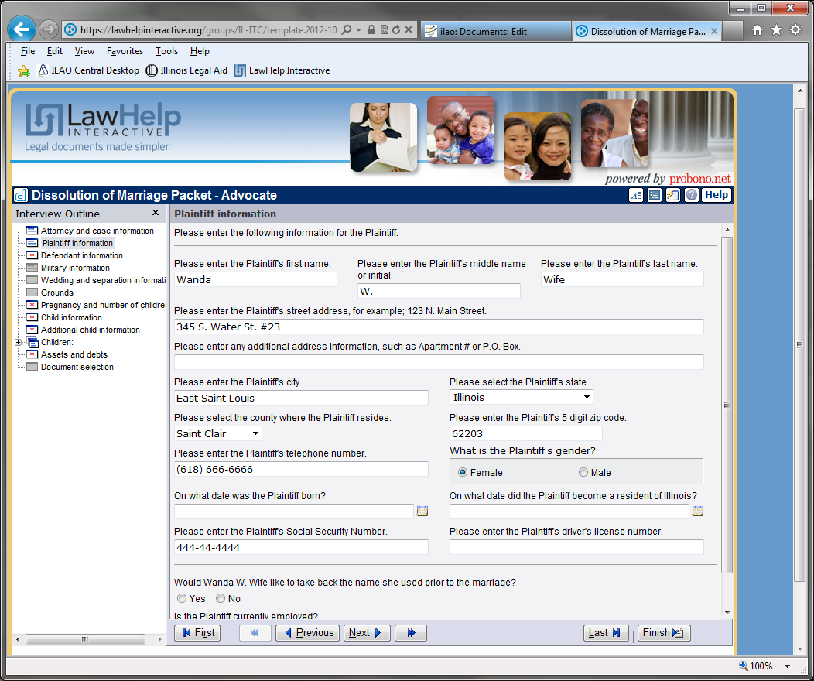
LegalServer/HotDocs Details

Slide 12
Agenda
ILAO LegalServer & HotDocs Integration Project
NPLS CMS & Desktop HotDocs Integration Project
Outcome of ILAO Project
Outcome of NPLS Project

Slide 13
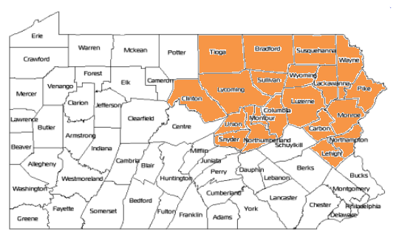
Regional, not statewide, service area
Today, NPLS operates with a staff of 68
in 10 office locations throughout 20 counties.

Slide 14
HotDocs Licenses
In 2010, HotDocs Corporation donated more than $2 million worth of software to 159 legal services organizations
Both Developer and User licenses
Also donated Server license for LHI
Now, licenses available at 70% discount (Developer $240; User $90 – approx.)

Slide 15
Uh, what hotdogs? Oh, HotDocs? No, thanks, I’m not hungry…
Hot dogs?
Yeah, I like hot dogs.
Oh, HotDocs?
Do they come with mustard?
So let me get this straight. YOUR
little computer program is gonna tell ME how to prepare MY pleadings?
Not another computer program to learn!
Stop the horror!
Oh, good grief,
there she goes again about the HotDocs . . .

Slide 16
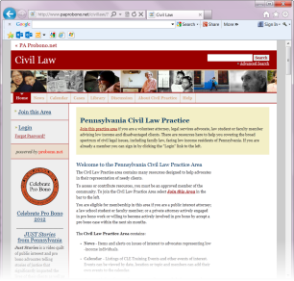
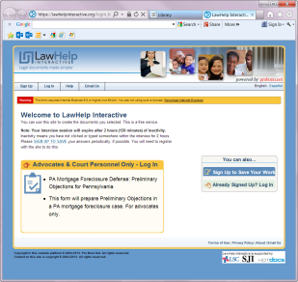
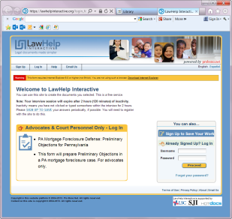
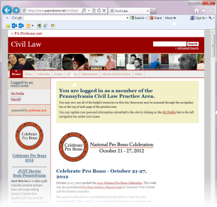
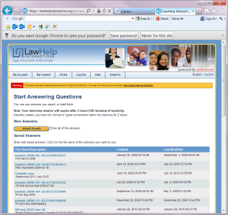
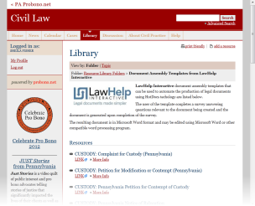
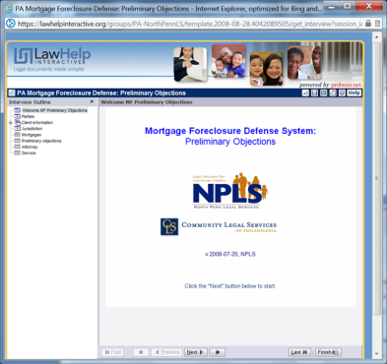
Instead of multiple steps and log-ins . . .

Slide 17
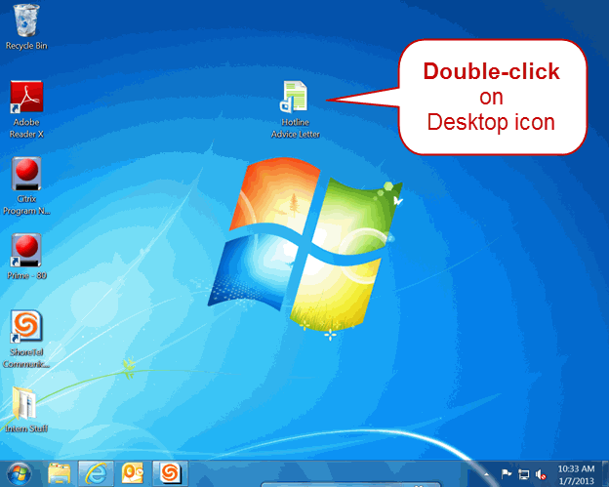
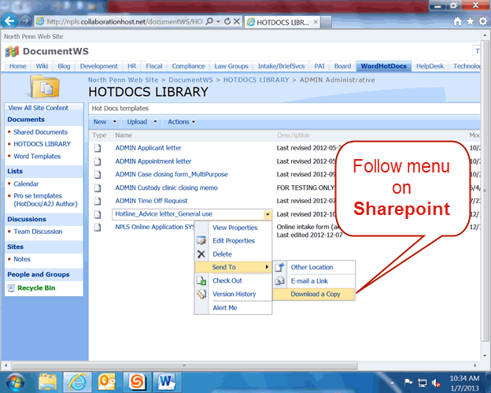
. . . A faster, easier way to access template
OR

Slide 18
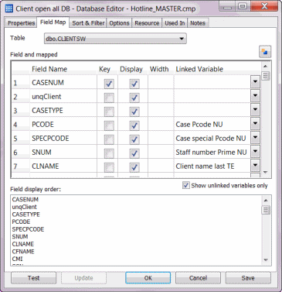
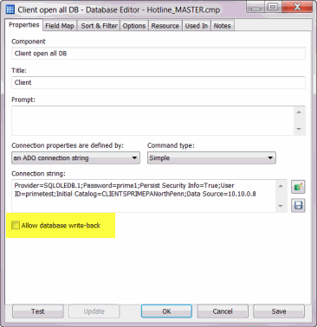
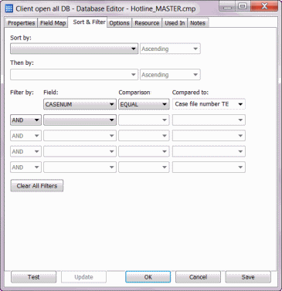
Then, add a Database Connection
Pull data from your CMS - and write back, if desired

Slide 19
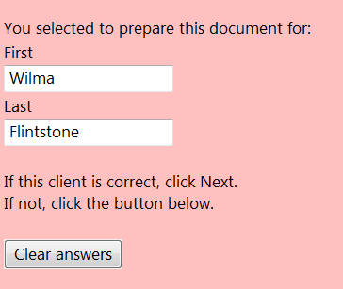
To pull the data from your CMS . . . You only need the case file number !

Slide 20
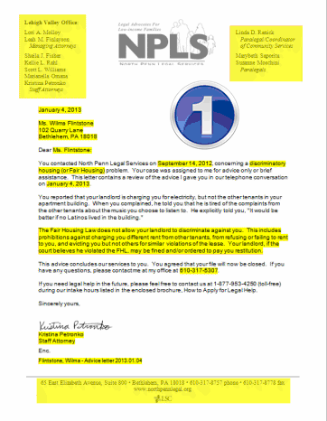
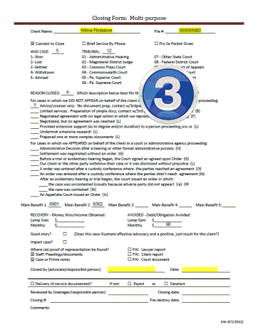
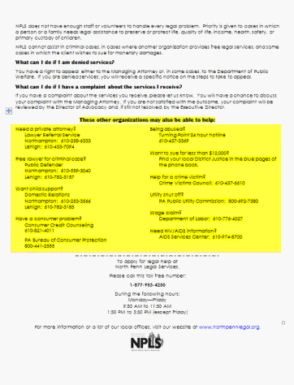
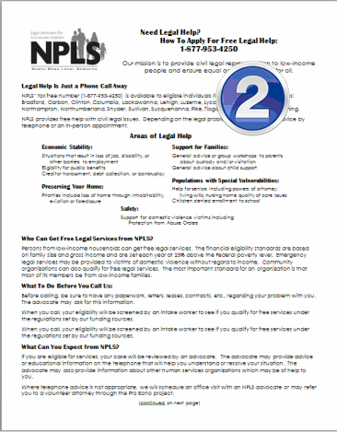
Types of documents
Most data from CMS and
/or standardized blurbs

Slide 21
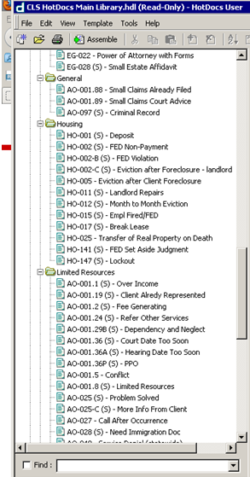
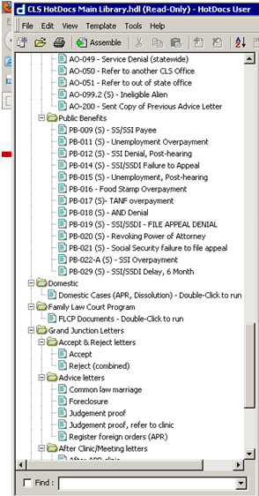
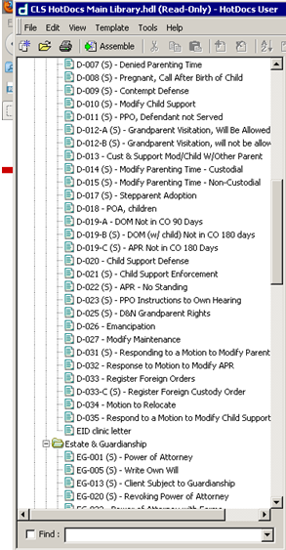
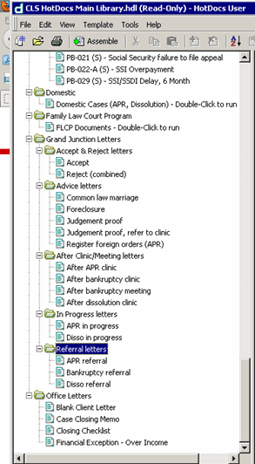
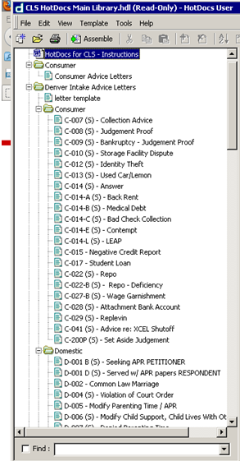
Colorado Legal Services HotDocs Library
IMPRESSIVE !!

Slide 22
Agenda
ILAO LegalServer & HotDocs Integration Project
NPLS CMS & Desktop HotDocs Integration Project
Outcome of ILAO Project
Outcome of NPLS Project

Slide 23
Project Challenges & Successes
CHALLENGES
Distrust of the system (documents & security)
Attorneys like to write & think reusing their own documents is faster
Browser restrictions: LHI HotDocs require IE
Many tech partners = tech speed bumps = deters advocates
SUCCESSES
Proven to be faster
New advocates find value & comfort in documents
Creates opportunity for more “lawyering” (meeting with clients, going to court, etc.)

Slide 24
ILAO Lessons & Future Steps
Get advocates involved in development & maintenance of documents
Get approval and buy-in of documents by supervising staff
Plan for system maintenance & improvements beyond initial project
Develop ability to pull new information from HotDoc back to CMS

Slide 25
Agenda
ILAO LegalServer & HotDocs Integration Project
NPLS CMS & Desktop HotDocs Integration Project
Outcome of ILAO Project
Outcome of NPLS Project

Slide 26
The “Tipping Point”
Staff love fast, easy access to templates
Staff love auto-name/auto-save macros
Staff love not having to use Internet Explorer
Staff love that data from CMS is imported into their documents
Staff love that forms can automatically be customized to meet compliance requirements based on CMS data (like funding source)
Staff are begging for CMS write-back !!

Slide 27
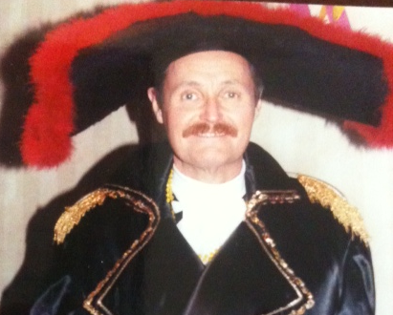
So those unhappy employees?
No more!
Off with their heads!

Slide 28
How to purchase discounted HotDocs licenses
HotDocs Charitable Donation Program
HotDocs Corporation
387 South 520 West, Suite 210
Lindon, UT 84042
801-615-2200
Kate.Anderson@HotDocs.com
Submit request with:
1 page summary of organization;
IRS determination letter;
LSC and/or IOLTA funding;
# of licenses (developer and user)

Slide 29
Mix It Up: Case Management Data & Document Assembly
Dina Nikitaides
Interactive Content Manager
Illinois Legal Aid Online
Phone: 312-906-9047 x18
Email: dnikitaides@illinoislegalaid.org
Sheila J. Fisher
Staff Attorney/Template Developer
North Penn Legal Services
Phone: 610-317-5307
Email: sfisher@northpennlegal.org

Slide 30
Thank You for Joining Us!
Photo Source: John Mayer
Artwork: Dina Nikitaides
Blame for Photo Appearing in this Presentation: David Bonebrake

