Slide 1
Who are the TIGgers?
Geeks Helping LegAid Save the World With Better Systems

Slide 2

TIGgers
are:
Innovators.
Engines for change.
Adorable.
photo by Chris Watson from Louisville, United States
So who is who around here?

Slide 3
TIG itself is a star
TIG project awardees and staff have dared to be innovative.
TIG projects don't tend to fund stuff that should simply be in a program's budget.
Great TIG projects dare to fail. Like great leaders.

Slide 4
Your co-attendees
Here as:
Net Admins, EDs, certified geeks, attorneys, LSC Staff, language access experts, vendor reps, national project leaders, courts, bar associations, and administrators.
From:
from Guam, the Virgin Islands, P.R., and all 50 states.

Slide 5
History
The first TIGs were in 2001.
Some of us go back that far!
We have collaborated in and out of TIGs ---->
TIG projects
National projects
LSTech
Ad hoc consulting (informal)

Slide 6

The Mainers
- Plenty of innovative techies saw the lunar landing.
- Wicked independent.
- PTLA had a statewide website before they were cool
- likely to tried a home-brewed solution
- created a state-wide provider network infrastructure, shared tech with other programs in Maine (Giant Citrix framework)
PTLA stops for blueberries!

Slide 7
LawHelpInteractive.org
Managed by Pro Bono Net, LHI serves up:
HotDocs forms for consumers, clients, internal workers and pro bono volunteers
A2J Author interviews, which sometimes populate HotDocs forms
Available at no per-program cost to all LSC-funded orgs
Notes:
add mini lhi screenshot or link

Slide 8
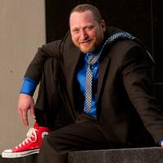


Vince Morris - Arkansas
Arkansas Legal Services Partnership
Arkansas Pro Bono Partnership
Lots of TIG experience
Doc assembly/ A2J expert
Helped with national vet website
Helped with sharelaw.org
Talk him about managing tech projects within the legal aid community...
Or if you have access to a time machine to take him to 1972
vmorris@arkansaslegalservices.org
P.S. Check out his band, Stumbling Home. Really.!

Slide 9

Scope Creep
Sneaky monster that delays and ruins TIG projects by turning our innovative nature into a desire to overreach and over-accommodate competing interests.

Slide 10
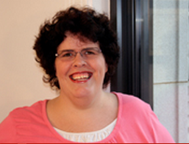
Gwen Daniels - ILAO
Illinois Legal Aid Online
Serious programmer!
Web based triage/intake system
e-Learning modules for foreclosure
iTunes and Google Play apps
Statewide, multi-program data analysis
gdaniels@illinoislegalaid.org
Ask her about mobile app development and online triage/intake!

Slide 11
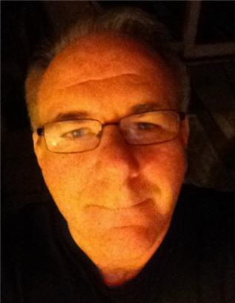
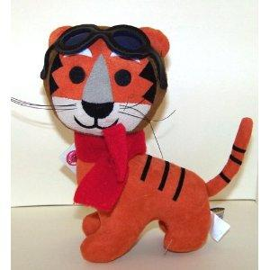
John Mayer - CALI
Center for Computer-Assisted Legal Instruction
Gold standard for legal educators
Visionary. Connector. Purveyor of flying stuffed
animals.
Initiated meeting of best tech thinkers in legal ed
eLangdell open casebook project
Seek out John for mind-bending brainstorming
jmayer@cali.org

Slide 12
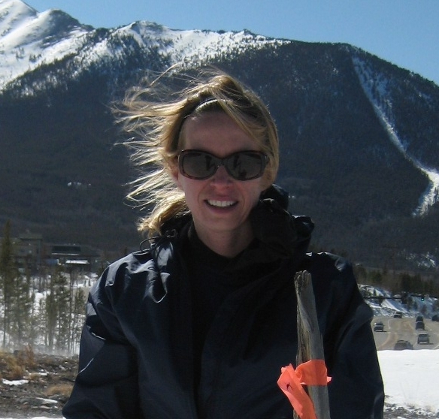

Molly French - Colorado
Projects\expertise:
VOIP phone system (Shoretel)
online eligibility tool
statewide website content
SJI grantee
Advocate for Legal Service Community Collaboration
Jill of All Trades
She even rode a bike from the top of Washington State to California-Green UP!

Slide 13
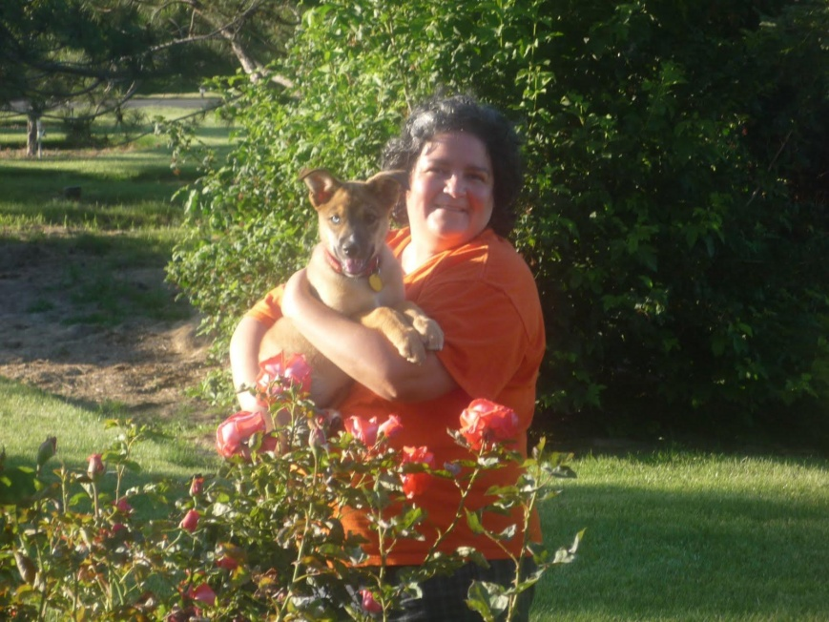
Claudia Johnson - PBN
Claudia knows what's going on all over the place…
especially language access and document assembly projects.
Claudia has lived in 4 countries and 15 cities. She grew up speaking Spanish and German. English her 3rd language!

Slide 14
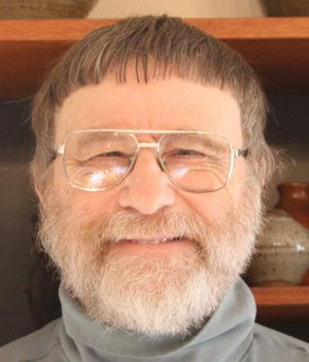
Richard Zorza
Zorza and Associates
Coordinator of the national Self Represented Litigation Network
Wrote The Self Help Friendly Court Designed from the Ground Up to Work for People Without Lawyers, published by the National Center for the State Courts in 2002
Big Ideas!

Slide 15
Common Partners and Vendors
PBN
Open Advocate (DLaw)
Capstone (Lauritsen & co)
State Justice Institute
LSNTAP
TechSoup
Transcend Translations
CMS providers (PIKA, Kemp's, Legal Server, Legal Files)

Slide 16
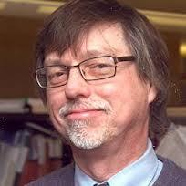
William Jones - ABA
Maintains the Center's databases and performs webmaster duties for the Center's web pages.
Supports the National Pro Bono Opportunities Guide, Celebrate Pro Bono and National Disaster Legal Aid websites.
2 Things you should know about Bill:
a.) Living proof of the saying "It’s hard to make something foolproof when fools are so ingenious"
b.) No jaywalking or Bill will hunt you down-Especially if you're Hugh Hefner
Technology, Information and Content Coordinator at American Bar Association's Center for Pro Bono
Notes:
Yes Bill nearly ran down Hugh Hefner as he jaywalked/dashed across Michigan Avenue in Chicago.Bill once accidentally brought down the email system for four of the five campuses of Loyola University Chicago (He somehow managed to miss the one in Rome).

Slide 17


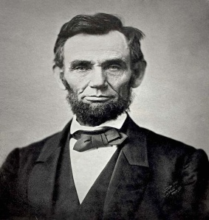
Who's Who in LSC
OIG – Office of the Inspector General
OCE – Office of Compliance and Enforcement
OPP – Office of Program Performance
Jane
David
Bristow

Slide 18
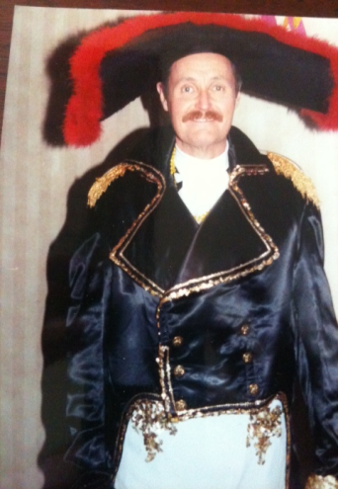

Glenn Rawdon
Early force in the creation of the TIG grant program.
Glenn in 1970:
Has X thing been done before? When in doubt, ask Glenn.

Slide 19

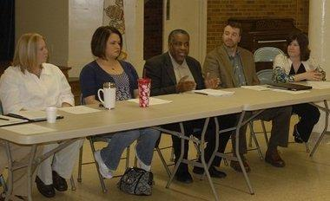
Steve Gray
-remember the open source computer lab?
-early leader in LSNTAP
-somewhere in Michigan now...

Slide 20
YOU!
This is really a community.
Meet someone new.
Be a partner on someone else's project.
Saving the world should be fun!
Jeff Hogue - jhogue@LawNY.org

