Slide 1
Legal Technology- Total cultural immersion
The trials and tribulation of Jack on his journey through the land of legal technology…
Xander Karsten- Pro Bono Net

Slide 2
This is Jack
I like helping other attorneys turn on their computers and use Word; I could work in technology for civil legal services…
A few months ago he thought…
And so… his life in the legal technology field began…

Slide 3
It is a new world- with different (and sometimes strange) customs, languages and traditions… Soon Jack finds himself in a total cultural emersion.

Slide 4
The language is a veritable alphabet soup…

Slide 5
Jack can master it

Slide 6
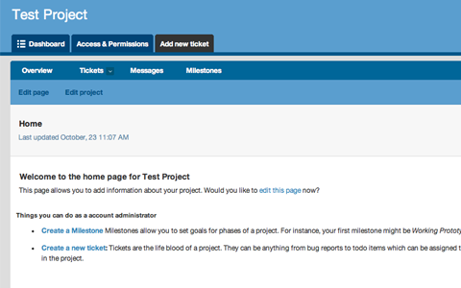
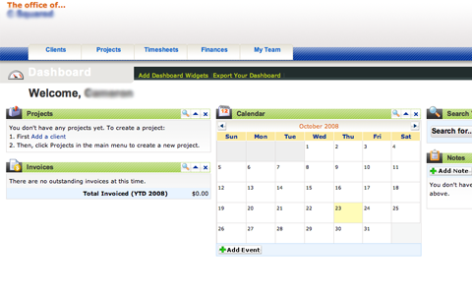
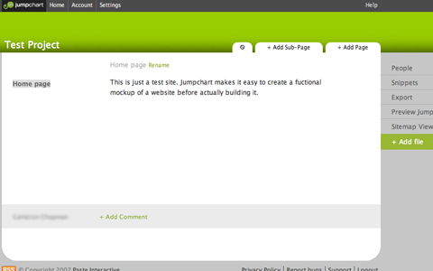
Everyone’s tools are completely different (and better than everyone else's!)
?
?
?

Slide 7
Jack manages all his sign ons!
Seriously, don’t keep your
passwords on a sticky note…

Slide 8
People believe in transparency, openness, and access…

Slide 9
Jack adopts these beliefs as his own

Slide 10
These values, tools and languages are learnt through a variety of means
Formal Instruction?
Putting pen to paper?
Oh no, not…
CLIPPY?!
Book
Learning?

Slide 11
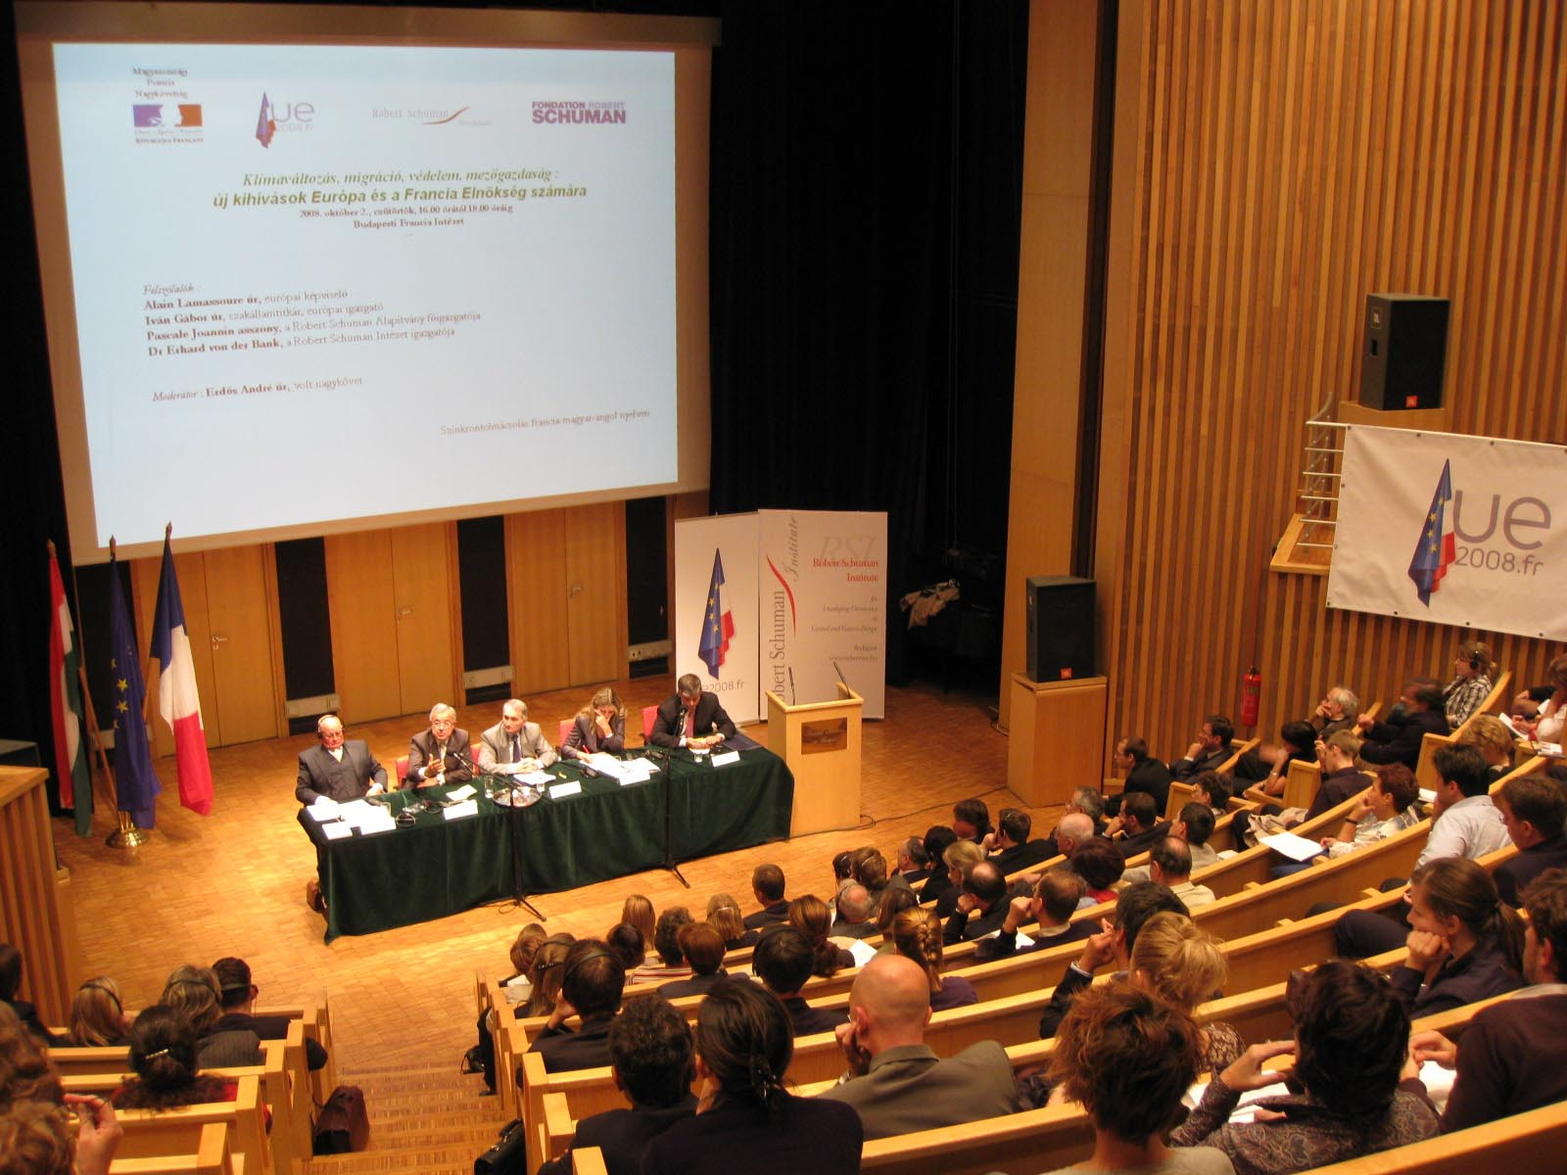
There is group indoctrination

Slide 12
Online learning

Slide 13
…and informal social opportunities
(He’s a little shy)

Slide 14
There are subcultures Jack meets along the way… Like MacHeads

Slide 15
Opensource Gurus

Slide 16
And Google Fans

Slide 17
The language, tools, technology and attitudes are constantly changing…

Slide 18
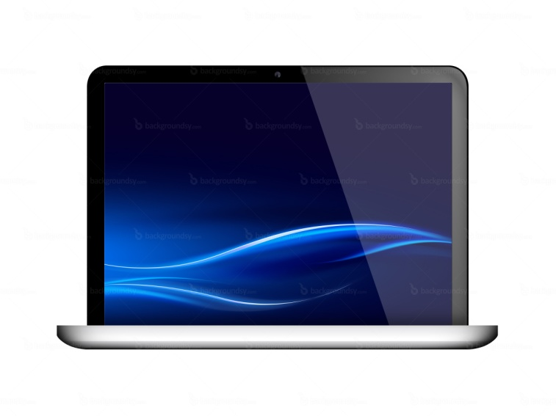
It is ubiquitous- there is no escape…

Slide 19
Jack learns how important it is to just…
…unplug.

Slide 20
In the end, Jack learns
!
Resistance is futile.

