Slide 1
2016 TIG Applications Informational Webinar
April 26, 2016
Glenn Rawdon, David Bonebrake, Jane Ribadeneyra
Legal Services Corporation
Notes:
GLENN: Welcome to the TIG Cycle Informational Webinar.
Today we’ll cover several items that TIG applicants should know about the upcoming grant cycle, including Letters of Intent, grant categories, areas of interest, the online submission system, the full application, and TIG rules and regulations.

Slide 2
2016 TIG Cycle
$4 million appropriation
Letters of Intent (LOI)
Notice Issued: January 7
LOIs Due: February 29
Invitations for Full Applications: By April 11
Full Applications Due: May 31
TIG Award Notifications: By September 15, 2016
Notes:
GLENN: For 2016, LSC has received an appropriation of $4 million to fund TIG projects.
To give you an idea of our grant cycle schedule, the process begins with submission of Letters of Intent. Our online system that allows those submissions opens within the next week. Applicants then have until February 29th to submit an LOI.
Following that, LSC will invite successful applicants from the LOI stage to submit full applications; those invitations go out by the end of April.
(REVIEW) Full Applications are due May 20th; and TIG Awards Notifications typically occur in the early fall.

Slide 3
Elements of a Successful Application
Partnerships
Achievable and practical plan
An innovative approach with replication potential
Resources and expertise
More access, not barriers
Ensure materials are accessible and understandable
Notes:
This is from appendix II.

Slide 4
Major Reasons Proposed Projects Have Not Been Funded
Limited resources
Failure to specify how project helps improve services to clients
Lack of state coordination
Unwarranted requests for staff support
Duplication of other initiatives
Inadequate planning and preparation or unrealistic goals
Absence of innovation

Slide 5
To Start Log into LSC Grants Home
Notes:
GLENN: If your program has more than one account in LSC Grants, be sure to log in with the same account that you used to create the LOI. At the top of the page, click on TIG.

Slide 6
Select the TIG Application to submit
Notes:
GLENN: You should have a task for a TIG application for each TIG number for which you were invited to apply.

Slide 7
Application elements are located to the left
Notes:
GLENN: Throughout the application process you will have a navigation bar on the left that will take you to any section of the application.

Slide 8
Validation Summary on Main page
Notes:
GLENN: On the Main page you will see all of the sections listed and be able to track your progress by seeing which sections are complete. You should be aware that, since they are not required, the Project Narrative Appendicles, Letter of Commitment from Key Partners, and Letters of Support all show as complete when you start the process even though you have not uploaded anything yet.

Slide 9
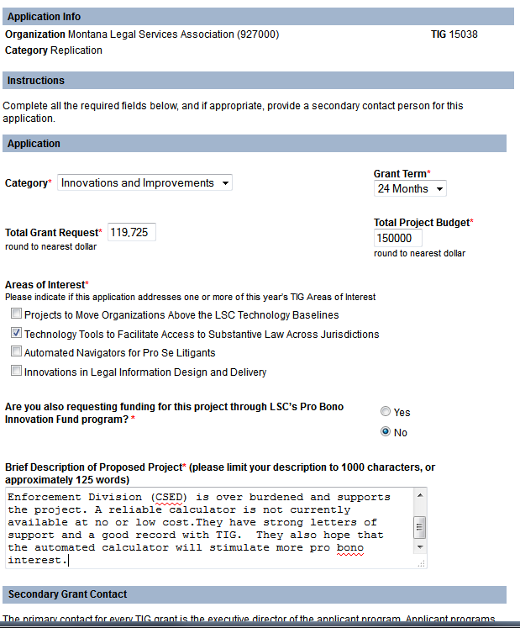
Start with the Application
Notes:
GLENN: The application will be prepopulated with the Category and the Total Grant Request from the LOI. If either of those need to change you can do that.
For the grant term, be sure to give yourself enough time to complete the project even if everything doesn’t go as planned. Anytime you complete the milestones for a payment period you can submit a payment request for that period. There is no “penalty” for finishing ahead of schedule.
Indicate if the project addresses one or more of this year’s TIG Areas of Interest. Also, let us know if you also applied for funding for this project from LSC’s Pro Bono Innovation Fund.
Under the Brief Description, provide a concise, plain language, one-paragraph description of the project that can potentially be published on the LSC website following the grant awards.
Finally, provide information for any additional person LSC should contact about the application, other than the person associated with the program’s LSC Grants login.

Slide 10
AREAS OF INTEREST 2016
Promoting 100% Access
Projects to Move Organizations Above the LSC Technology Baselines
Innovations in Legal Information Design and Delivery
Notes:
2016 Areas of Interest for LSC’s Technology Initiative Grants
Achieving “100 Percent Access.” LSC’s 2013 Technology Summit Report proposed an integrated service-delivery system that would “move the United States toward providing some form of effective assistance to 100 percent of persons otherwise unable to afford an attorney for dealing with essential civil legal needs.” Recently, the Conference of Chief Justices and the Conference of State Court Administrators adopted a resolution advocating a similar access goal:
NOW, THEREFORE, BE IT RESOLVED that the Conference of Chief Justices and the Conference of State Court Administrators support the aspirational goal of 100 percent access to effective assistance for essential civil legal needs and urge their members to provide leadership in achieving that goal and to work with their Access to Justice Commission or other such entities to develop a strategic plan with realistic and measurable outcomes;
and BE IT FURTHER RESOLVED that the Conferences urge the National Center for State Courts and other national organizations to develop tools and provide assistance to states in achieving the goal of 100 percent access through a continuum of meaningful and appropriate services.
With this area of interest, LSC seeks proposals that use technology to further the goal of 100 percent access to effective assistance for essential civil legal needs, particularly through projects that advance related objectives developed by the Access to Justice Commission in the applicant’s state.
LSC’s Technology Summit Report provides examples of strategies for achieving 100 percent access, but proposals should not be limited to approaches discussed in the report. Applicants should work with their local commissions (where they exist) and/or other stakeholders to determine the best ways to use technology to move toward achieving this goal.
Projects to Move Organizations Above the LSC Technology Baselines. The LSC Baselines: Technologies That Should Be in Place in a Legal Aid Office Today provide a detailed overview of the technologies that enable modern legal aid offices to operate efficiently and effectively. While LSC’s policy is that TIGs cannot be used to bring grantees up to the baselines in an area, we encourage applicants as they implement a baseline capacity to think about how they can do more than just the minimum. This area of interest focuses on initiatives that advance organizations beyond the 2015 Baselines by developing innovative, creative technology solutions that not only address one or more Baseline capacities, but also exceed them. Grantees applying under this area of interest should address how their project could establish a new technology best practice that could be incorporated into future versions of the Baselines.
Innovations in Legal Information Design and Delivery. Legal tools and content should be developed with the end user in mind, but too often the result reflects what the developer determines the end user will need, rather than what the user understands and finds helpful. Technology provides an opportunity to design and deliver legal information optimized for the end user, and there are good examples of how user-centric design can improve legal innovation (see www.legaltechdesign.com and www.nulawlab.org). Projects in this area of interest could incorporate new approaches to visual law, online learning, and user interaction in the design and delivery of content. In one example from the 2015 TIG cycle, a grantee received funding to develop a courtroom experience app that delivers just-in-time support directly to litigants' smartphones as they navigate various stages of the court process, increasing effective self-representation. Projects could also focus on low/no-literacy and Limited English Proficiency (LEP) communities or others who are under-served by traditional methods.

Slide 11
Your Budget - Be Sure it all Adds Up!
Notes:
GLENN: Be sure that you budget numbers match the numbers from your application. These are listed at the top for your reference. You can hit Save and Calculate as you go to be see where you are in matching these numbers. You cannot do the budget narrative until you complete your budget.
Reviewers will be analyzing the budget request for clarity, cost-effectiveness, and consistency with the goals and objectives described later in the Project Narrative. The budget should be appropriate to the tasks proposed and sufficiently detailed so that reviewers can easily understand the relationship of the items in the budget to the project activities.
Indicate who is paying for each of the budget items. The Budget Form has five columns for (A) the amount requested from LSC, (B) the applicant’s contributions, (C) additional funds from other LSC-funded partners, (D) additional funds from non-LSC-funded partners, and (E) the total of (A), (B) (C) and (D). All calculations will be automatically tabulated. Note: Do not request LSC funding to travel to the TIG Conference in column (A). LSC will add funding to send one person to the TIG Conference for each TIG awarded. The applicant may include travel for additional participants to attend the TIG Conference under columns (B) through (D).
1630. This includes costs for: personnel; fringe benefits; purchase or rental of computer hardware, software, and other end-user equipment; telecommunication services and related equipment; consultants and other contractual services, including evaluators; travel; and supplies. Please note: Administrative costs must be captured through these line items only; no general ‘administrative cost’ line item will be approved. All costs must be reasonable and directly related to the project, and included in the approved project budget.
There is a detailed description of each Budget Line Item in the NOFA – please refer to this as you develop your budget information. For example, under Salary:
Salaries and Wages: Include the salary or wages of all personnel who will staff or have responsibilities for the proposed project, indicating the share that will be attributable to LSC, the applicant, or another partner, either LSC-Funded or Non LSC-Funded. Each staff person included in the budget must be described in both the application Project Narrative and in the Budget Narrative. Individuals or personnel from other organizations with whom the applicant is planning to contract or subgrant TIG Funds will have their information listed separately in the appropriate Contracts and Subgrants budget line and in the Third-Party Contracting Form.

Slide 12
Tracking Your Progress
Notes:
GLENN: If you have to leave and come back to the application, you can see your progress on the Main page, then click by the first Incomplete section to resume.

Slide 13
Details in the Budget Narrative
Notes:
GLENN: For each item on your Budget there will be a corresponding blank on the Budget Narrative. Use the Budget Narrative to expand on the budget items listed in the Budget Form. This is the place to detail proposed expenditures in relation to the project timetable. If the term of the project is three years, give the proposed expenditures for each of those years.
Fully explain each budget item, including descriptions and specific costs, so that it can be effectively evaluated. If the budget includes a request for personnel costs, identify the proposed personnel and the estimated time they will spend on the project. For Columns (A) and (B) be sure to list each individual separately with his/her title, the percentage of time or number of hours that will apply to the grant and the annual salary or hourly rate applicable. Example: Joe Smith, the IT Director, will spend 30% of his time on the project. 30% x $60,000 = $20,000.
The budget must be reasonable for the tasks proposed, and the relationship of items in the budget to the Project Narrative, especially the project objectives and activities, should be clearly defined and communicated.

Slide 14
Remember to Save Your Work!
Notes:
GLENN: Next we will be coming to the Contracts form but we wanted to remind you to save your Budget Narrative BEFORE going to the Contracts form. You will lose anything that you have entered without saving.

Slide 15
If you will have contracts -
Notes:
DAVID: If you have Contracts there is a separate form on which to provide details. Each proposed contract will be added separately. Go to the Contract form and click Add Contract.

Slide 16
Proposing a Specific Contractor
Notes:
DAVID: Programs will either identify a specific third-party entity that they intend to contract with or, if that entity is not yet known, indicate that the contractor will be decided later. Regardless of whether a specific contractor is identified, applicants should provide as much information as possible about the planned contracts, such as the expected contract amount, the contractor's staff that will work on the project, and the contractor's anticipated responsibilities. Third-party contracting requirements are available on the TIG Compliance Resources page at http://tig.lsc.gov/grants/compliance; these requirements should be reviewed before submitting an application. If the project is funded, grantees can work with TIG staff to modify contracting information if necessary.
Although applicants can propose a particular third-party contractor, approval of a TIG application does not imply LSC approval of any specific contractor for the project; all procurement transactions must be conducted in a manner to provide, to the maximum extent practical, open and free competition; and all third-party expenditures, regardless of cost, must be appropriately documented.

Slide 17
Oversight and Subgrants
Notes:
DAVID: In addition to the contractor, you will need to explain how you will oversee the work of the contractor and provide details on the nature of the work to be done. If the programmer will be doing programmatic work, you should indicate that a subgrant will be required.

Slide 18
Again, be sure it adds up!
Notes:
DAVID:

Slide 19
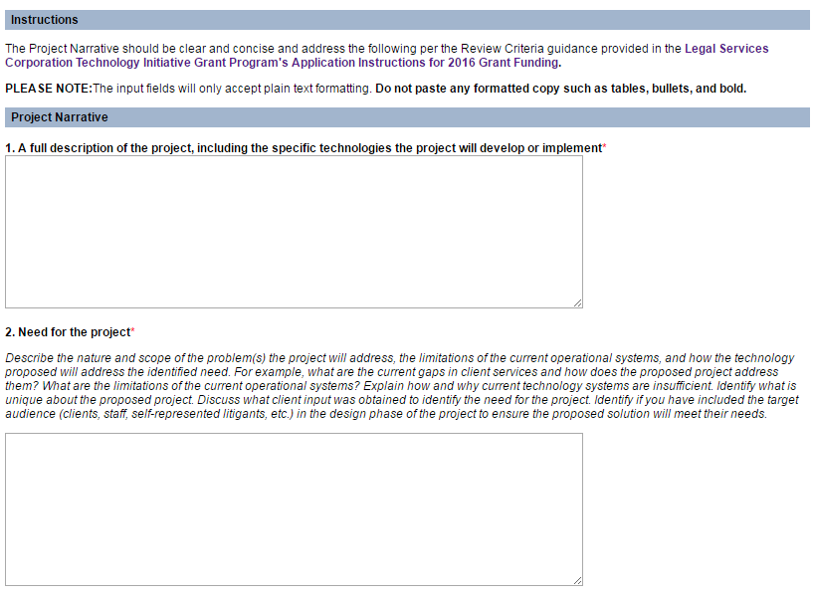
The Meat of the Application – the Project Narrative
Notes:
DAVID: The Project Narrative is the applicant’s opportunity to demonstrate to reviewers that the project fits LSC objectives. Provide specific information about the project’s goals and objectives, the major activities that will be conducted to achieve the goals and objectives, the project’s partners, and the people affected by the project’s outcomes (e.g., clients, program staff, and partners).
The Project Narrative should be clear and concise and address the following per the Review Criteria outlined in the Notice:
A full description of the project, including the specific technology(ies) the project will develop or implement;
The need for the project;
The project’s goal, objectives, activities, and evaluation data;
Justice community partnerships;
Replication;
Past Performance; and
Sustainability of the project.
Carefully review the descriptions of each of these criterions in the Notice before preparing the Project Narrative.

Slide 20
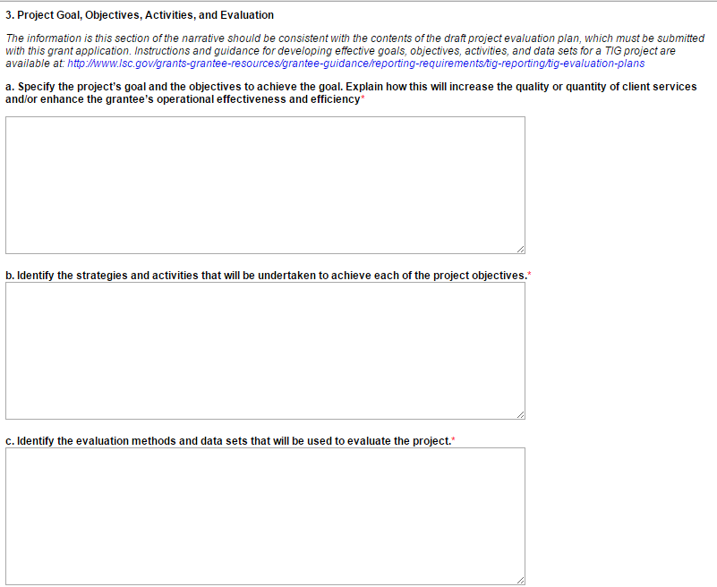
Project Goal, Objectives, Activities, and Eval.
Notes:
DAVID: Even though you are submitting a Draft Evaluation Plan you must complete this section. You cannot just refer us to the Draft Evaluation Plan. The information in this section of the narrative should be consistent with the contents of the draft project evaluation plan, which must be submitted with this grant application. Instructions and guidance for developing effective goals, objectives, activities, and data sets for a TIG project are available at: http://bit.ly/TIGEvaluation.
In this section, applicants should clearly: Articulate the goals and objectives of the project; Identify the specific activities and strategies that will be implemented to achieve the goals and objectives; and Specify the methods and data sets that will be used to evaluate the project.
Applicants should ensure that their responses clearly explain what tasks they will complete during the course of the project to meet the grant’s goals and objectives. (This can include details on product development, procurement of equipment or consulting services, staff training, outreach strategies, and other activities).

Slide 21
5. Replication
Applicants should highlight their project’s potential for replication and/or improvement of the legal services delivery system, focusing on the following factors:
The degree to which the problem identified by the applicant is commonly found in the legal services community, thereby demonstrating that it would be of value to other LSC-funded programs;
How the proposed project will promote replication by others in the legal services community, such as a plan to share information about the project at a conference or webinar, by providing a toolkit, and/or creating an online repository through Github or a similar service.
The ease of replication and adaptation, based on considerations such as cost and complexity, including the applicant’s plans to build the innovation in such a way that it can be directly used in other jurisdictions or can be modified at low cost for use in other jurisdictions; and
Whether a proposed project is replicating a prior TIG project at a reduced cost because of the benefits of replications and/or whether the project will make improvements to the prior TIG project or is adding to it a new component, thereby increasing the likelihood of additional replications.
Proposals in the Innovation and Improvement category should likely focus more on factors a), b) and c), while Replication and Adaptation proposals should likely emphasize factors a) and d).
Notes:
DAVID: This is the 17th year of the TIG program, which has made over 600 grants. Many of the projects TIG has funded still exist and represent critical components of the service delivery system. In order to leverage limited TIG funds, it is important that there be other funds to sustain the project after TIG funding gets it started so that TIG funds will be available for new projects.
LSC expects that each awarded project will either serve as a model for other legal services providers to follow or efficiently replicate a successful TIG Project. Accordingly, applicants should highlight their project’s potential for replication and/or improvement of the legal services delivery system, focusing on the following factors:
The degree to which the problem identified by the applicant is commonly found in the legal services community, thereby demonstrating that it would be of value to other LSC-funded programs;
How the proposed project will promote replication by others in the legal services community, such as a plan to share information about the project at a conference or webinar, by providing a toolkit, and/or creating an online repository through Github or a similar service.
The ease of replication and adaptation, based on considerations such as cost and complexity, including the applicant’s plans to build the innovation in such a way that it can be directly used in other jurisdictions or can be modified at low cost for use in other jurisdictions; and
Whether a proposed project is replicating a prior TIG project at a reduced cost because of the benefits of replications and/or whether the project will make improvements to the prior TIG project or is adding to it a new component, thereby increasing the likelihood of additional replications.
Proposals in the Innovation and Improvement category should likely focus more on factors a), b) and c), while Replication and Adaptation proposals should likely emphasize factors a) and d).

Slide 22
Program Capacity and Project Staffing
Sustainability Strategy
Notes:
DAVID: Program Capacity and Project Staffing
Organizational experience and track record in managing and overseeing projects comparable to the one being proposed – this criteria is often overlooked – talk about the org’s administrative capacity and experience overseeing grant projects, whether TIG funded or not. Fiscal staff, management staff, etc.
A staffing plan that identifies specific staff members with sufficient capacity, qualifications, and experience to be effective and compliant with programmatic and fiscal requirements. This includes the involvement of senior management and board members, where appropriate. Identify the proposed staffing for the project as well as who has been involved in planning the project.
Sustainability Strategy
This is the 17th year of the TIG program, which has made over 600 grants. Many of the projects TIG has funded still exist and represent critical components of the service delivery system. In order to leverage limited TIG funds, it is important that there be other funds to sustain the project after TIG funding gets it started so that TIG funds will be available for new projects.
Applicants should address the potential long-term viability of the project in their narratives and include the following:
a) A description of the grantee's overall strategy to sustain the project after the completion of the grant, including a list of likely or potential future funders;
b) An evaluation of the ongoing costs of the project projected two (2) years out from the completion of the grant, including but not limited to, projected staffing, bandwidth, equipment, and overhead costs in dollar values; and
c) A plan for how the grantee will meet the project's cost after the completion of the grant.

Slide 23
Project Narrative Appendices
Notes:
DAVID: In addition to the Project Narrative, up to 32 total pages may be submitted to fully document the proposal.
Relevant documentation: Appendices may include documents such as timelines, technical diagrams, organizational charts, maps, letters of commitment from key partners, letters of support, draft administrative plans, draft evaluation plans and résumés of key staff. This may also include information on past projects and credentials of firms and outside consultants you’re proposing for this project.
The appendices is comprised of four sections: the general Project Narrative Appendices, Letter of Commitment from Key Partners, Letters of Support, and the Draft Evaluation. All four of these the feature works in the same way. First click Browse to locate the document on your local computer, then hit Upload. You can only select one document at a time so, if you have multiple documents to upload, you must do this for each document. Uploads are limited to file extension types of .doc, .docx, .xls, .xlsx, pdf, and .rtf only. Any portion of the application that exceeds the specified page limits will not be reviewed.
Letters of Commitment from Key Partners: Letters of commitment to the project from any key partner whose participation is necessary for the completion of the project will be required.
Letters of Support: We are recommending that you submit no more than three letters of support. Letters of support may come from members of the community who will benefit from the success of the project.

Slide 24
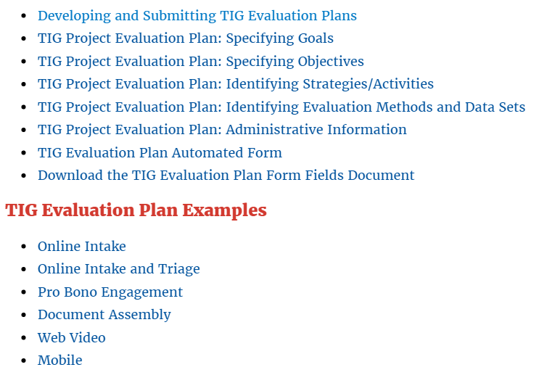
Draft Evaluation Plan http://bit.ly/TIGEvaluation
Notes:
DAVID: Evaluation planning is a critical component of TIG project management, and TIG applications must include a draft evaluation plan. The evaluation plan draft should clearly articulate the goals and objectives of the project; identify the activities and strategies that will be implemented to achieve the goals and objectives; and specify the methodologies and data sets that will be used to evaluate the project's progress and accomplishments. Applicants should develop their evaluation plan using the TIG evaluation plan automated form found on the TIG evaluation plan webpage at http://bit.ly/TIGEvaluation.
Instructional and guidance materials are accessible from within the document as well as on the evaluation plan webpage. The contents of the draft evaluation plan should be consistent with the Project Goals, Objectives, Activities, and Evaluation section of the Project Narrative.

Slide 25
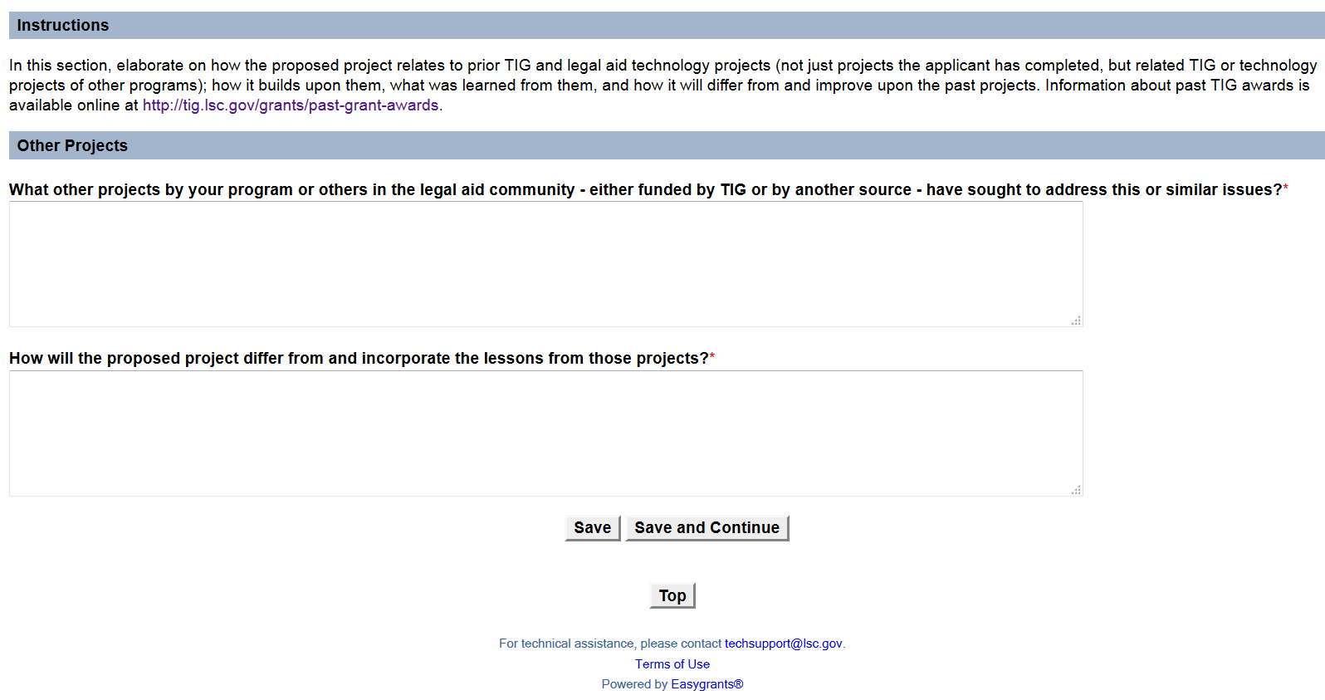
Lessons Learned from Other Technology Projects
http://bit.ly/TIGPastAwards
http://bit.ly/TIGFinalReports
Notes:
DAVID: In this section, elaborate on how the proposed project relates to prior TIG and legal aid technology projects (This is not just projects the applicant has completed, but related TIG or technology projects of other programs – or other non-profit sectors, if relevant); This will show reviewers that the applicant has researched similar projects and understands how their proposal will build upon them, what was learned from them, and how it will differ from and improve upon the past projects.
Information about past TIG awards is available online at http://bit.ly/TIGPastAwards and final reports from past projects at http://bit.ly/TIGFinalReports. There is also information about prior tech projects on LSNTAP.org and the Pro Bono Net document assembly support site.

Slide 26
Proposed Payment Schedule and Milestones
Sample Schedule for a 12 month project for $100,000:
Initial Payment – Oct 2016: $40,000
Payment Period 2 – June 2017: $20,000
Payment Period 3 – Dec 2017: $20,000
Payment Period 4 – June 2018: $10,000
Payment Period 5 – Sept 2018: $10,000
Notes:
JANE: As Part of the Application you need to submit a Proposed Payment Schedule and Milestones that you will complete and provide reports on to demonstrate the progress of the project.
Plan the project for two fixed payments (initial and final) and an interim payment for each six months of the grant term. If the grant is awarded, the initial payment will be made shortly after the grant acceptance letter is returned to LSC. LSC recognizes that many of the costs for a project are incurred early on, so the initial payment may be the largest, but it may be no more than 40% of the grant total.
After over 10 years of experience with TIG projects, we now allow extra time for the evaluation and final reporting stage of the project. So after all the substantive milestones of the project are completed, there will be a 6 month period to collect evaluation data and then draft a final report to submit to LSC. The final period is 3 months, to get the final report approved, and to submit the final budget. The total of these final two payments must be for at least 20% of the grant request, up to a maximum of $50,000. Apportion the balance of the monies requested among the interim payments.
The dates and number of payments on the grant will be generated depending upon the length of the proposed project.
For Example – for a one year grant request of $100,000, the five payments might be: payment one (initial payment) in October, 2016 for $40,000; payment two in July 2017 for $20,000; payment three in December 2017 for $20,000; (At this point the technical work on the project is completed); payment four (for evaluation and drafting the final report) in June 2018 for $10,000; and payment five (Final report approved and grant closed out) in September 2018 for $10,000 (the last two payments total 20% of the grant). An eighteen-month grant would have six payments, a two-year grant seven payments, etc.

Slide 27
Adding Milestones
Review the Sample Payment Schedules:
http://bit.ly/TIGApply
Notes:
JANE: For each payment period generated, indicate the major activities and milestones that will be completed towards meeting the goals and objectives of the project. The milestones should reflect the major activities and deliverables identified in the draft evaluation plan that will need to be completed to achieve the project’s goals and objectives. Milestones should also include relevant tasks for gathering evaluation data that will be needed for the final report. You will need to demonstrate completion of those milestones to receive the associated payments – so think about the appropriate tasks and activities and the order they will need to be completed.
Please be sure to input each deliverable as a separate milestone in the online system. This is done using the “Add Milestone” button. Plan on including approximately 3-6 milestones per payment period.
Review the Sample Payment Schedules:
http://bit.ly/TIGApply

Slide 28
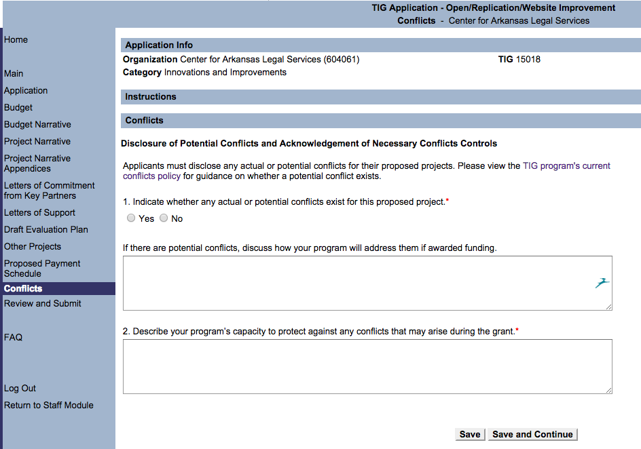
Avoiding Conflicts of Interest
Notes:
JANE: Applicants must indicate whether any actual or potential conflicts exist for the proposed project. If there are potential conflicts, discuss how your program will address them if awarded funding. Describe your program’s capacity to protect against any conflicts that may arise during the grant.

Slide 29
Main Page Validation Summary
Notes:
JANE: As we mentioned previously, there is Validation Summary on the Main page of the application system. It tracks your progress to the completion of the application but it is not very informative as to why a section is complete.
Remember, any items that are not required will show as complete – The Project Narrative Appendices, the Letters of Commitment and the Letters of Support. While it’s strongly suggested that relevant material be included in these items to make the application stronger, they are not required components of the application.

Slide 30
Review and Submit Validation Summary – Detailed Analysis
Notes:
JANE: At any time, you can click on the Review and Submit page to get a Validation Summary with detailed information on why a section is incomplete. If a section shows as Incomplete and you’re not sure why, check here.

Slide 31
When you are finished -
Notes:
JANE: When you believe you are finished go to the Review and Submit page. Before you click the Submit button, be sure to click the View PDF button. This will create a PDF of the entire application package you are submitting.

Slide 32
Generate PDF
Notes:
JANE: When you click on the View PDF you will see this screen while the document is being generated.

Slide 33
Review the PDF of the Application
Notes:
JANE: Review the entire PDF carefully to be sure it is complete, including any letters of support and appendices to the Project Narrative. You can also Save a copy locally for your records. You will be able to view this PDF again after the application is submitted.

Slide 34
The Most Important Step - Submit!
Notes:
JANE: When you are sure you are done, click the Submit button. Don’t forget to do this as your application will not be considered for funding until you do.
After you Submit your application, you will no longer have access to edit it, but you will be able to see the PDF of what was submitted. If someone accidently Submits the application before it is complete, please contact us using the TechGrants@lsc.gov email to request to have it unsubmitted.

Slide 35
Confirmation & Email
Notes:
JANE: After you click Submit you will get a Confirmation screen that looks like this. Even though you will be getting confirmation of your submission via email, to be safe, capture or print this screen so you will have proof you submitted.
JANE: You will also be receiving a confirmation email that will be sent to the email address used to log into LSC Grants. If you don’t receive it, contact us at the TechGrants@lsc.gov email.

Slide 36
Tips for Successful TIG Applications
READ the Application Instructions for 2016 Grant Funding
See the Review Criteria – Pages 12-15
Justice Community Partners
Replication
Program Capacity & Project Staffing
Sustainability
Follow Appendix I, Part III: Instructions for Preparing Applications
Read the Sample Narratives, Payment Schedules and Budget at http://bit.ly/TIGApply
Notes:
JANE: Tips for Successful Applications
READ the Instructions and Provide What we ask for. Pay particular attention to the Review Criteria on Pages 12-15.
Justice Community Partners – be specific and show that you have the partners on board (no future tense, such as ‘we anticipate’, “we expect”, etc. This section should demonstrate that you’ve had discussions and planned the project with the proposed partners. If you indicate there will be a significant partner, you should have a letter of commitment from them uploaded with the appendices.
Replication: Note that there are 4 things we ask you to address under replication.
Program Capacity and Project Staffing – asks for both the Program’s capacity as well as a specific staffing plan – that means individuals should be identified by name, position and provide an example of their expertise to carry out the project.
Sustainability – 2 parts:
a) An evaluation of the ongoing costs of the project projected two (2) years out from the completion of the grant, including but not limited to, projected staffing, equipment, and overhead costs in dollar values; and
b) A description of the grantee's overall strategy to meet these costs, including a list of likely or potential future funders.
Appendix I, Part III – Instructions for Preparing Applications - goes through item by item of the application in more detail -
Payment Schedules & Budget samples

Slide 37
More Tips
Be succinct and clear
Review the Project Narrative once it is complete
Have someone who knows nothing about the project read through it for feedback
Use appendices to provide supporting materials
Check the application for completeness
Notes:
JANE: General Suggestions for TIG Applications
• Be succinct and clear. Because of page limitations, discuss the project clearly and succinctly. Reviewers should learn what is proposed and how well it responds to the Review Criteria published in the Notice. Be sure to read over the Review Criteria in the NOFA prior to drafting your responses.
• Review the Project Narrative once it is complete. It should be a coherent and convincing presentation. I’d suggest having someone who knows nothing about the proposed project review it for clarity and comprehension.
• Use the appendices to make the proposed project understandable. Use the thirty-two (32) pages allocated for appendices to expand upon the important points or to provide additional information not addressed in the project narrative.
• Check the application for completeness. Reviewers can only evaluate proposals using the documentation that is provided. It is the applicant’s responsibility to ensure that the uploaded copy includes the required materials.

Slide 38
What happens after you receive a TIG award?
LSC will notify successful applicants by September
Final Budget, Payment Schedule and Milestones approved
Award Package available in LSC Grants - Program director and board chair sign the grant award acceptance and grant assurances form
Grant project begins by January 2017
At least one program staff attends TIG Conference in January 2017
Notes:
JANE: Once TIG awards are approved by the LSC president, programs will be notified – we expect this to happen by September. There may be instances where the award amount approved does not exactly match the request, and there will be a negotiation of the final amount, final payment schedule, milestones and a final budget. In addition, staff will review proposed milestones and payment schedules of all approved projects, and will work with programs to develop final payment schedules with milestones that are appropriate for the grant deliverables.
Successful TIG recipients will be notified when their TIG Award packages are available in the online LSC Grants system. Programs must download the award package, have both the Executive Director and Board Chair sign it and then upload the signed award letter. At that point, LSC will distribute initial payments, and projects can begin. So for the 2015 TIG cycle, projects will normally begin by January, 2016.

Slide 39
TIG Resources
Technology Initiative Grants Website: http://www.lsc.gov/grants-grantee-resources/our-grant-programs/tig
TIG Conference: http://www.lsc.gov/meetings-and-events/tig-conference
Grantee Resources: http://www.lsc.gov/grants-grantee-resources/resources
Legal Services Nonprofit Technology Network (LSNTAP): www.lsntap.org
NTAP helps nonprofit legal aid programs improve client services through effective and innovative use of technology. They provide technology training, maintain information, create online tools and host community forums such as the LSTech email list.
LSNTAP’s Tech Library: http://lsntap.org/library
Upcoming Training: http://lsntap.org/trainings
LSTech YouTube Channel: http://lsntap.org/aggregator/sources/4
NTAP HelpDesk – Live Chat: http://lsntap.org/helpdeskchat
Online Intake Systems: http://lsntap.org/blogs/online-intake-and-online-screen-systems
LawHelp Interactive: www.lawhelpinteractive.org
LawHelp Interactive is an online document assembly service that LSC grantees can use to create online forms
Pro Bono Net’s Document Assembly Support Site:
http://www.probono.net/dasupport
Contact Claudia Johnson, cjohnson@probono.net for password
A2J Author: www.a2jauthor.org
Access to Justice Author (A2J Author®) is a cloud based software tool that delivers greater access to justice for self-represented litigants by enabling non-technical authors from the courts, clerk’s offices, legal services organizations, and law schools to rapidly build and implement user friendly web-based interfaces for document assembly.
Notes:
JANE: There are a lot of resources available online as you work on planning potential TIG projects. We have two slides listing many of the primary resources. The TIG Website – under grantee Resources - includes the recently released Report of The Summit on the Use of Technology to Expand Access to Justice, which discusses many of this year’s Areas of Interest. We have posted some replicable projects and final reports on the TIG website; LSNTAP.org has a wealth of resources, webinar recordings and guides.
For document assembly projects you can get access to the developer portal on lawhelpinteractive and also contact Claudia Johnson, or Mirenda Watkins at Pro Bono Net

Slide 40
TIG Resources
Plain Language Resources: www.writeclearly.org
Legal Assistance of Western New York (LawNY) has created a robust website of legal aid-focused plain language documents and resources, including:
http://openadvocate.org/writeclearly - Tool to easily test the reading grade level of a web page with a single click.
Plain Language Glossary: The glossary contains clear, concise definitions of hundreds of legal words and phrases in English and Spanish.
Transcend Plain Language Lessons: www.transcend.net/services/PL_training.html#lessons
Website Templates
LawHelp Statewide Websites Support Site: www.probono.net/statewebsites
Drupal for Legal Aid Websites: http://openadvocate.org/dlaw/
Self Represented Litigation Network: http://www.srln.org/
The SRLN website is a national clearinghouse of information on self-representation, with a library of materials, listservs, working groups, best practices and research.
Notes:
JANE: Here are some additional resources – we will post this presentation as well as the full recording on the Grants section of the TIG website – on the Application Process page.
We also encourage you to talk to your colleagues in other programs that have implemented projects you may want to replicate or adapt.

Slide 41
TIG Staff Contacts
Eric Mathison– Payment Requests and Milestones
mathisone@lsc.gov or 202-295-1535
Bristow Hardin – Evaluations and Final Reports
hardinb@lsc.gov or 202-295-1553
David Bonebrake – Grant Administration for North:
CT, IL, IN, MA, ME, MI, NH, NJ, NY, OH, PA, RI, WI, WV
bonebraked@lsc.gov or 202-295-1547
Glenn Rawdon – Grant Administration for West:
AK, AZ, CA, CO, GU, HI, ID, IA, KS, MP, MN, MT, NE, NV, NM, ND, OK, OR, SD, TX, UT, WA, WY
grawdon@lsc.gov or 202-295-1552
Jane Ribadeneyra – Grant Administration for South:
AL, AR, DC, FL, GA, KY, LA, MD, MS, MO, NC, PR, SC, TN, VI, VA
ribadeneyraj@lsc.gov or 202-295-1554
Notes:
JANE: The TIG staff works in three regions – David handles the North region, Glenn works with the West Region and I work with programs in the South Region. In addition, Bristow Hardin assists grantees in developing Evaluation Plans and Final Reports.

Slide 42
2016 TIG Application Q & A
$4 million appropriation
Invitations for Full Applications: April 11
Full Applications Due: May 31
TIG Award Notifications: By September 15, 2016
Notes:
JANE: Questions?
$4 million appropriation.
Letters of Intent (LOI)
Notice Issued: February 17
LOIs Due: March 20
Invitations for Full Applications: By April 30
Full Applications Due: June 15
TIG Award Notifications: By September 15, 2015

