Slide 1
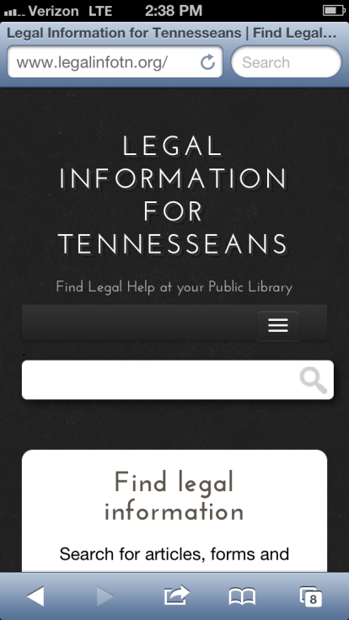

Building Responsive Websites TIG Conference 2013
Legal Information for Tennesseans (LIFT)
Erik Cole, Executive Director, TALS
ecole@tals.org/615.627.0956

Slide 2
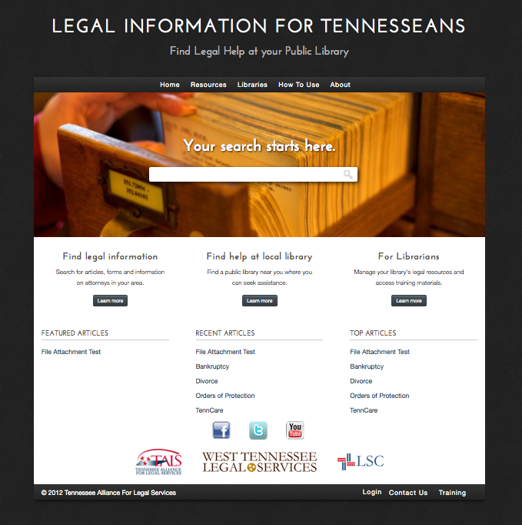
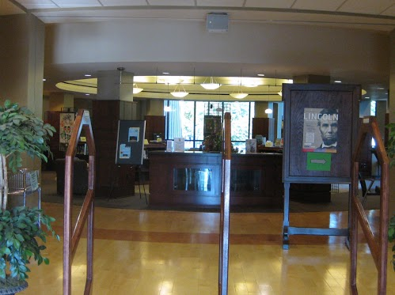
Legal Information for Tenneseans (LIFT)
www.legalinfotn.org

Slide 3
LIFT – www.legalinfotn.org
One-stop online resource for librarians and library patrons to get accurate legal information
Searchable by county, by library or by legal need
Quickly find legal information, libraries, and where to find legal help
Includes direct connection to online pro bono assistance – www.onlinetnjustice.org
Includes direct connection to 1-888-aLEGALz for in-person referrals
Launching in February 2013 with librarian trainings across Tennessee

Slide 4
LIFT continued
Project of West Tennessee Legal Services and the Tennessee Alliance for Legal Services
Funded by a Legal Services Corporation Technology Initiatives Grant (TIG)
Working in partnership with the Tennessee State Library and Archives and the Tennessee Access to Justice Commission
Website platform, design and mobile-first approach done by Urban Insight, Inc.
Statewide Advisory Committee driving development and content

Slide 5



LIFT Integrates Existing Programs
Online Pro Bono Assistance
Toll-free Legal Information & Referral
Online Resources and Court-Forms

Slide 6
Optimized for Mobile
Studies now show that as many as half of all Web users use their mobile device as their main method of connecting to the Internet.
It is estimated that in as little as a few years, mobile devices will outnumber PCs and laptops among Web users.
www.legalinfotn.org is optimized to be fully functional on all mobile devices.
The goal is to make the site usable for years to come AND to make it the best product possible for clients who are increasingly accessing resources through phones and mobile devices.

Slide 7
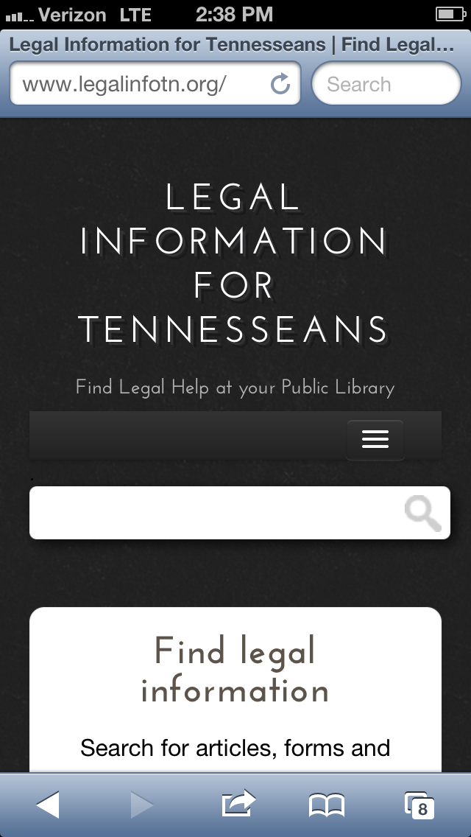
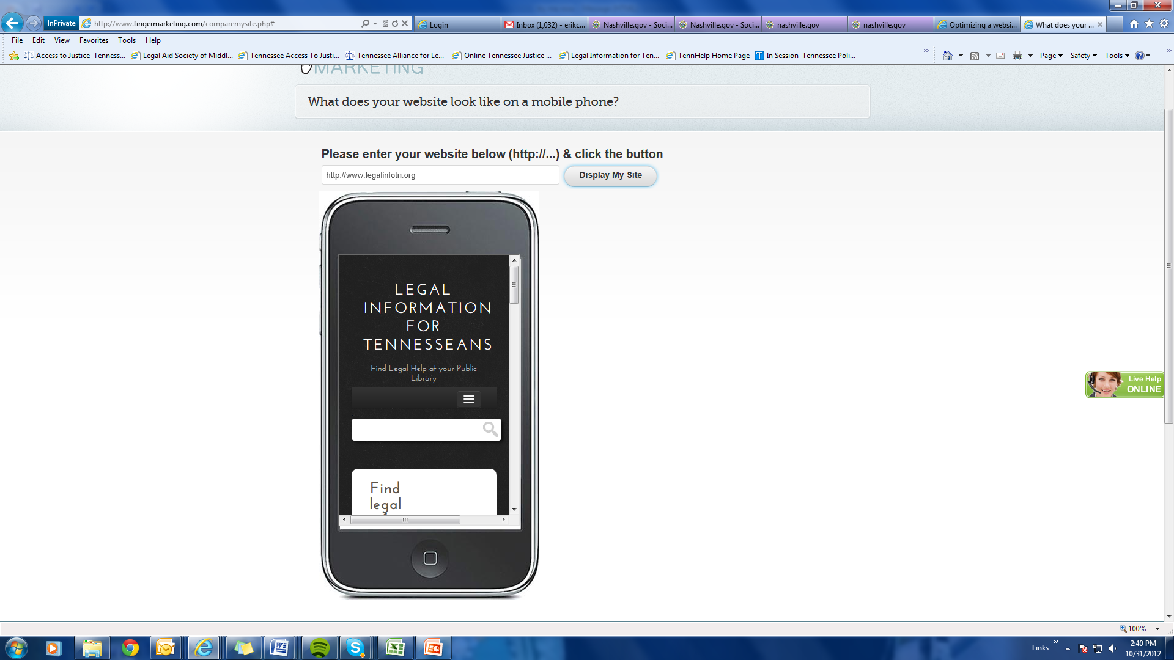
On smartphones..

Slide 8
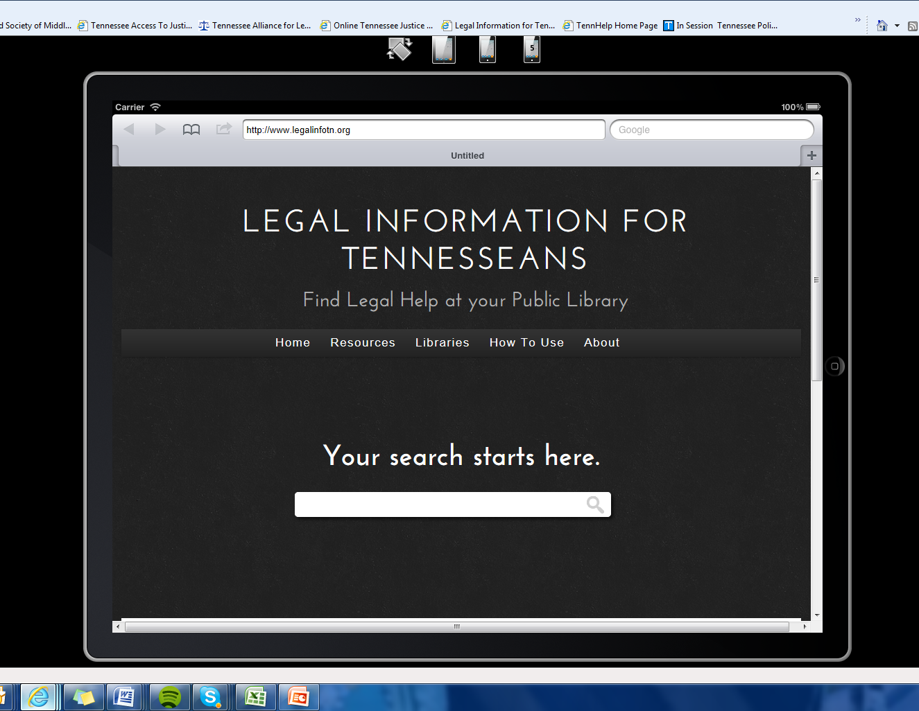
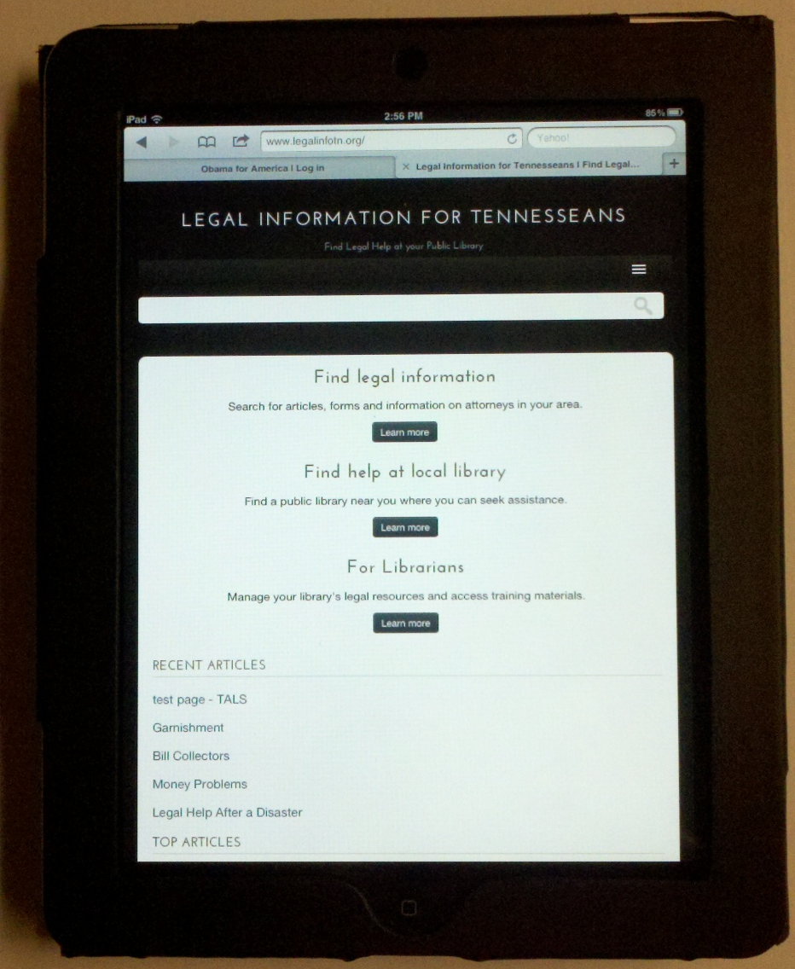
On tablets…

Slide 9
On PCs

Slide 10
User-friendly
The portal is built on a “Resources” list which is categorized by hierarchical terms and includes articles, organizations, and links.
The portal builds upon existing resources but adds legal assistance content as needed.
Each resource page features:
Self-help (pro se) legal information and community education materials
Online standardized forms approved by the Tennessee Supreme Court (when available)
Link to online probono assistance website – OnlineTNJustice
Find representation – link to statewide directory of legal aid services, pro bono assistance services, etc.

Slide 11
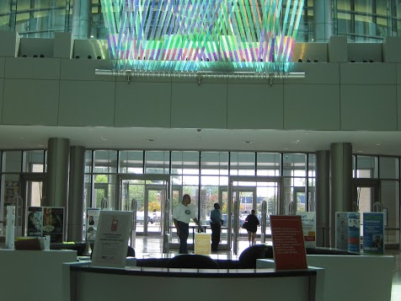
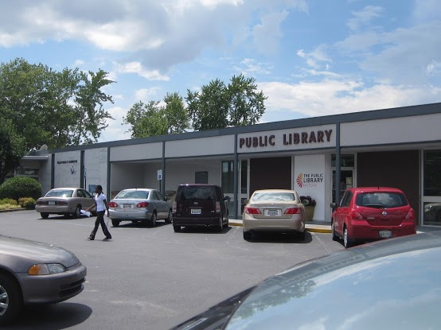
Interactive for Librarians
Each participating library will have its own profile (or page) in the portal.
Librarians will be able to login and change the information on their profile.
Librarians will also be able to select and associate specific content to appear on the profile.
Each librarian will also be able to submit content to add to legal resources.
Allows each library to also build up their hard-copy legal help library and highlight it online.
For libraries without sophisticated websites (often in rural locations) it gives them additional web resources.

Slide 12
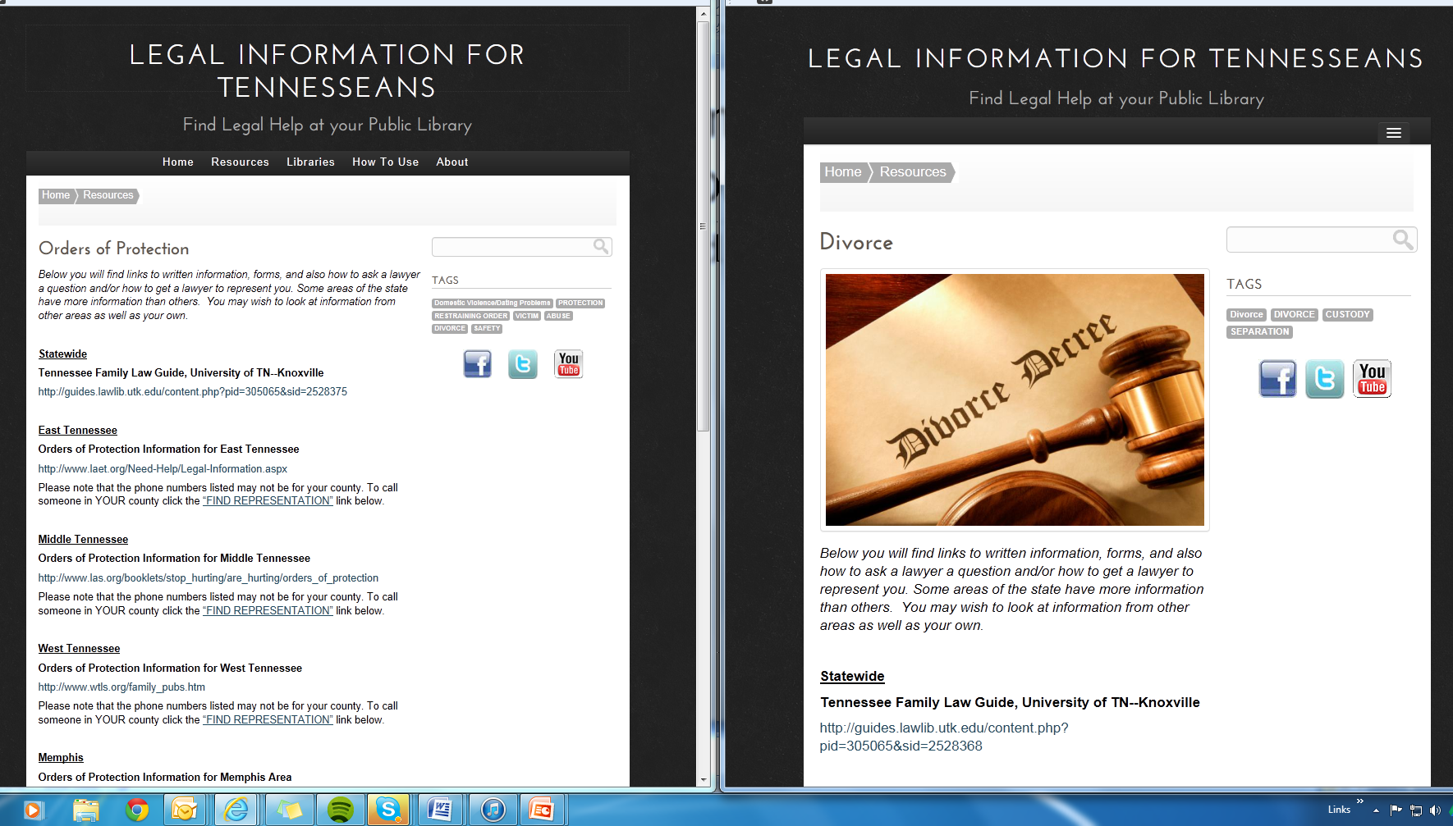
LIFT Sample Resource Pages: Orders of Protection & Divorce

Slide 13
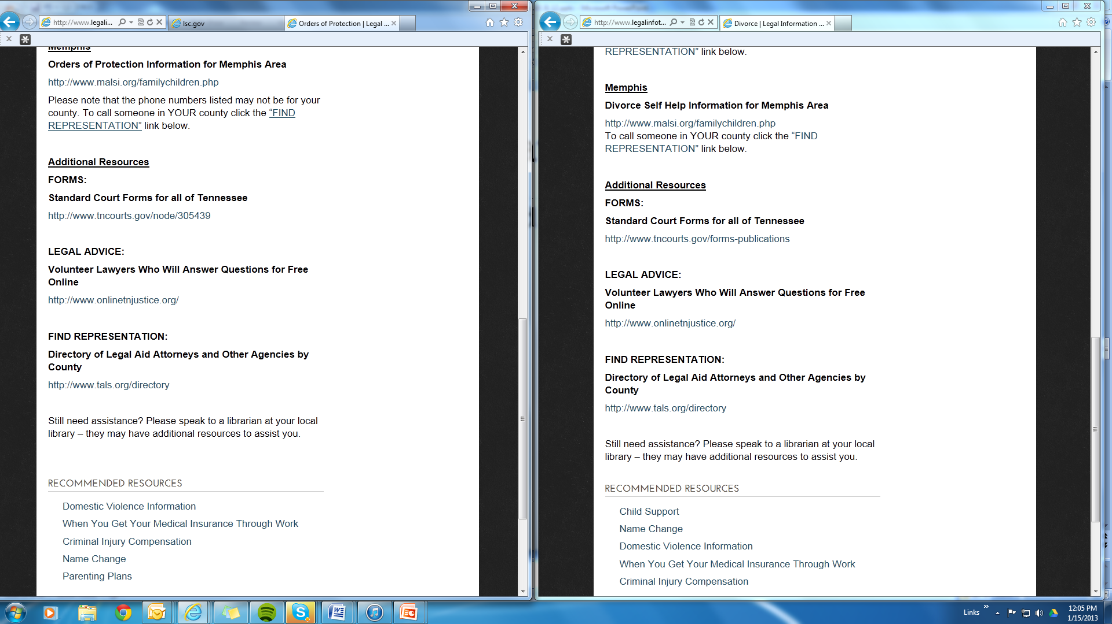
Conservatorship Page Cont’d.

Slide 14
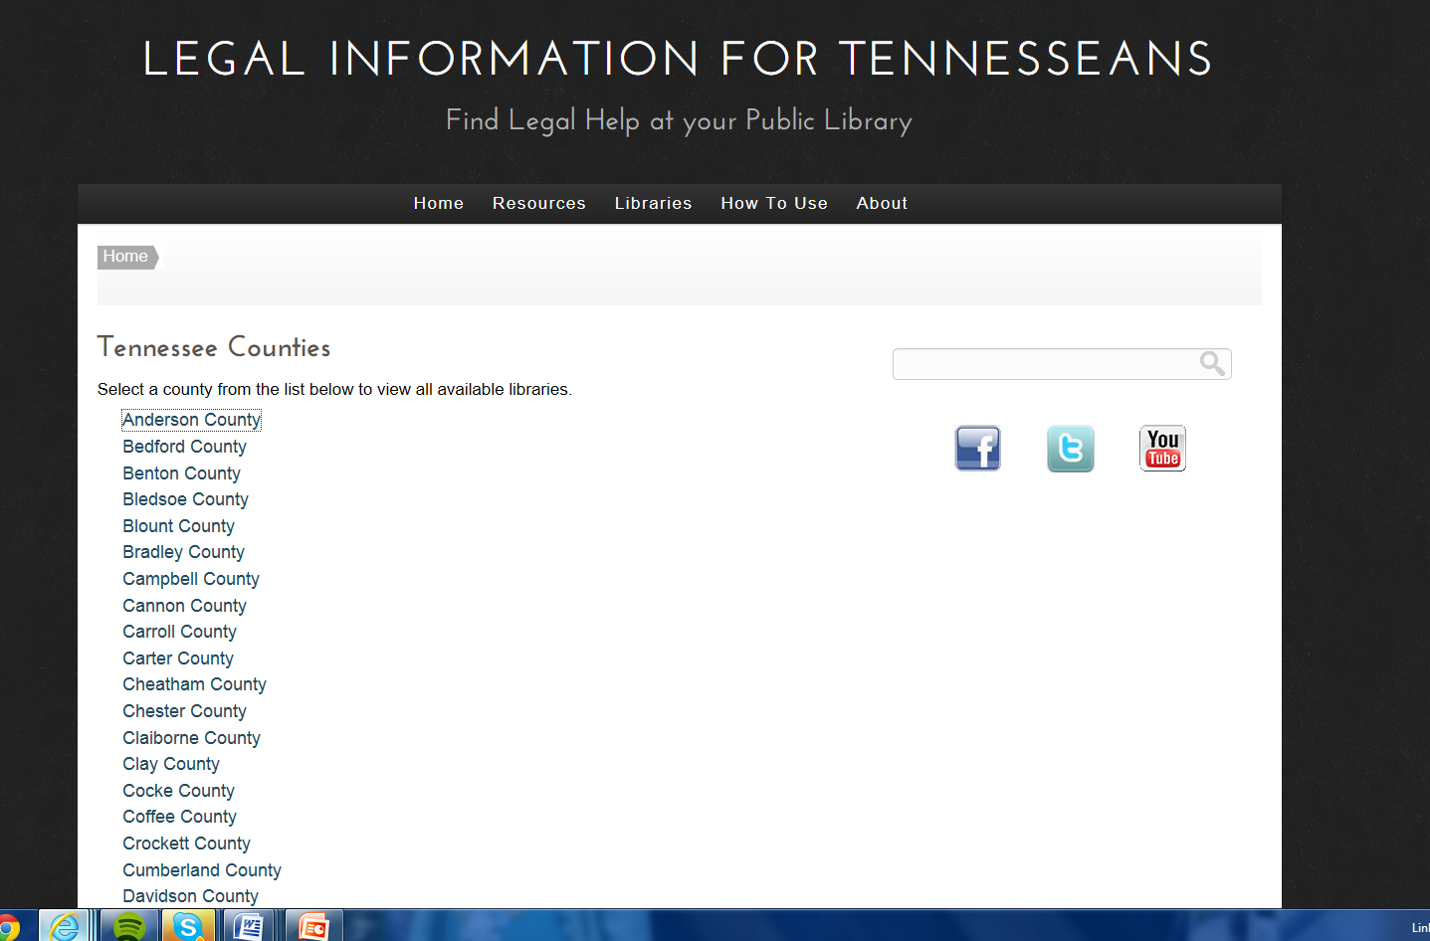
Find Help at a Local Library

Slide 15
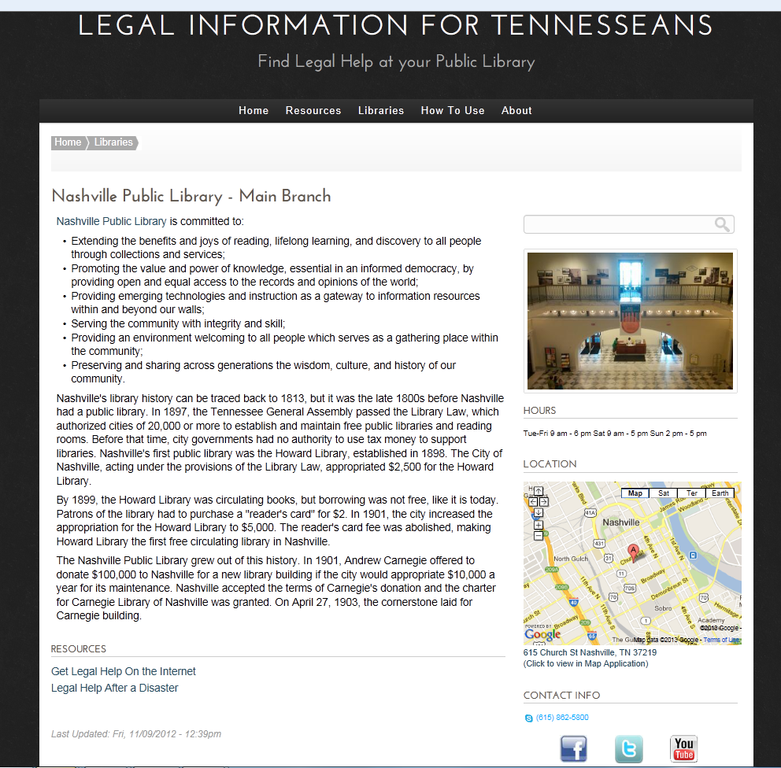
Find Help at a Local Library

Slide 16
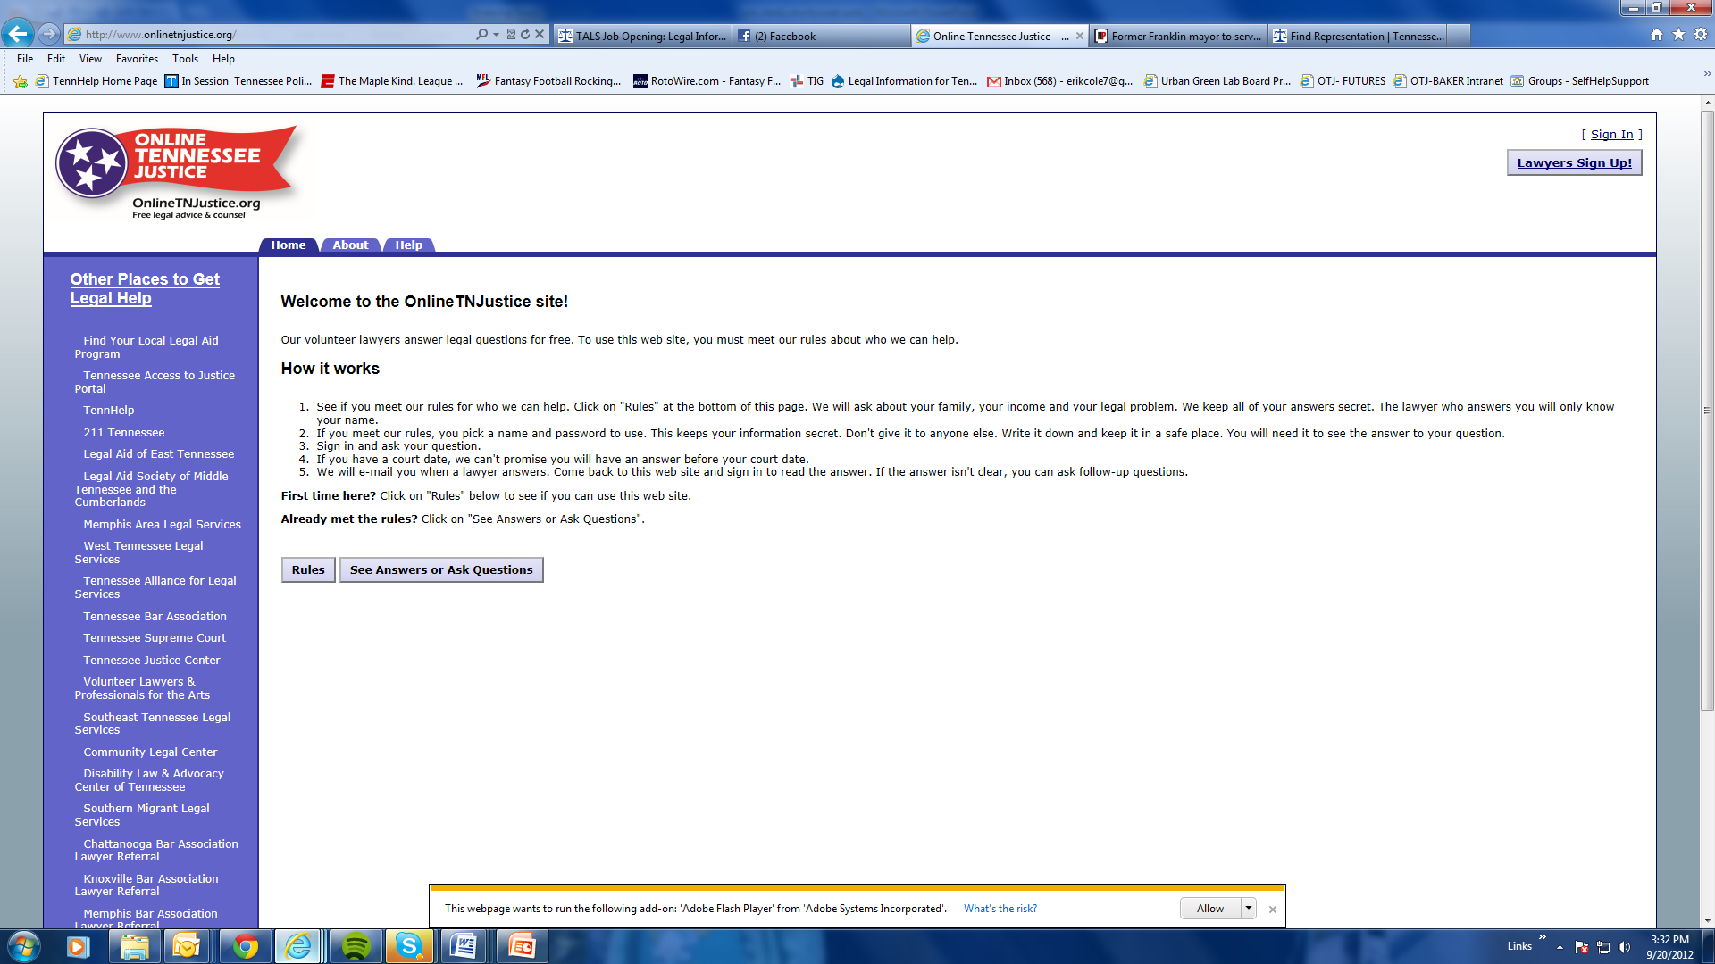
Ask a Lawyer a Question OnlineTNJustice

Slide 17
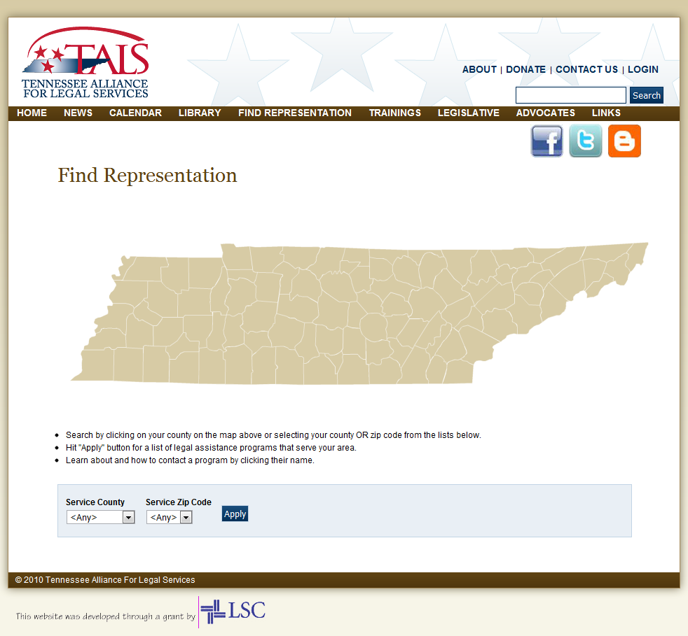
Find Representation

Slide 18
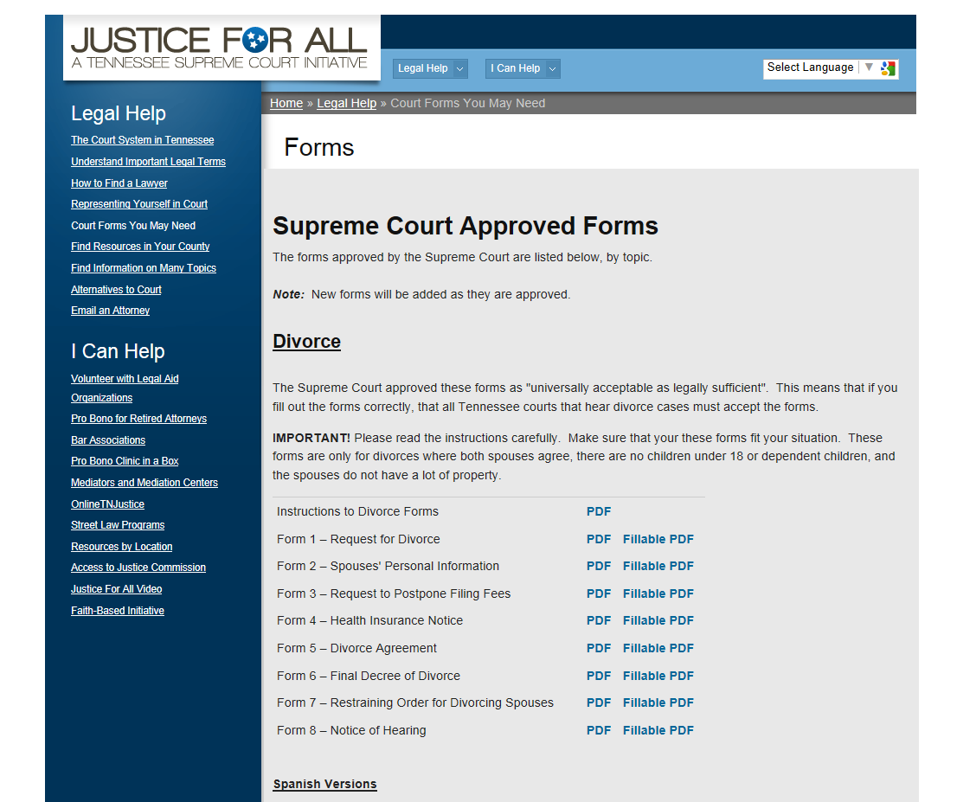
Tennessee Forms

Slide 19
Next Steps
Four libraries are piloting site once content upload is complete – Two major metropolitan, one rural, one medium-sized city
Once the portal is finalized and tested, TALS and WTLS will train librarians across Tennessee on its use.
Trainings will be conducted in all the regions of the State Library system and they will be recorded for live and on-demand web viewing. Librarians will be taught how to use the site, how to login an create their own profile pages, how to talk with clients needing legal assistance, and about local legal resources.
What is legal aid?
What is the difference between legal advice and legal information?
A detailed “how-to” on the TN Library/Legal Resource Portal
What are the most common civil legal questions you will encounter?
How to make a referral to your local legal aid program or pro bono program.

Slide 20
Library trainings
Curriculum for librarians is currently in development
Regional librarian trainings scheduled for 2013
9 trainings will be held across Tennessee in conjunction with State Library Regional Meetings

Slide 21
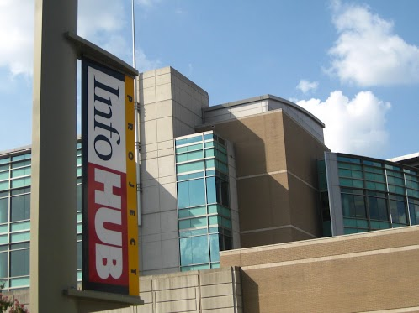
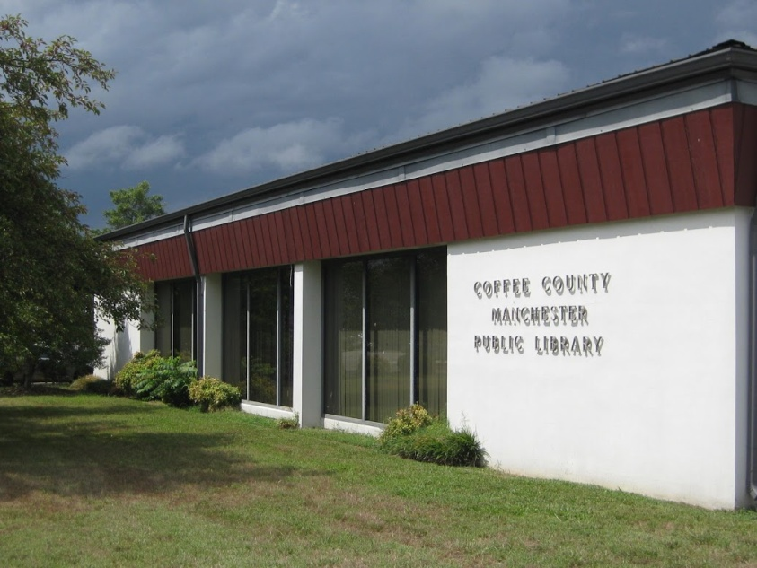
For more information about LIFT…
Erik Cole, Tennessee Alliance for Legal Services
ecole@tals.org – 615-627-0956 ext. 23 – www.tals.org

