Slide 5
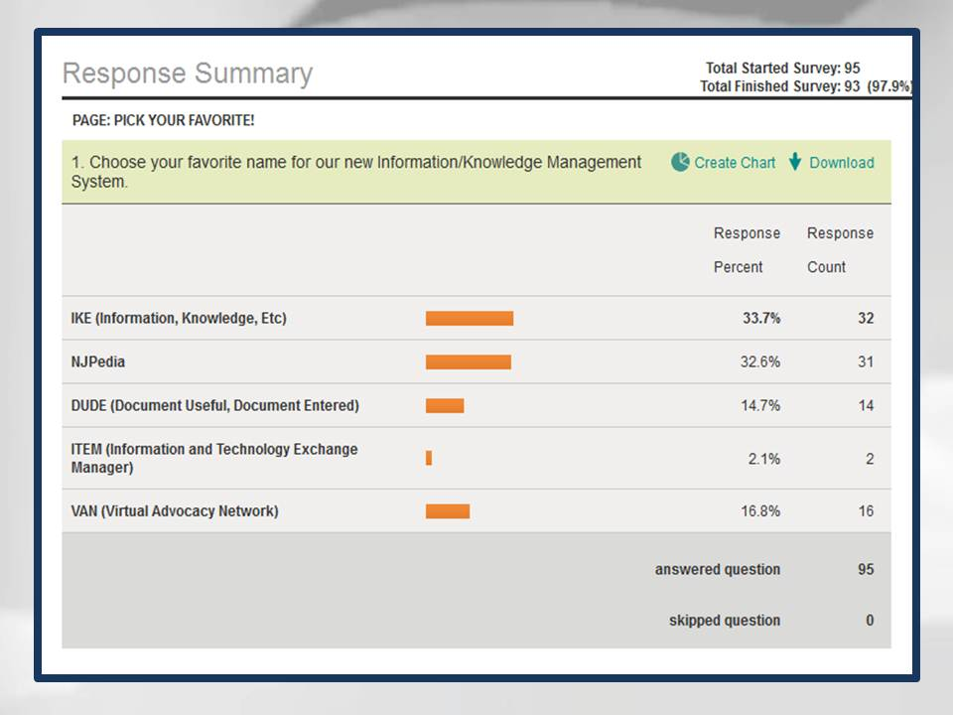

Slide 9
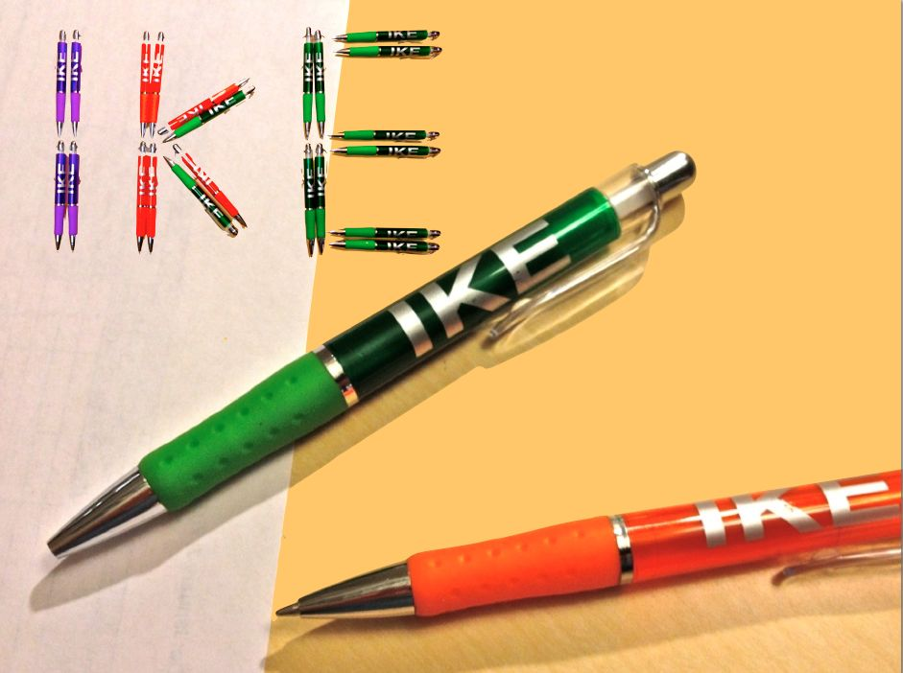

Slide 22
What’s New in
in 2012?

Slide 23
Google Drive

Slide 24
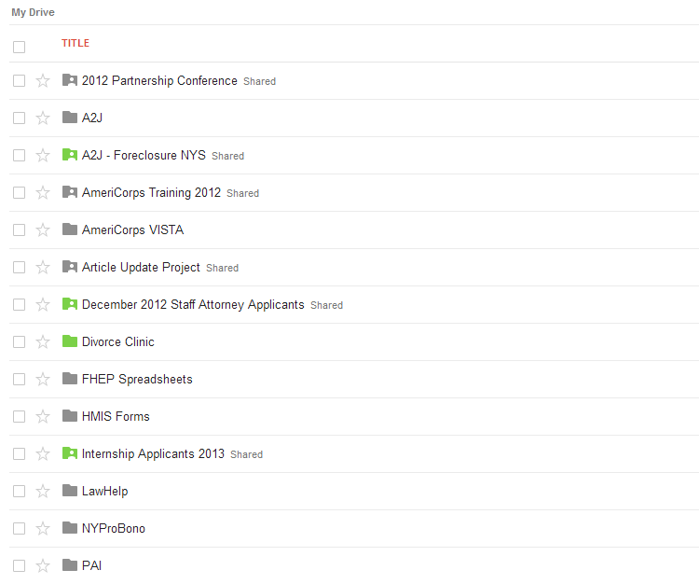
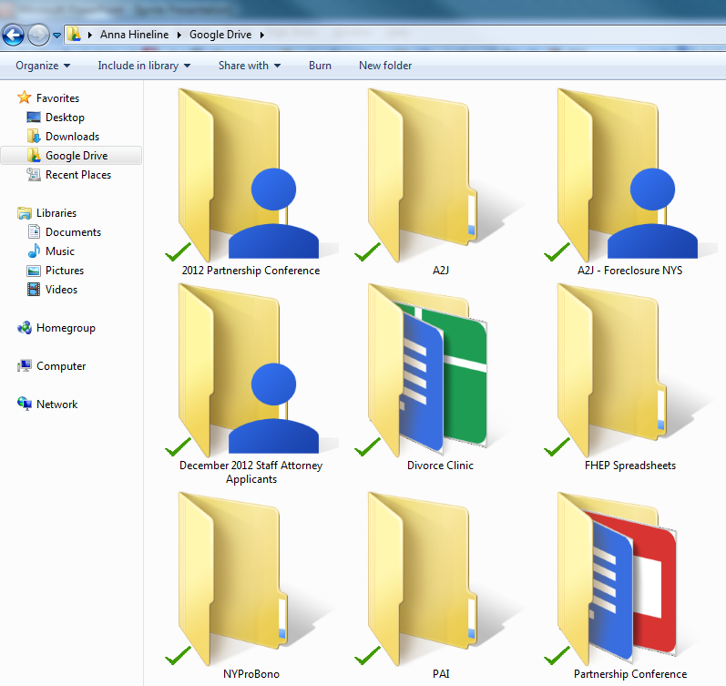

Slide 25
Collaboration

Slide 26
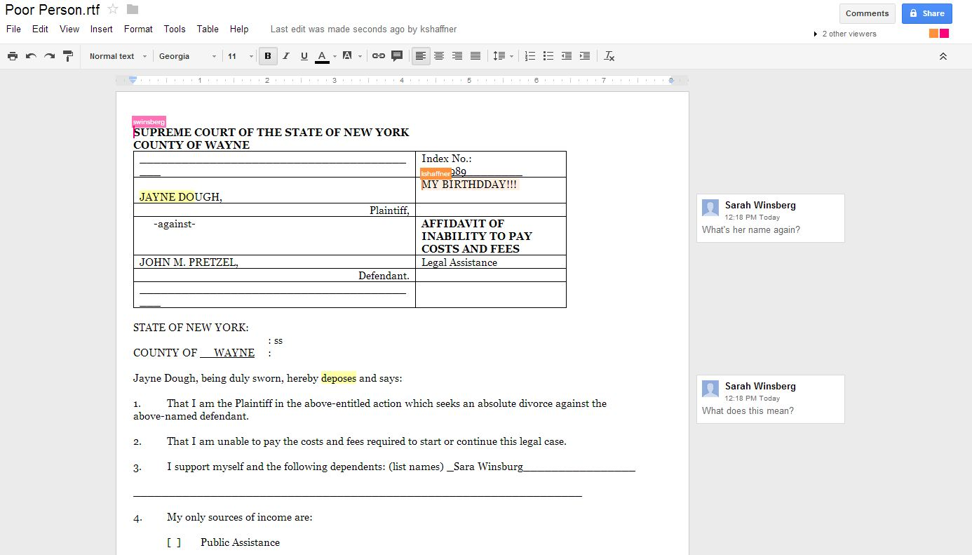

Slide 27
File Formats

Slide 28
.JPEG
.AI
.SVG
.TXT
.DXF
.CSS
. AVI
.DOC
.PSD
.PDF
.XLS
.WPD
.ZIP

Slide 29
Google⁺

Slide 30
XKCD

Slide 31
Hangouts

Slide 33
Communities

Slide 35
Administrative

Slide 36
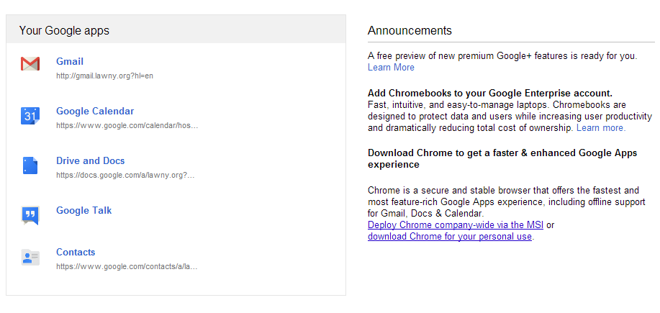

Slide 37
Email Settings

Slide 38
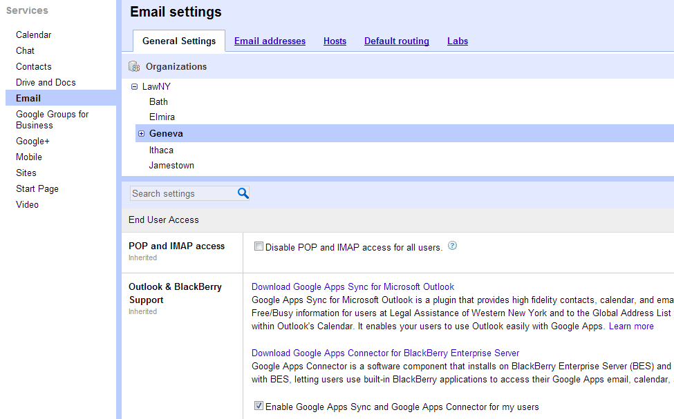

Slide 39
Mobile Controls

Slide 40
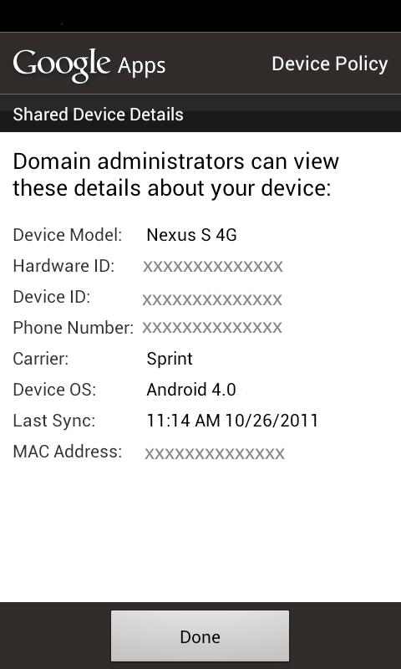
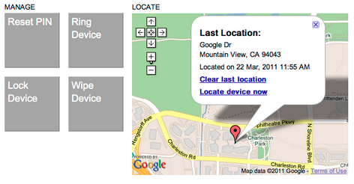

Slide 41
Anna Hineline
Legal Assistance of Western New York, Inc.®
ahineline@lawny.org

Slide 43
Legal Technology- Total cultural immersion
The trials and tribulation of Jack on his journey through the land of legal technology…
Xander Karsten- Pro Bono Net

Slide 44
This is Jack
I like helping other attorneys turn on their computers and use Word; I could work in technology for civil legal services…
A few months ago he thought…
And so… his life in the legal technology field began…

Slide 45
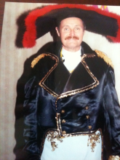
It is a new world- with different (and sometimes strange) customs, languages and traditions… Soon Jack finds himself in a total cultural emersion.

Slide 46
The language is a veritable alphabet soup…

Slide 47
Jack can master it

Slide 48
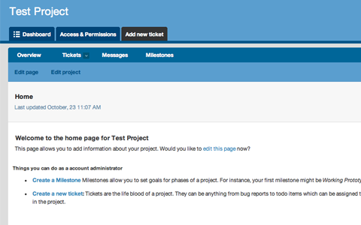
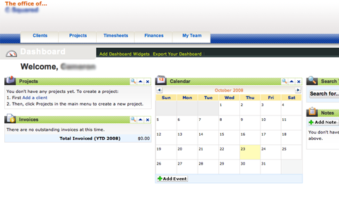
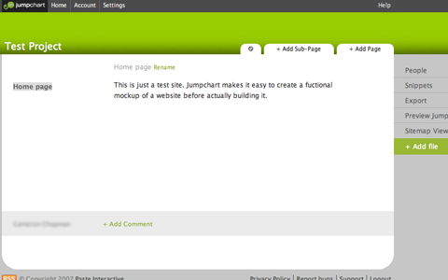
Everyone’s tools are completely different (and better than everyone else's!)
?
?
?

Slide 49
Jack manages all his sign ons!
Seriously, don’t keep your
passwords on a sticky note…

Slide 50
People believe in transparency, openness, and access…

Slide 51
Jack adopts these beliefs as his own

Slide 52
These values, tools and languages are learnt through a variety of means
Formal Instruction?
Putting pen to paper?
Oh no, not…
CLIPPY?!
Book
Learning?

Slide 53
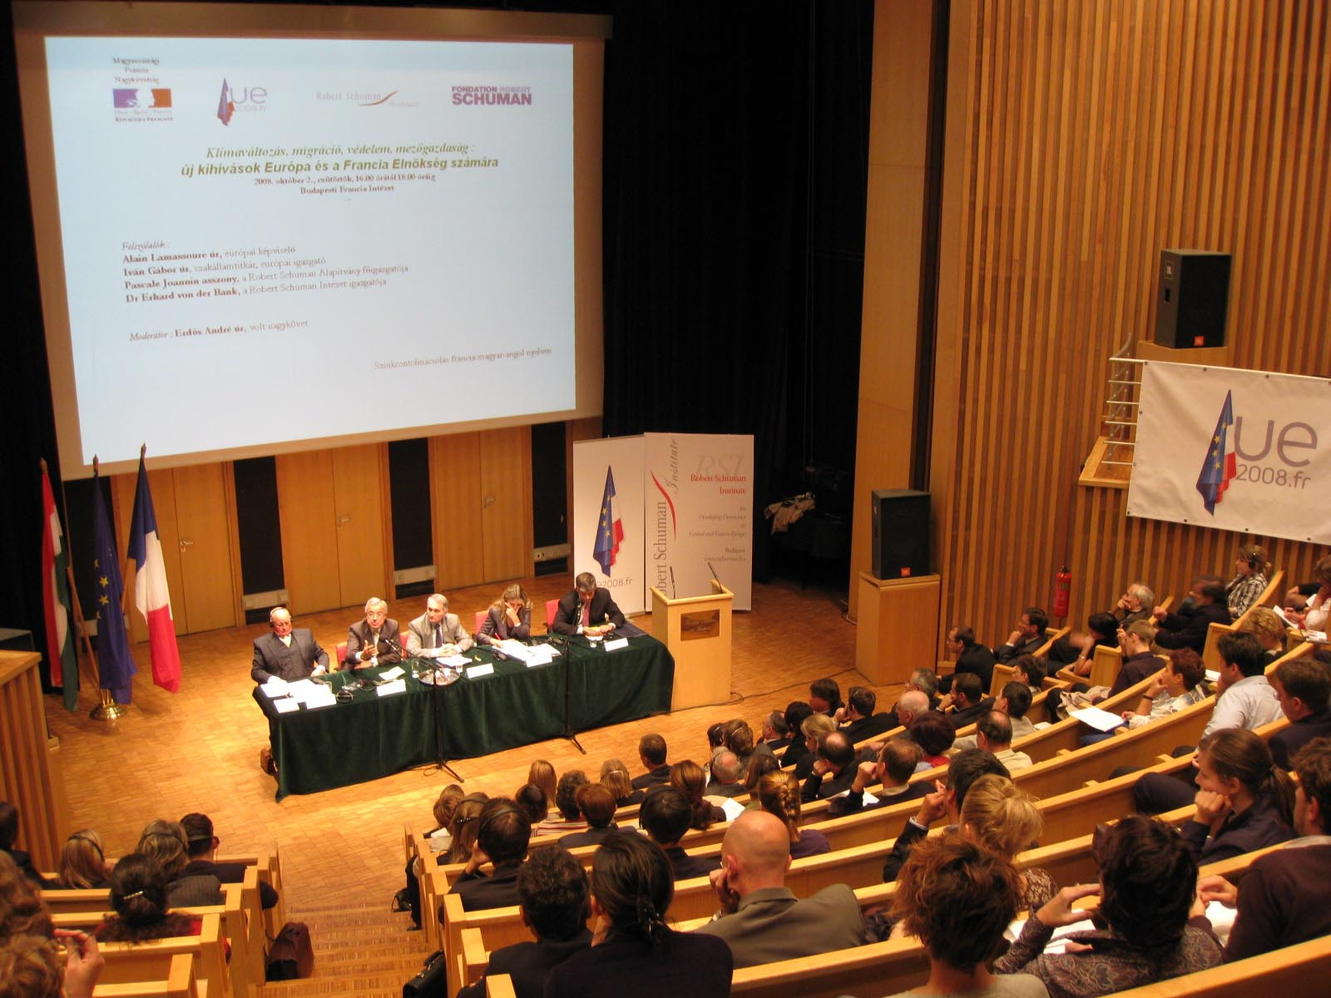
There is group indoctrination

Slide 54
Online learning

Slide 55
…and informal social opportunities
(He’s a little shy)

Slide 56
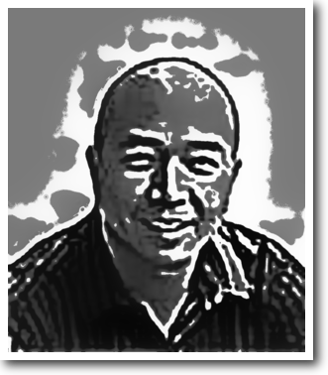
There are subcultures Jack meets along the way… Like MacHeads

Slide 57
Opensource Gurus

Slide 58
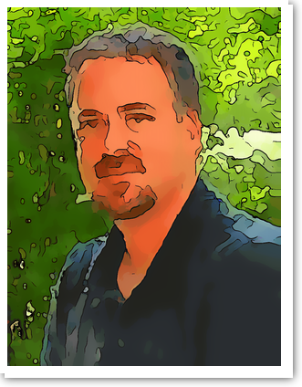
And Google Fans

Slide 59
The language, tools, technology and attitudes are constantly changing…

Slide 60
It is ubiquitous- there is no escape…

Slide 61
Jack learns how important it is to just…
…unplug.

Slide 62
In the end, Jack learns
!
Resistance is futile.

Slide 64
Technology Enabled Disaster Relief Assistance
2013 TIG Conference
Leah Margulies, Ignite presenter

Slide 65
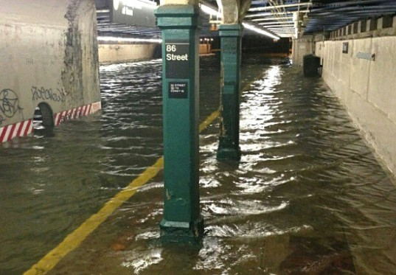
Welcome to New York City
October 30, 2012
86th & Lexington Station

Slide 66
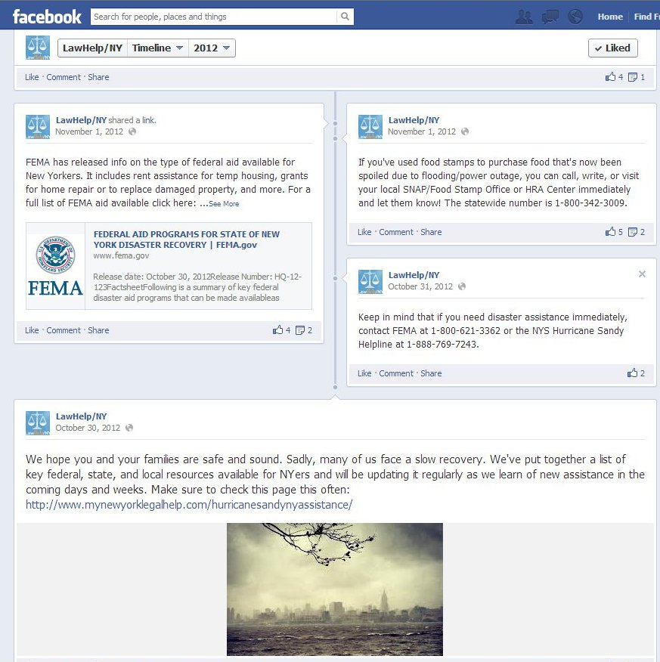

Slide 67
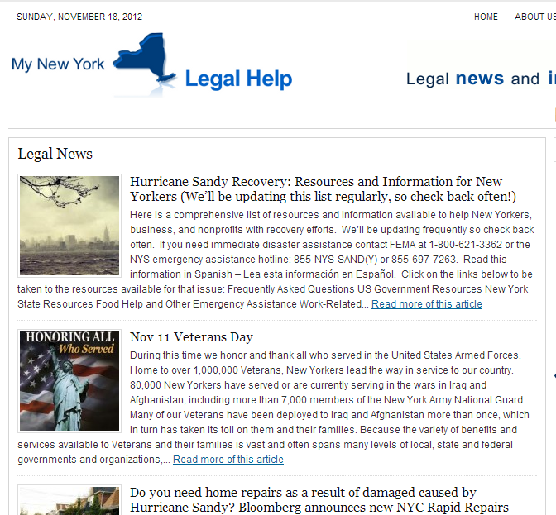
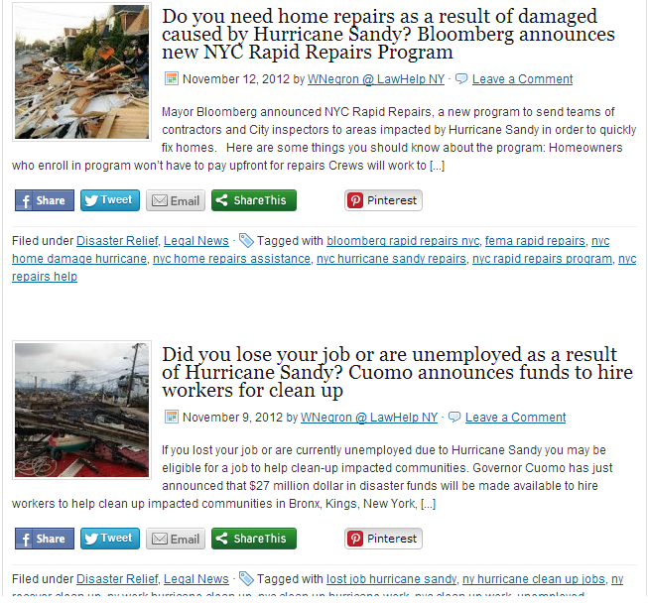
My New York Legal Help blog, entries tagged Disaster Relief.

Slide 68
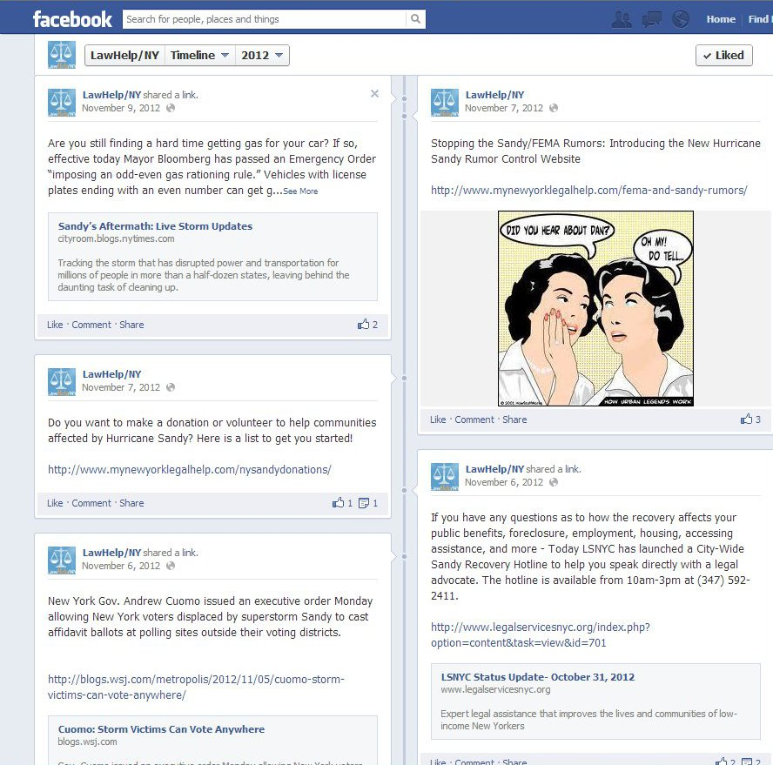
Whenever we did a new blog entry, we added a Facebook post and tweeted.

Slide 69
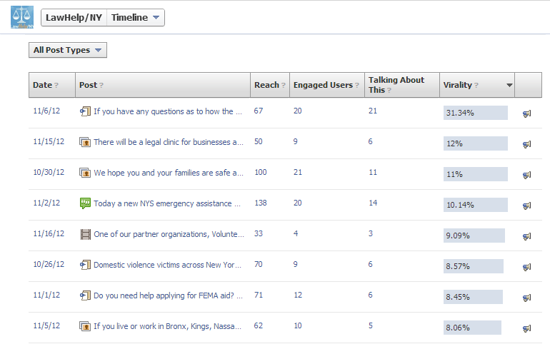
Facebook “virality” statistics:
Only 1% of FB pages get over 20% virality rate
Only 3% of FB pages get between 10% - 20%

Slide 70
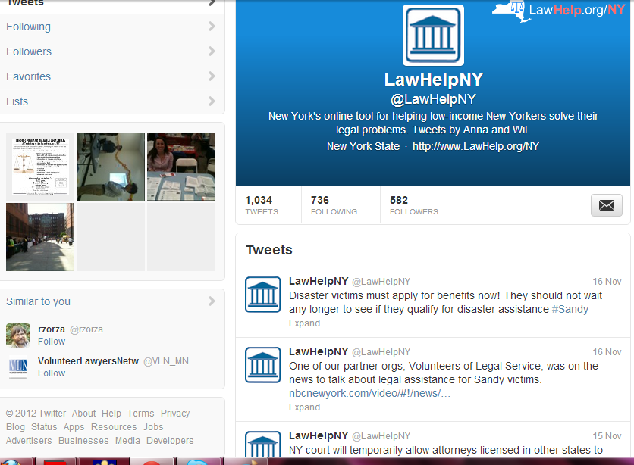
Tweeting in English

Slide 71
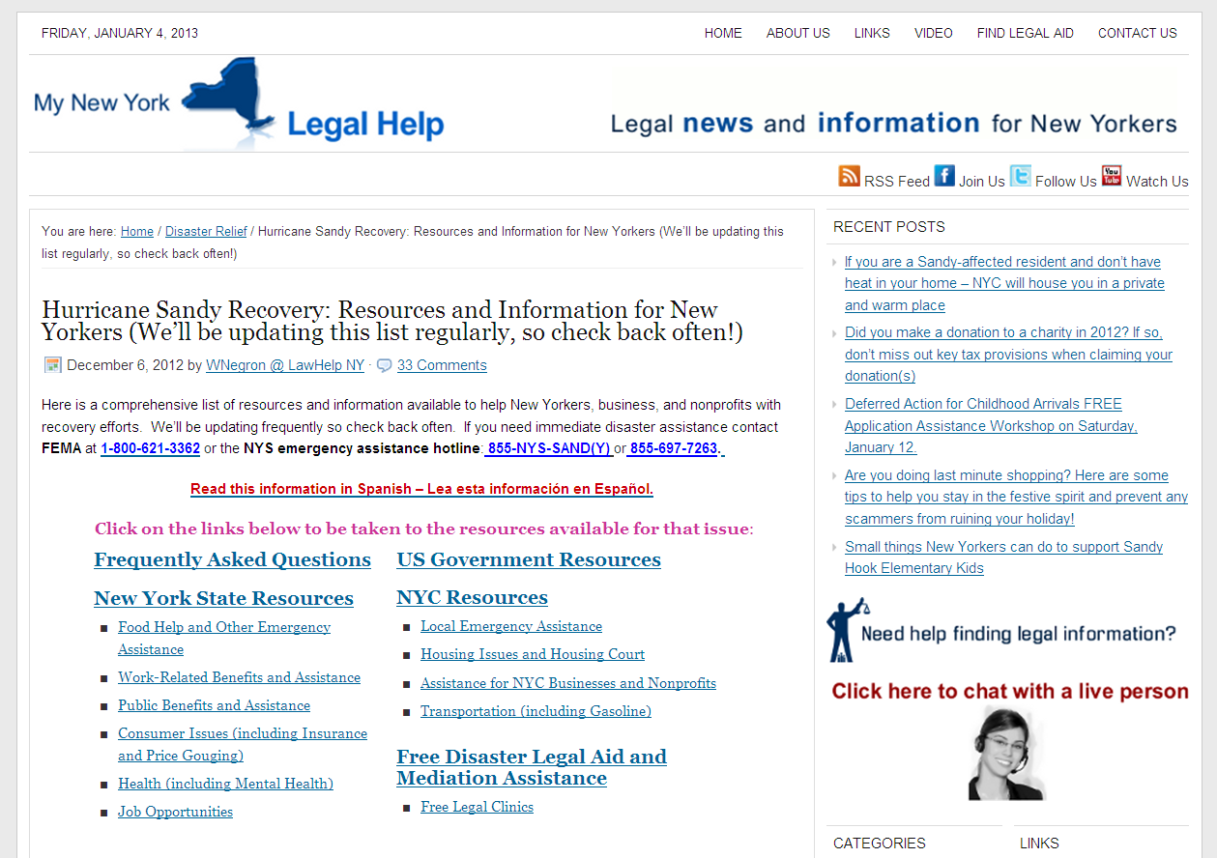
MyNewYorkLegalHelp.com, LawHelpNY’s blog, main Sandy Recovery resource page

Slide 72
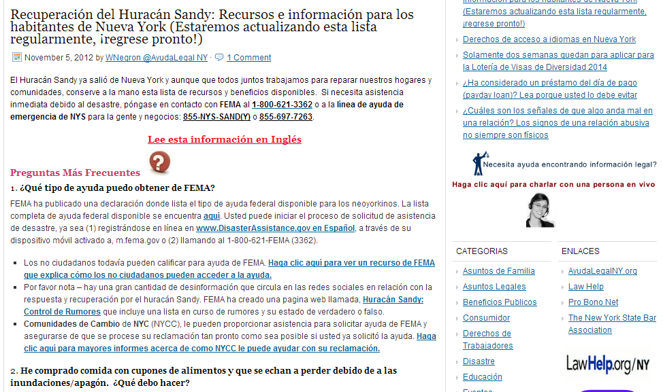
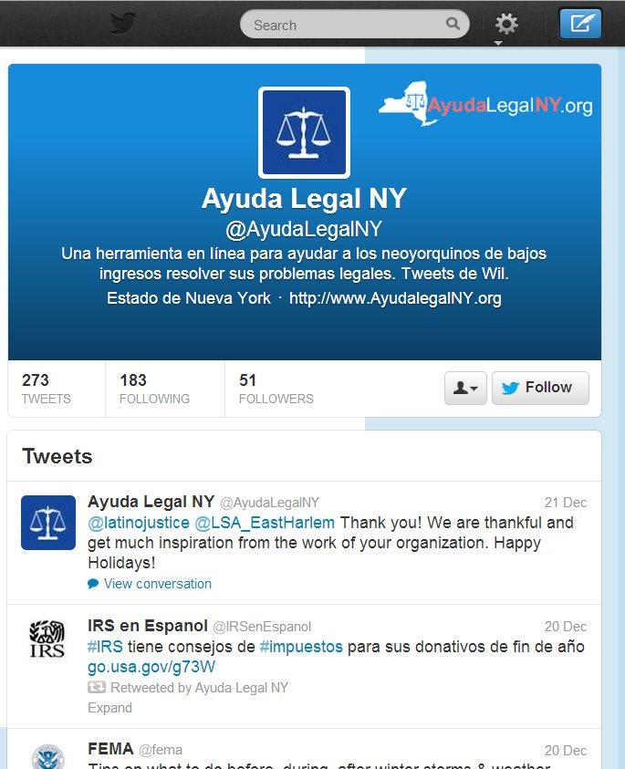
Spanish blog and Spanish Twitter

Slide 73
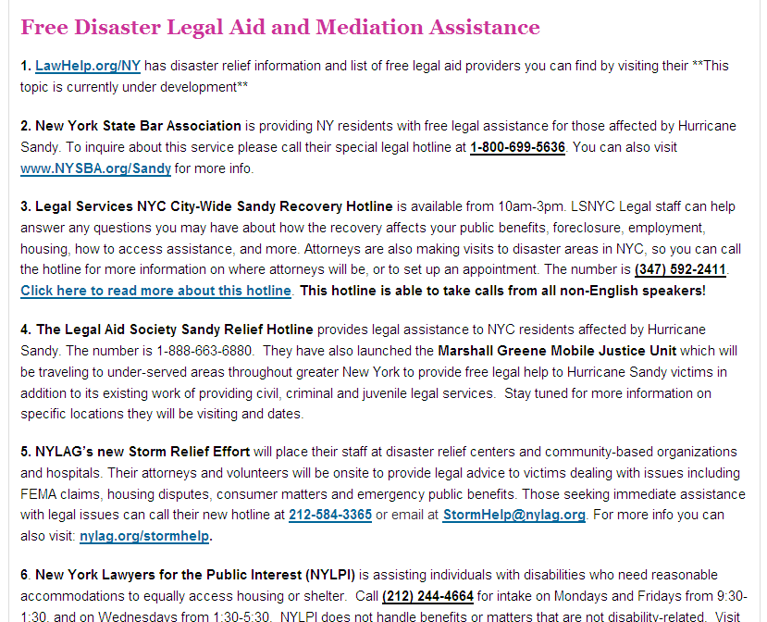

Slide 74
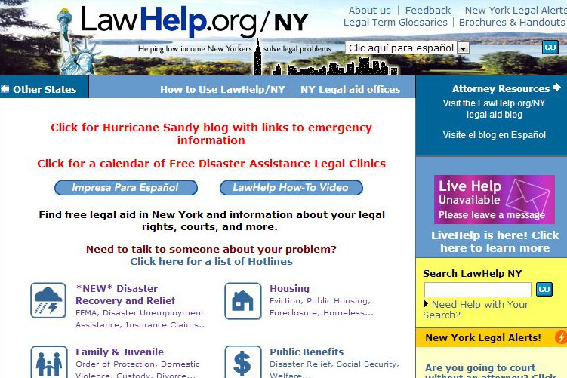
Home page links to emergency relief blog and free legal clinics calendar, with new Disaster topic

Slide 75
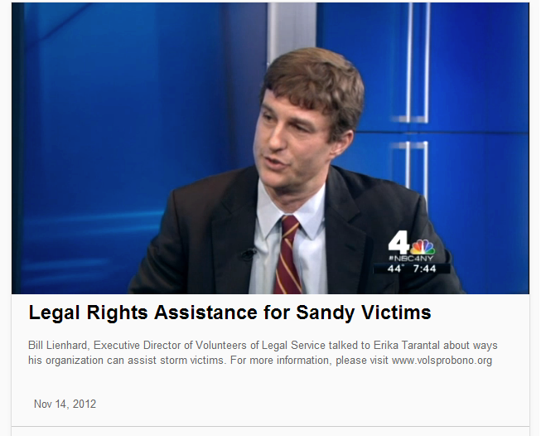

Slide 76
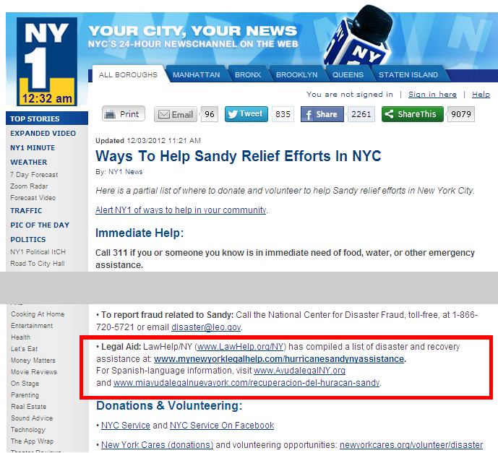

Slide 77
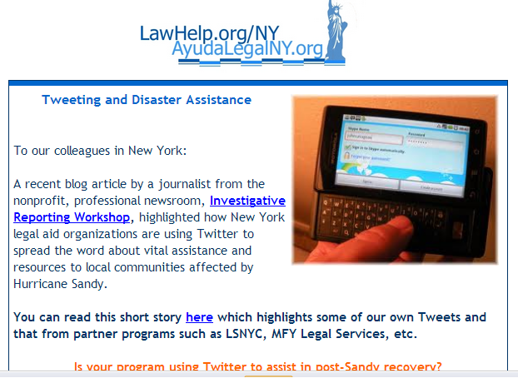
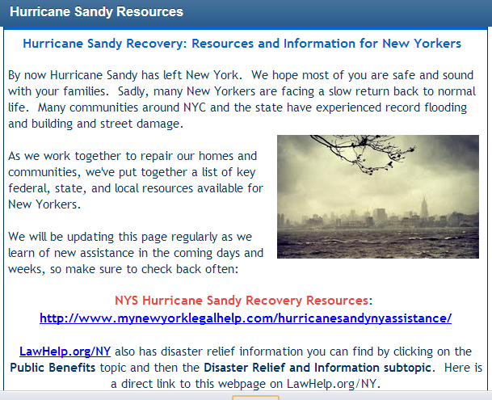
Special eNewsletters reached 3,700, primarily legal and social services staff

Slide 78
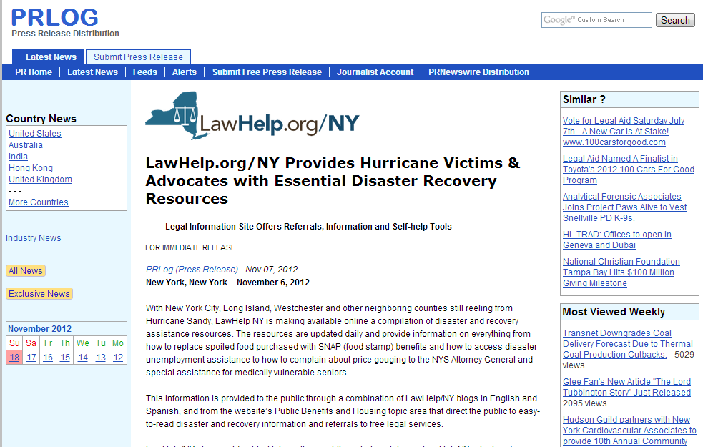
Pro Bono Net and City Bar helped us put out a press release that was picked up widely.

Slide 79
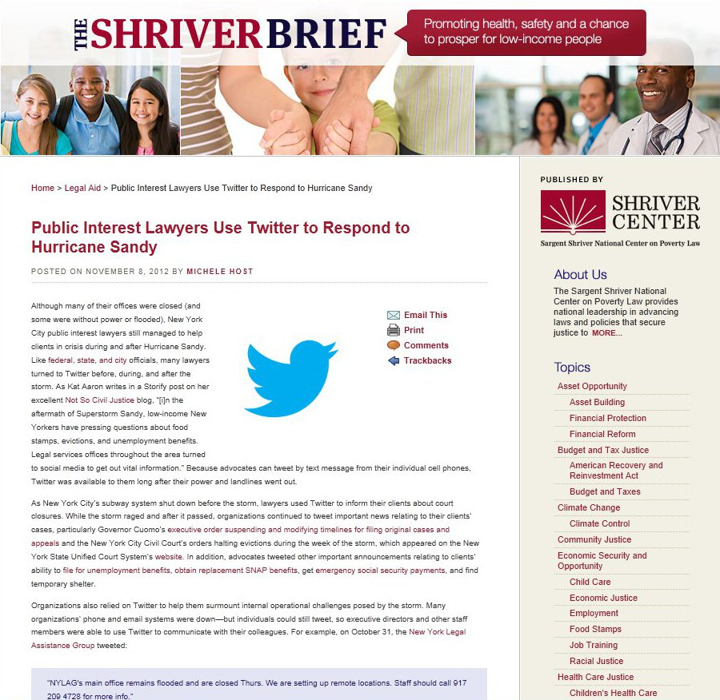
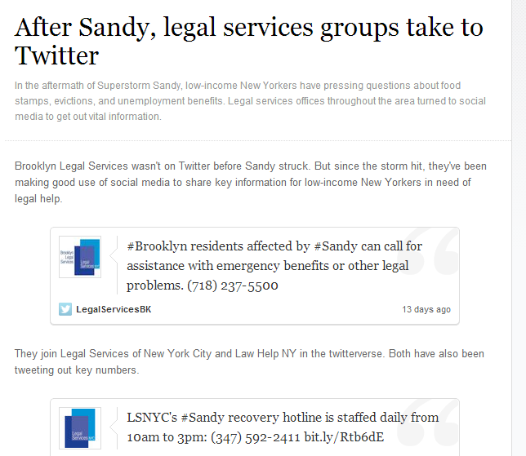
LawHelpNY gets a mention from the Shriver Center, as do LS-NYC and others

Slide 80
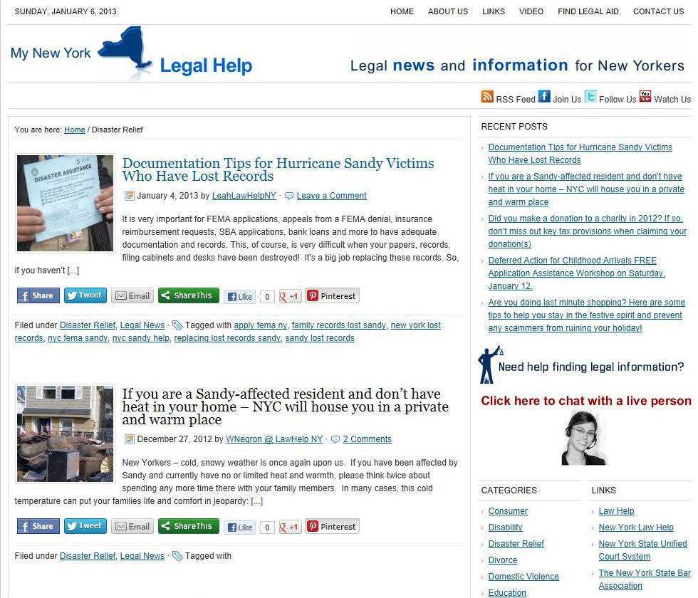

Slide 81
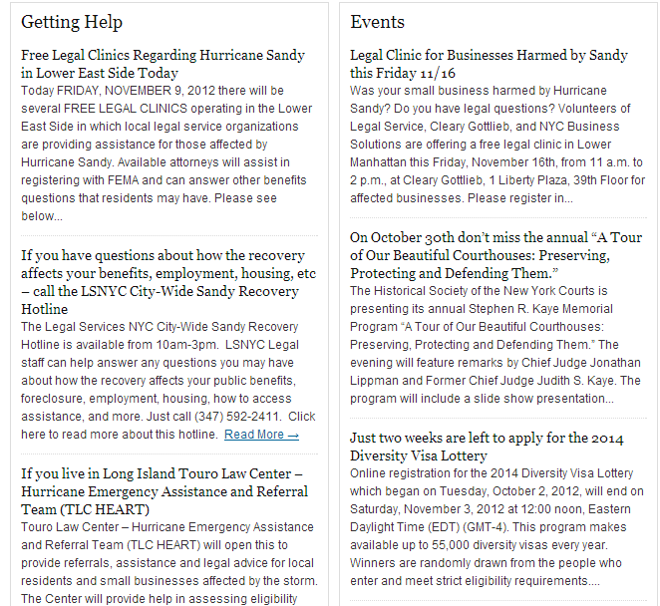

Slide 82
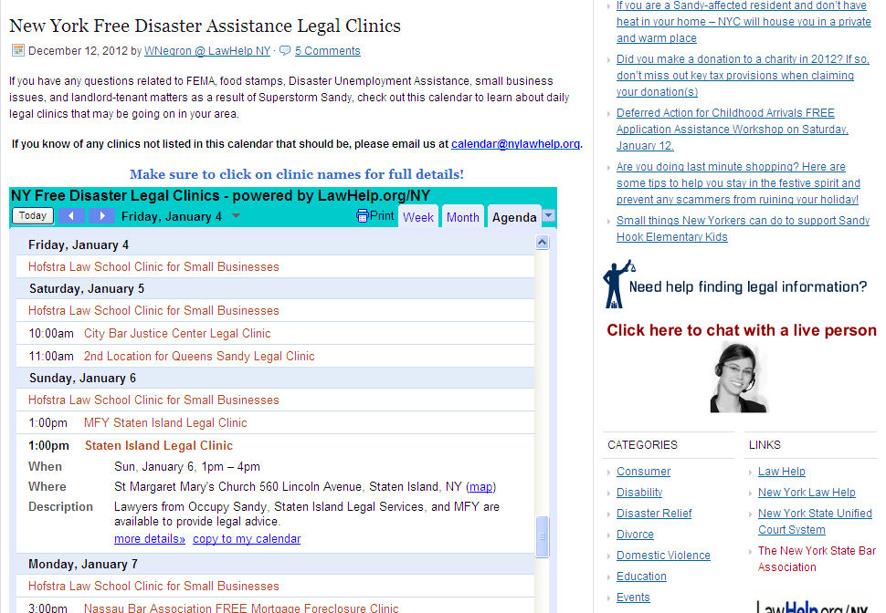

Slide 83
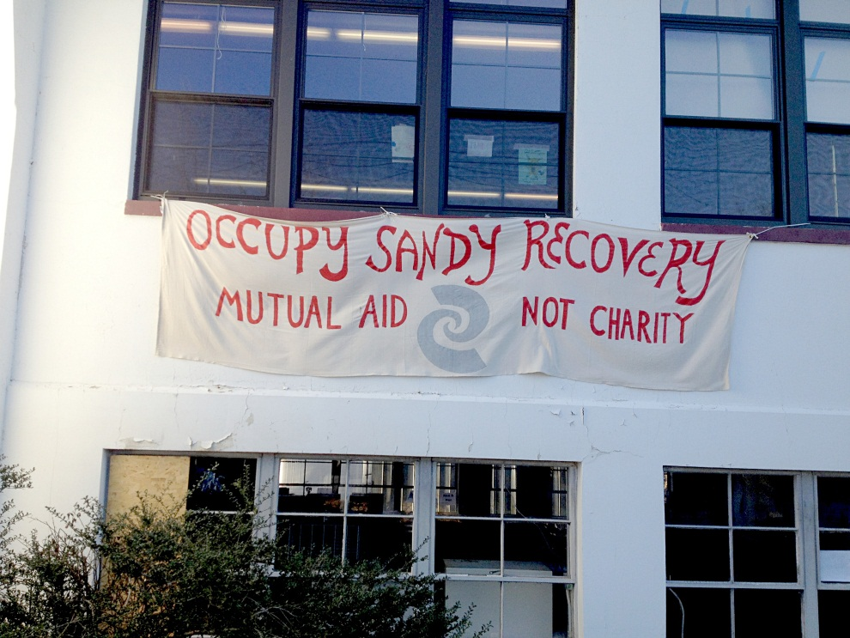
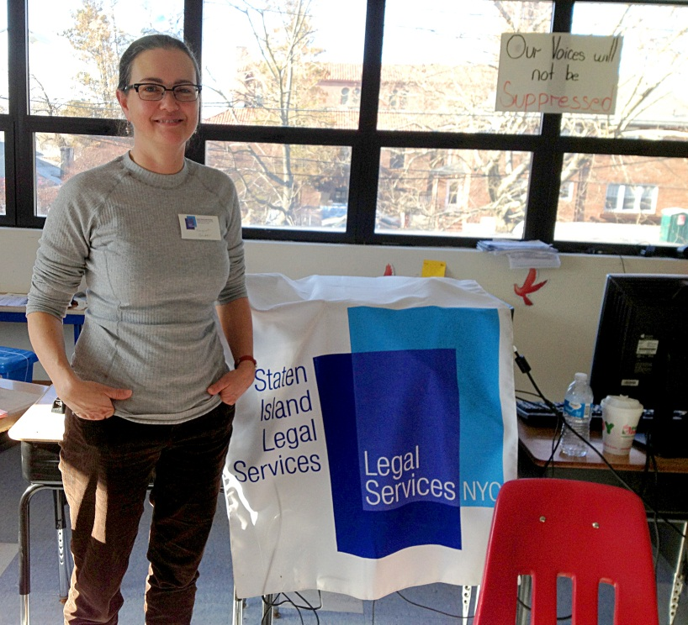
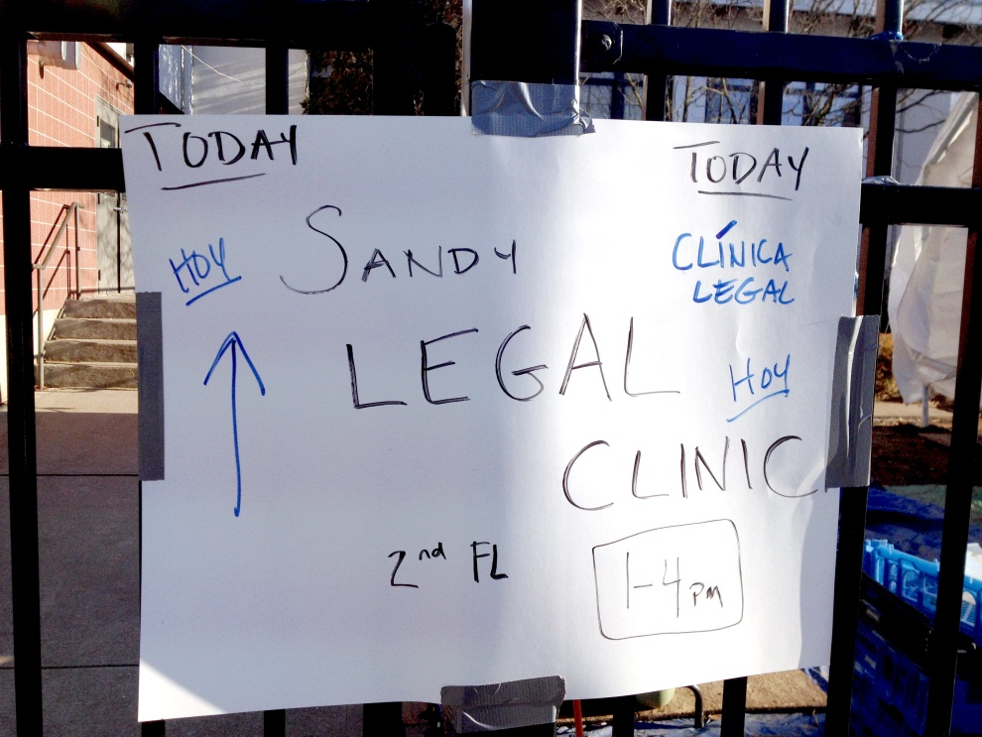
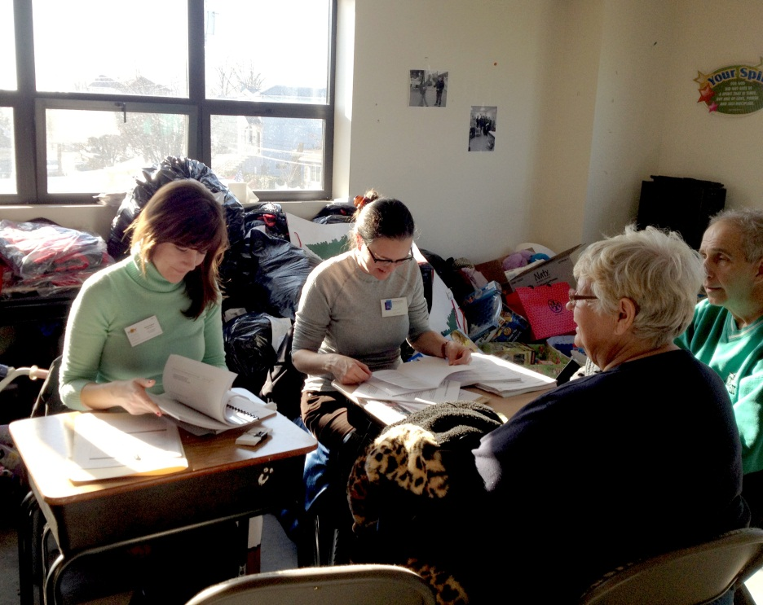

Slide 84
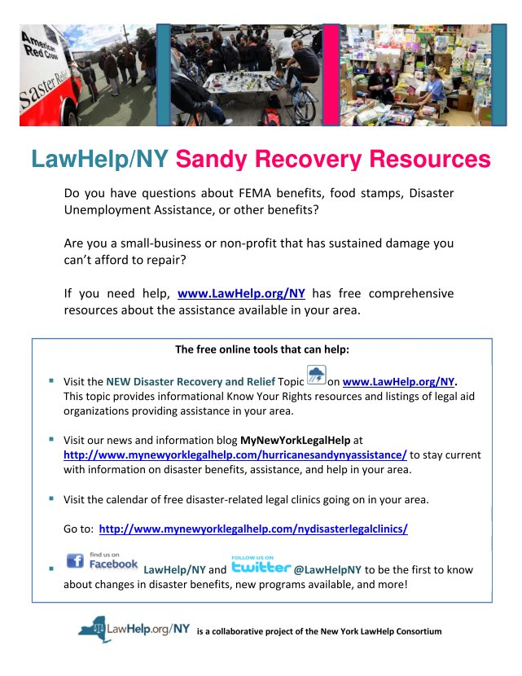
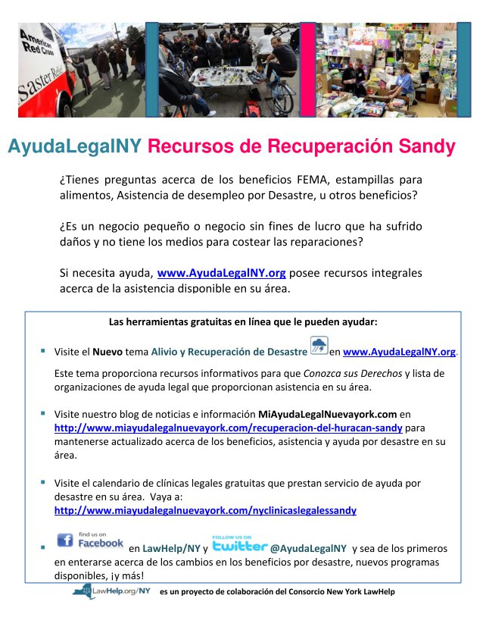
New leaflet now being distributed by law students throughout affected areas

