Slide 1
TIG 2012 Information session
David Bonebrake, Glenn Rawdon, Jane Ribadeneyra
Legal Services Corporation

Slide 2
2012 TIG Cycle
Approximately $3.4 million is available for 2012 grant awards
Letters of Intent (LOI)
Online System Available: February 10
LOIs Due: March 9
Invitations for Full Applications: April 16
Full Applications Due: June 1
TIG Award Notifications: September 2012

Slide 3
TIG 2012 Letters of Intent Eligibility
Only LSC program grantees are eligible to apply for TIG funds. Other entities are encouraged to participate as project partners.
Programs should be up to date on all previous TIG grants prior to submitting a LOI.
LSC encourages all grantees to submit LOIs, particularly those that have not previously participated in the TIG program

Slide 4
TIG 2012 Grant Categories
LSC will accept projects in three application categories for 2012:
Website Improvement and Innovation
Replication and Adaptation
Open Category
Notes:
No earmarks for any grant specific category; simply allows us to organize the LOIs submitted by category.
1. Website Improvement & Innovation
Initiatives to improve and expand the use of statewide websites (SWWS)
Add new tools, promote website traffic, build community and increase effectiveness of SWWS to better serve the community, partners, advocates and client population
Note: 2010 was the last year for Renewal and Continuation Website Grants
. Replication and Adaptation – to replicate, adapt, or provide added value to the work of prior TIG projects.
A. Replication of Previous TIG Projects – e.g., look at projects where software or content has been created and is available at no (or low) cost
B. Automated Form Replication – identify Hot Docs and A2J templates on LawHelp Interactive National HotDocs Server (http://www.lawhelpinteractive.org) that can be replicated for your jurisdiction
Examples and final reports of some replicable projects are available at: http://tig.lsc.gov/finalreportsamples.php
Replicable Projects: Live Help, Online Intake, Court Channel to the SWWS, Web-based Video content, Findability Project, a variety of HotDocs and A2J projects.
Open Category – projects that don’t fall within website or replication categories and:
Implement new or innovative approaches for using technology in legal services
Enhance the effectiveness and efficiency of other TIG initiatives or use technology to increase the quality and quantity of services to clients
Enable grantees to substantially increase and/or improve services provided to their client communities
Proposals that would have broad applicability or impact are strongly encouraged
Additional weight is given to projects with strong demonstrated support from appropriate partners.

Slide 5
TIG 2012 Areas of Interest
Using Mobile Technologies to Provide and Increase Access to Legal Assistance
Leveraging Technology to Increase Pro Bono Attorney and Law Student Involvement
Technology Tools with Applicability to Federal Laws
Use of Data to Analyze Service Delivery and Develop Advocacy Strategies
Shared Infrastructure and Staff
Notes:
Mobile: LSC encourages proposals to explore how these mobile technologies can be used by legal aid programs, for example by increasing pro bono involvement through mobile clinics, creating mobile apps, or using SMS text messaging to follow-up with clients about appointments and information.
Pro Bono: LSC recognizes that technology can play an important role in recruiting pro bono attorneys and law students and providing them the tools necessary to effectively meet the legal needs of clients. To that end, LSC seeks proposals for projects that leverage creative uses of technology to enhance private attorney and law student involvement.
Tools for Federal Laws: Substantive legal areas might include, but are not limited to: Social Security Disability, SSI, Individuals with Disabilities Education Act, Bankruptcy, Fair Labor Standards Act, Public and Federally Subsidized Housing, and Medicare. Resources for clients might include web-based legal information and guidance, including appropriate automated documents and videos. Advocate resources could include web-based trainings, informational materials and automated documents and court forms. These technology tools should be developed so they can be readily used and/or adapted by advocates or clients across the country. Tools also might include mechanisms for coordinating and sharing information about federal legal issues.
Proposed new areas – Data and Shared Infrastructure
Other ideas? Doing more with less?

Slide 6
TIG 2012 LOI Requirements
One Project per Letter of Intent; applicants may submit multiple LOIs
Submit online in LSC Grants at http://lscgrants.lsc.gov.
Reminder: Programs with prior TIGs must be up to date according to the milestone schedule on all previous grants prior to submitting a LOI.
Notes:
If there are compelling reasons for delays in completing prior grants, programs must work with LSC staff to secure new payment due dates prior to submitting a Letter of Intent. Failure to do so will disqualify submissions.

Slide 7
What’s Needed in the LOI
Grant Category
Description of Project
Major Benefits
Estimated Costs
Major Partners
Innovation/Replication/Sustainability
Notes:
Major Benefits. Describe the specific ways in which the project will increase or improve services to clients and/or enhance the effectiveness and efficiency of program operations. To the extent feasible, discuss both the qualitative and quantitative aspects of these benefits.
Estimated Costs. Start by stating the amount of funding you are seeking from the TIG program, followed by the estimated total project cost, summarizing the anticipated costs of the major components of the project. List anticipated contributions, both in-kind and monetary, of all partners involved in the project. Note: You can change the actual amount you request in the full application – the LOI is meant as a “concept paper”
Major Partners. Identify organizations that are expected to be important partners. Specify the role(s) each partner will play.
Innovation/Replication/Sustainability. Identify how and why the proposed project is new and innovative. Identify how and why the proposed project can significantly benefit and/or be replicated by other legal services providers and/or the community at large. Identify how the proposed project will be maintained to ensure sustainability.

Slide 8
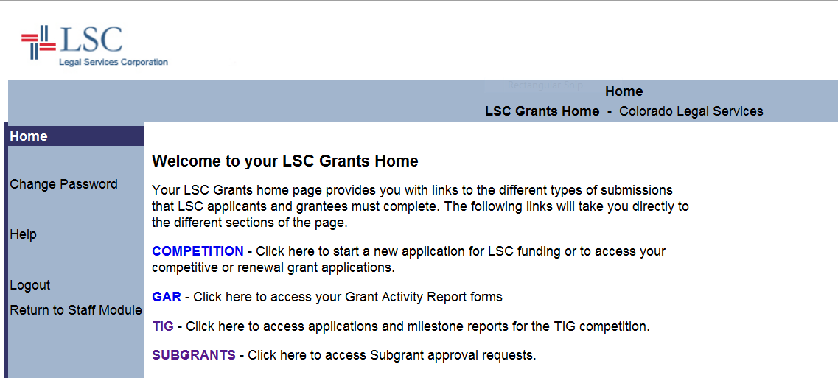
LSC Grants Home Page http://grants.lsc.gov

Slide 9
Create a New LOI

Slide 10
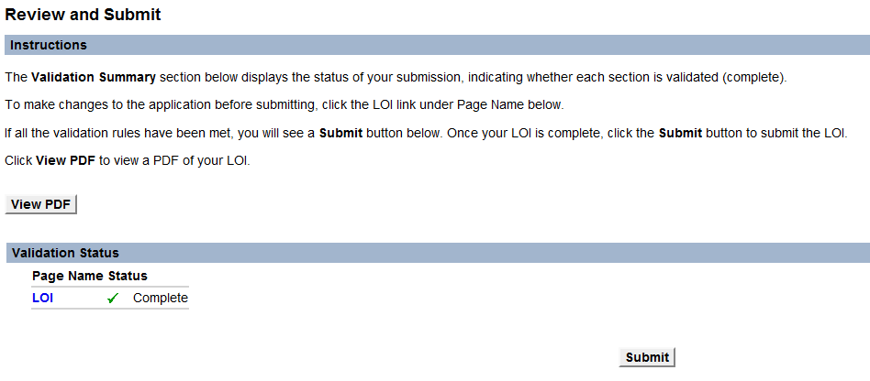
Proof and Submit
Notes:
Be sure to View PDF to proof it and save a copy locally prior to Submitting. You will also be able to go back and View PDF from your home login page at LSC Grants until June 1, 2012, when full applications are due. (for those invited to submit full applications).

Slide 11
Tips & Resources for an LOI
Include IT staff, project managers and expected users from the beginning
Talk to past TIG recipients
Get information about past TIG projects: http://tig.lsc.gov/grants/final-reports
http://tig.lsc.gov/grants/past-grant-awards
Talk to TIG Staff
David Bonebrake – North
Glenn Rawdon – West
Jane Ribadeneyra – South
Notes:
Full state lists and contact information for TIG staff at the end of the presentation.

Slide 12
TIG Compliance Resources
http://tig.lsc.gov/grants/compliance
Grant Assurances
Disclosure of Interests for Determination of Conflicts Policy
Online Intake Special Grant Assurances
Third-Party Contracting of TIG Funds

Slide 13
What Comes Next: Full Applications
In early April, LSC invites successful LOI applications to submit a full application in the LSC Grants online system
Full Applications will be looking for:
Project Budget, including TIG funding, program contribution, partner funding, and narratives on each item
Project Narrative, including what is proposed, why it is proposed, and what it will accomplish

Slide 14
Full TIG Applications
Full Applications will also be looking for:
Length of Project
Need for the Project
Goals and Objectives
State Justice Community Partnerships
Replication Potential
Program Capacity and Staffing
Past Performance
Sustainability of the Project
Proposed Milestones
Letters of Support
Notes:
Think about creating a project plan and draft Evaluation Plan to help you define the project’s goals and objectives. Go to TIG Website – Online Systems – TIG Grant Evaluation Planning and Final Reporting (http://tig.lsc.gov/tig_eval_plan_requirements.php).
Be realistic about the amount of time your project will take – we don’t penalize people for submitting payment requests early if you get the project done early!
State Justice Community Partnerships – As Glenn mentioned, we encourage collaboration with the courts, as well as other access to justice partners.

Slide 15
Grant Awards
No limits on TIG funding requests; typically range between $25,000 to $100,000
Complete list can be found at: http://tig.lsc.gov/sites/default/files/TIG/pdfs/2011_TIG_Awards.pdf
Typical projects last 12 to 24 months plus an additional 3 months for final report

Slide 16
Additional Resources
LSC’s TIG Website: http://tig.lsc.gov
LSNTAP’s Tech Library: http://lsntap.org/tech-library
Pro Bono Net’s Document Assembly Support Site:
http://www.probono.net/dasupport
Contact Claudia Johnson, cjohnson@probono.net for password, other questions and brainstorming ideas.
LawHelp Statewide Websites Support Site:
http://www.probono.net/statewebsites
Contact Liz Keith, lkeith@probono.net
Drupal for Legal Aid Websites:
http://www.legalaidtech.org
A2J Author: http://www.a2jauthor.org
Law Help Interactive:
http://www.lawhelpinteractive.org

Slide 17
TIG Staff Contacts
Eric Mathison– Payment Requests and Milestones
mathisone@lsc.gov or 202-295-1535
Bristow Hardin – Evaluations, Final Reports and Veterans Projects
hardinb@lsc.gov or 202-295-1553
David Bonebrake – Grant Administration for North:
CT, DC, IL, IN, MA, ME, MI, NH, NJ, NY, OH, PA, RI, WI, WV
bonebraked@lsc.gov or 202-295-1547
Glenn Rawdon – Grant Administration for West:
AK, AZ, CA, CO, GU, HI, ID, IA, KS, MP, MN, MT, NE, NV, NM, ND, OK, OR, SD, TX, UT, WA, WY
grawdon@lsc.gov or 202-295-1552
Jane Ribadeneyra – Grant Administration for South:
AL, AR, FL, GA, KY, LA, MD, MS, MO, NC, PR, SC, TN, VI, VA
ribadeneyraj@lsc.gov or 202-295-1554

Slide 18
Please Submit Your Session Evaluation
http://svy.mk/TIGEval from your laptop, smartphone, or tablet
Session Title:
TIG 2012 Information Session
Or Enter This Session Code:
TIGI
(You can also still submit a paper evaluation.)

