Slide 1
2012 TIG Cycle Informational Webinar
David Bonebrake, Jane Ribadeneyra
Legal Services Corporation
Notes:
Welcome to the TIG Cycle Informational Webinar.
Today we’ll cover several items that TIG applicants should know about the upcoming grant cycle, including Letters of Intent, grant categories, areas of interest, the online submission system, the full application, and TIG rules and regulations.

Slide 2
History of TIG
LSC’s Technology Initiative Grant (TIG) program began in 2000 when Congress appropriated $5 million for special grants to improve access to justice through technology
Since 2000, awarded more than 450 grants, totaling almost $40 million
Projects funded demonstrate Innovation, Replication, and Sustainability in the use of technology to improve client access
Notes:
We realize that some of you on the call might not be familiar with our program, so I thought we’d start with a little background…

Slide 3
2012 TIG Cycle
Approximately $3.4 million is available for 2012 grant awards
Letters of Intent (LOI)
Online System Available: February 10
LOIs Due: March 12
Invitations for Full Applications: April 16
Full Applications Due: June 1
TIG Award Notifications: September 2012
Notes:
We’re happy to announce that TIG has approximately $3.4 million available for 2012 technology grant awards.
To give you an idea of our grant cycle schedule, the process begins with submission of Letters of Intent. Our online system that allows those submissions opens at the end of this week. Applicants then have until March 12th to submit an LOI.
Following that, LSC will invite successful applicants from the LOI stage to submit full applications; those invitations go out April 16th.
Full Applications are due June 1st; and TIG Awards Notifications typically occur around September.

Slide 4
Grant Awards
No limits on TIG funding requests - we recommend a minimum request of $30,000, but lower requests will be considered
37 Grants in 2011, with a median funding level of $70,205
Complete list can be found at: http://tig.lsc.gov/grants/past-grant-awards/technology-initiative-grant-2011
Typical projects last 12 to 24 months plus an additional 3 months for final reporting and accounting
Notes:
I’d also like to give a general sense of award amounts for TIGs, the number of projects we typically fund, and grant terms of those projects.
There is no limit on TIG funding requests, so you can request as much or as little as you’d like. We do recommend a minimum request of $30,000 – this is a federally funded program, and there are certain administrative and oversight activities that our grantees are required to complete for each grant. This does take up some time and does involve a cost.
That said, we will consider all requests, including those lower than $30,000.
…

Slide 5
TIG 2012 Letters of Intent Eligibility
Only LSC program grantees are eligible to apply for TIG funds. Other entities are encouraged to participate as project partners.
Programs should be up to date on all previous TIG grants prior to submitting a LOI.
LSC recipients that have had a previous TIG terminated for failure to provide timely documentation are not eligible to receive a TIG for three years after their earlier grant was terminated.
LSC encourages all grantees to submit LOIs, particularly those that have not previously participated in the TIG program.
Notes:
There are certain eligibility rules that potential applicants should be aware of. First….
LSC recipients that have had a previous TIG terminated for failure to provide timely documentation are not eligible to receive a TIG for three years after their earlier grant was terminated. This policy does not apply to applicants that worked with LSC to end a TIG early after an unsuccessful project implementation resulting from technology limitations, a failed proof of concept, or other reasons outside of the applicant’s control. What’s important here is that this ineligibility only applies to a very small group of grantees, and if you have questions about it you should contact TIG staff for more information.

Slide 6
TIG 2012 Grant Categories
LSC will accept projects in three application categories for 2012:
Website Improvement and Innovation
Replication and Adaptation
Open Category
Notes:
As with previous TIG cycles, LSC has three grant categories for 2012. It’s important to note that we don’t allocate any specific amount of our funding for any specific grant category. This is simply our system allows us to organize the LOIs submitted. So applying in one category instead of another provides you no additional benefit during the review; it’s just to help us keep our applications organized during the review.

Slide 7
TIG 2012 Grant Categories
Website Improvement & Innovation
Initiatives to improve and expand the use of statewide websites (SWWS)
Add new tools, promote website traffic, build community and increase effectiveness of SWWS to better serve the community, partners, advocates and client population
Note: 2010 was the last year for Renewal and Continuation Website Grants
Notes:
Our first category is Website Improvement and Innovation. For 10 years, TIG offered very structured website grants that were intended to establish and further develop statewide websites across the country. While those grants no longer exist, we still seek initiatives to improve and expand the use of statewide websites. This can include adding new tools, promoting website traffic, supporting integrations between other sites or other systems, and building community around the SWWS to better serve the advocates and client population.
So if you have a project to improve or enhance your statewide website, you should submit your LOI under this category.

Slide 8
TIG 2012 Grant Categories
Replication and Adaptation – to replicate, adapt, or provide added value to the work of prior TIG projects.
A. Replication of Previous TIG Projects – e.g., look at projects where software or content has been created and is available at no (or low) cost
B. Automated Form Replication – identify Hot Docs and A2J templates on LawHelp Interactive National HotDocs Server (http://www.lawhelpinteractive.org) that can be replicated for your jurisdiction
Examples and final reports of some replicable projects are available at: http://tig.lsc.gov/grants/final-reports/final-report-samples-replicable-projects
Notes:
Our next category is Replication and Adaptation. Here, LSC seeks projects that replicate, adapt, or provided added value to the work of prior successful TIG projects. As I mentioned at the beginning, TIG has funded over 450 grants, and many of those have very effectively increased access to justice. Replication and Adaption invites you to bring those successful projects to your program, service area, or state.
Replication and Adaptation has two subcategories. This first is the general Replication, which is open to any previous TIGs with replication potential. The second is automated form replication, which is focused on adapting successful document assembly interviews to new jurisdictions. The widespread adoption of automated forms has been one of our biggest success stories with TIG, and here we invite programs to submit projects that expand the reach and impact of automated forms.
Finally, at the bottom of the slide, you can see that we have a link to several projects that TIG staff have identified as having significant replication potential.

Slide 9
TIG 2012 Grant Categories
Open Category – projects that don’t fall within website or replication categories and:
Implement new or innovative approaches for using technology in legal services
Enhance the effectiveness and efficiency of other TIG initiatives or use technology to increase the quality and quantity of services to clients
Have broad applicability or impact
Notes:
Finally, the Open category is our catch-all category for projects that don’t fall within the website and replication classifications. The Open category provides a lot of flexibility – not to mention a great opportunity for applicants interested in coming up with smart and creative uses of new technology in legal aid.
If you apply in the Open category, please keep in mind that we’re looking for proposals that can demonstrate all or most of the following:
We are seeking projects that…

Slide 10
TIG 2012 Areas of Interest
Using Mobile Technologies to Provide and Increase Access to Legal Assistance
Leveraging Technology to Increase Pro Bono Attorney and Law Student Involvement
Technology Tools with Applicability to Federal Laws
Use of Data to Analyze Service Delivery and Develop Advocacy Strategies
Leveraging Technology to Support Shared Infrastructure and Staffing
Notes:
In addition to grant categories, TIG also has areas of interest. These are areas where LSC believes TIG funding has the potential to have a significant impact. I should make clear that your application does not have to fall into any of these areas; these are just areas where we believe LSC can receive strong applications for innovative uses of technology. This year we have five areas of interest:
The first is Mobile. LSC again encourages proposals to explore how mobile technologies can be used by legal aid programs, for example by increasing pro bono involvement through mobile clinics, creating mobile apps, or using SMS text messaging to follow-up with clients about appointments and information.
Pro Bono is also once again an area of interest. Here, LSC recognizes that technology can play an important role in recruiting pro bono attorneys and law students and providing them the tools necessary to effectively meet the legal needs of clients. To that end, we seek proposals for projects that leverage creative uses of technology to enhance private attorney and law student involvement.
Our next area is Technology Tools with Applicability to Federal Laws. With this area, LSC seeks technology solutions that can enhance access to legal information and resources related to federal laws affecting LSC-eligble clients. We’re particularly interested in tools that could be used by clients and advocates across the country. Substantive legal areas might include, but are not limited to: Social Security Disability, SSI, Individuals with Disabilities Education Act, Bankruptcy, Fair Labor Standards Act, Public and Federally Subsidized Housing, and Medicare. Resources for clients might include web-based legal information and guidance, including appropriate automated documents and videos. Advocate resources could include web-based trainings, informational materials and automated documents and court forms.
We also have two new categories for 2012.
The first of these is Use of Data. Here, LSC encourages initiatives that enable recipients or partnerships to use technologies to more readily identify, compile and employ data in ways that improve legal services delivery.
. We recognize that data analysis can enable recipients to better identify things like: 1.) current and emerging needs of client communities; 2.) patterns of service delivery by case type, level of service or demographics of clients; and 3.) outcomes achieved for clients. I would encourage anyone who is interested in this category to consult the LOI Notice, and if you have questions, please contact TIG staff for more information.
Our final category is Shared Infrastructure and Staffing. Here LSC seeks projects that leverage technology to provide shared IT infrastructure and/or staffing across recipients. What do we mean by that? Well, the emergence of new technologies – particularly cloud computing– has made it easier for the legal services community to share critical capacities across organizations. For instance, LSC recipients can adopt cloud solutions that consolidate the IT environments of multiple recipients into regional data centers. Additionally, recipients can use established web applications and remote access and meeting tools to share staffing for positions that have been hard for LSC recipients to fill or sustain, especially in light of recent budget cuts. Examples of shared staffing capacity could include IT helpdesk staff and communications and development professionals.

Slide 11
TIG 2012 LOI Requirements
One project per Letter of Intent; applicants may submit multiple LOIs
Submit online in LSC Grants at http://lscgrants.lsc.gov
Reminder: Programs with prior TIGs must be up to date according to the milestone schedule on all previous grants prior to submitting a LOI.
Notes:
So now I want to shift to how you actually submit an LOI to LSC.
First, our rule has always been one letter of intent per project. You are certainly welcome to seek funding for multiple projects in the grant cycle, but you will need to submit multiple LOIs to do that.
Second, you will submit your LOIs online through the LSC Grants system.
Finally, another reminder about being up-to-date on all previous projects. If there are compelling reasons for delays in completing prior grants, programs must work with LSC staff to secure an approved extension prior to submitting a Letter of Intent. Failure to do so will disqualify submissions.

Slide 12
What’s Needed in the LOI
Grant Category
Requested Amount
Description of Project
Major Benefits
Estimated Costs
Major Partners
Innovation/Replication/Sustainability
Notes:
Total LOI should not be longer than 2-3 pages.
In terms of what’s needed in an LOI, each applicant must select a grant category – either website innovation, replication, or open – and provide a requested funding amount.
You do have some flexibility with changing this funding amount request if you’re invited to the full application stage – you can reduce it in the full application by however much you’d like and you can make reasonable increases in the funding amount requested so long as those are backed up in the application itself.
TIG has five LOI response sections where applicants provide short answer responses. Those are Description of Project, Major Benefits, Estimated Costs, Major Partners, and Innovation/Replication/Sustainability. You will need to review the LOI Notice to make sure you fully understand what’s required for each of these items.
Finally, I want to mention our character length limits. For Description of Project and Major Benefits, the character length limit is 2500 characters, which is roughly 2/3 of a page in Word using a standard sized font. For the other three, the limit is 1500 characters, which is slightly less than ½ page in Word.

Slide 13
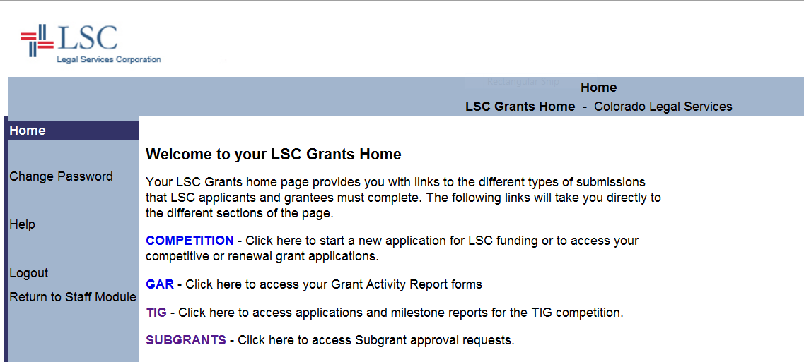
LSC Grants Home Page http://lscgrants.lsc.gov
Notes:
So now I want to quickly walk you through the process of using our online grants management system to submit an LOI. You start out by logging into the system and selecting “TIG” from the top of the LSC Grants homepage.

Slide 14
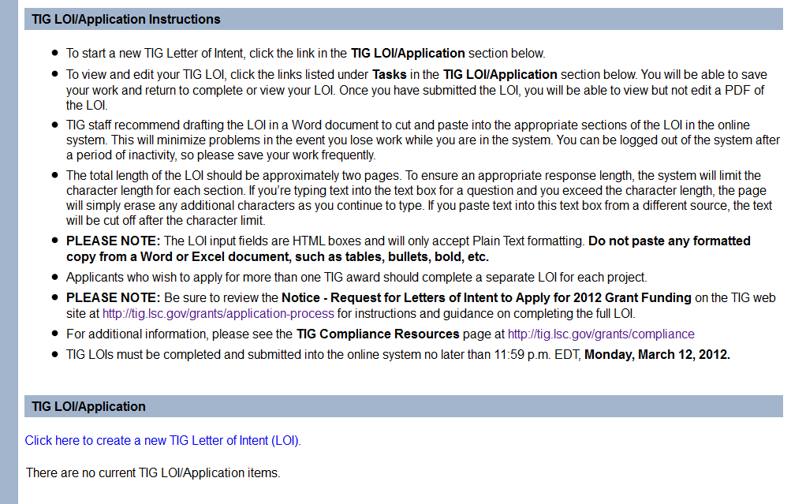
Create a New LOI
Notes:
From there, you’ll see Letter of Intent instructions and an option that allows you to create a new TIG Letter of Intent. You’ll click on that option.

Slide 15
Choose Category
Notes:
Next you’ll choose a grant category. Again, the categories are either Website Innovation, Replication, or Open.

Slide 16
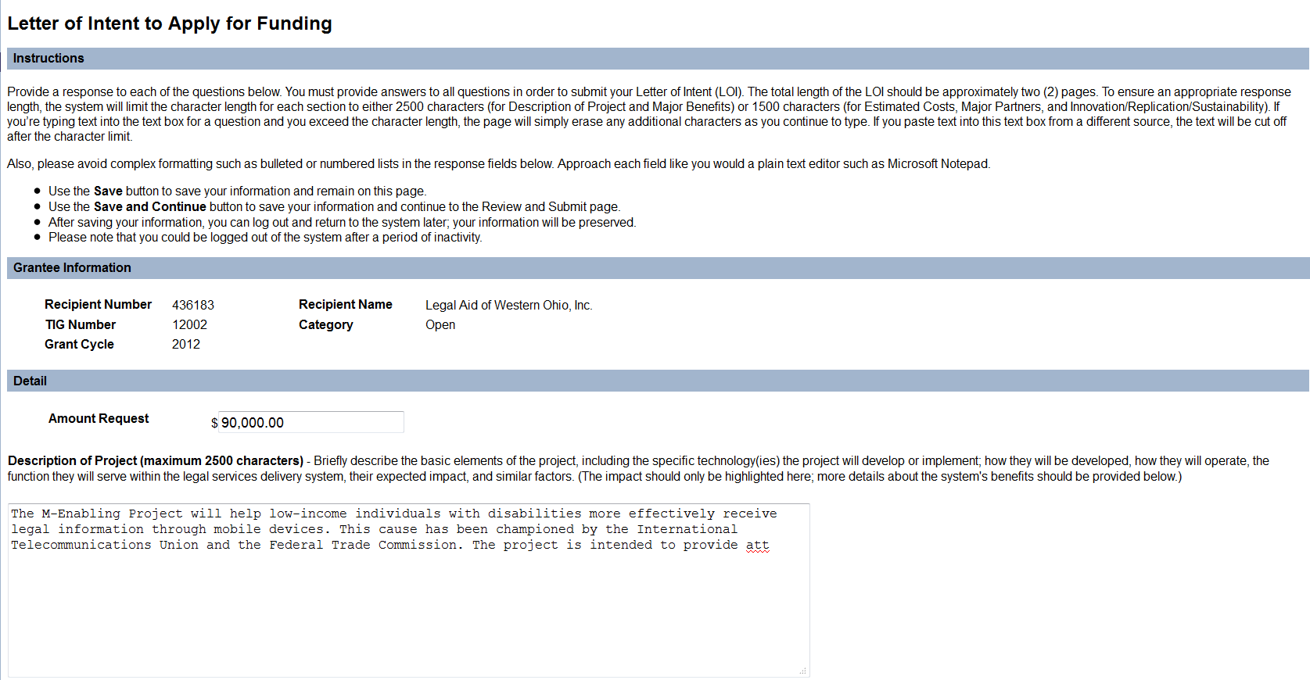
Notes:
And then you’ll get to the LOI responses page. We recommend preparing your LOI responses in a Word or Notepad document prior to submitting them in the online system, to ensure you don’t lose any work. The online system will automatically log you out after a period of inactivity, and even though it will prompt you, that won’t help if you’re away from your desk.
Please Note – the online system does not accept Word formatting like bullets, tables, bold, etc. So it’s best to use no formatting if you’re using a Word document to prepare your LOI.

Slide 17
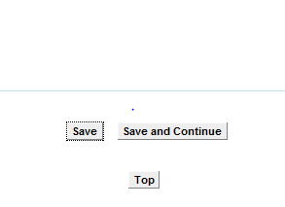
Save Your Work!
Notes:
Make sure to save early and often…
When you’ve completed your responses in each field, hit save and continue.

Slide 18
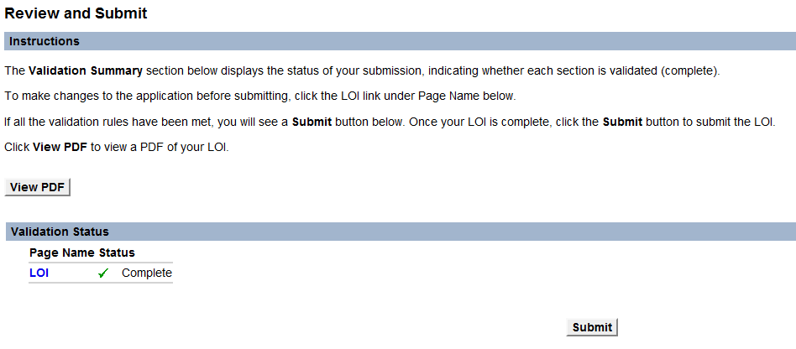
Proof and Submit
Notes:
Be sure to View PDF to proof it and save a copy locally prior to Submitting. You will also be able to go back and View PDF from your home login page at LSC Grants until June 1, 2012, when full applications are due. (for those invited to submit full applications).

Slide 19
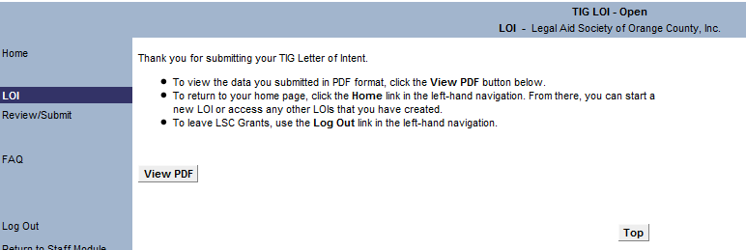
Create New LOI or Exit
Notes:
And this is the confirmation screen.
So at this point, I’m going to turn things over to Jane. She’s going to tell you what you need to do with your confirmation and then walk you through some other important information about the TIG cycle.

Slide 20
LOI Confirmation
Open the PDF of your final LOI submission and save a copy
Review the PDF to ensure all information is included in the LOI
You’ll receive an email confirmation of the LOI submission – also save a copy of this email
If you don’t receive an email confirmation, email us at techgrants@lsc.gov
Notes:
As David explained, it’s very important that you review the pdf of your submission BEFORE you click the Submit button to ensure that all of the information is included in the LOI.
Once you do submit the LOI, an email confirmation will be sent to the email associated with the login address used to submit the LOI. Make sure to save a copy of that email as your confirmation.
If you don’t receive an email, be sure to contact us.

Slide 21
Tips & Resources for an LOI
Include IT staff, project managers and expected users from the beginning
Talk to past TIG recipients
Get information about past TIG projects: http://tig.lsc.gov/grants/final-reports/final-report-samples-replicable-projects
http://tig.lsc.gov/grants/past-grant-awards
Talk to TIG Staff
David Bonebrake – North
Glenn Rawdon – West
Jane Ribadeneyra – South
Notes:
As you plan your TIG project, I’d like to review some tips and resources to use. It’s very important to include all the relevant staff that will be part of, or affected by, the project in the early planning stages. That includes IT staff, project managers and users. So, if you are planning an online intake project, include some of your intake staff in the planning.
Talk to past TIG recipients for tips and advice. We have a TIG community that is collaborative and willing to share lessons learned. The TIG website includes some descriptions and final reports from past projects, as well as complete lists of past awards.
Talk to the TIG staff if you have questions or need additional information about a project you are planning. There’s a full list of the states included in each region and contact information for TIG staff at the end of the presentation.

Slide 22
TIG Compliance Resources
http://tig.lsc.gov/grants/compliance
Grant Assurances
Transfers and Subgrants
Disclosure of Interests for Determination of Conflicts Policy
Technology Standards
Third-Party Contracting of TIG Funds
Termination
Notes:
TIG funds are subject to the same rules and regulations as other LSC funds, including transfers and subgrants (45 CFR 1627), the Property Acquisition and Management Manual (PAMM – 45 CFR 1630) and Program Integrity (45 CFR 1610). In addition, TIG awards include their own Grant Assurances. You can review prior year grant assurances on the Compliance page of the TIG website. Some examples of the TIG grant assurances include things like:
A Conflicts of Interest Policy
Following Technology Standards – such as the National Subject Matter Index and Naming Conventions for document assembly projects
Requirements for 3rd Party Contracting for Services.
Termination Policies – for failure to report on time without receiving an extension; by mutual consent when the grantee decides to withdraw; for performance; if the recipient is no longer an LSC grantee.
Examples of Other Grant Assurances:
Consider and address the special needs of persons with disabilities to ensure that any websites, materials and other grant-supported products are accessible to them.
Similarly, consider and address the special needs of persons with limited literacy and limited English proficiency
All funds disbursed by LSC pursuant to this grant shall be used solely for the project for which this grant is being made.
Staff designated to work on this project shall be given sufficient time to achieve the milestones of the grant - the total time commitments of any staff member working on this grant shall not exceed 1.0 Full-time Equivalent (FTE) for all work to be performed for the recipient.

Slide 23
LOI Review
Projects likely to:
improve access to justice
Improve the efficiency, effective and quality of legal services
Project is clear and well thought out
Offers major benefits to client community
Involves all the parties/partners needed
Innovative and/or cost effective replication
Notes:
LSC will initially review all complete Letters of Intent to identify those that propose projects likely to improve access to justice or the efficiency, effectiveness, and quality of legal services provided by grantees. The Letters of Intent will be reviewed to determine the extent to which the project proposed is clearly described and well thought out, offers major benefits to our targeted client community, is cost effective, involves all of the parties needed to make it successful and sustainable, and is either innovative or a cost effective replication of prior successful projects.
Projects that meet the required criteria will be invited to submit full applications.

Slide 24
What Comes Next: Full Applications
In April, LSC invites successful LOI applications to submit a full application in the LSC Grants online system
Full Applications will be looking for:
Project Budget, including TIG funding, program contribution, partner funding, contracting information, and narratives on each item
Project Narrative, including what is proposed, why it is proposed, and what it will accomplish
Notes:
The invitations to submit a full application will be emailed (to the address in LSC Grants used to submit the LOI) in mid-April
For Project Budgets, think about the Personnel that will be working on the project – if they are current employees, how their duties will change to allow them time to work on the TIG. All TIG funds must be accounted for separately – including appropriate personnel records for work on TIG projects. For any proposed contracts, competitive bidding must be used to determine final contractor. If sole source contracting is used, appropriate justification and documentation must be included in the grant file.
The full application also includes a Project Narrative section, which we’ll review on the next slide.

Slide 25
Full TIG Applications
Full Applications will also be looking for:
Length of Project
Need for the Project
Goals and Objectives
State Justice Community Partnerships
Replication Potential
Program Capacity and Staffing
Past Performance
Sustainability of the Project
Proposed Milestones
Letters of Commitment and Support
Notes:
Think about creating a project plan and draft Evaluation Plan to help you define the project’s goals and objectives. Go to TIG Website – Online Systems – TIG Grant Evaluation Planning and Final Reporting (http://tig.lsc.gov/tig_eval_plan_requirements.php).
Be realistic about the amount of time your project will take – we don’t penalize people for submitting payment requests early if you get the project done early!
State Justice Community Partnerships – we encourage collaboration with the courts, as well as other access to justice partners.
Full application requirements are subject to changes, and will be published in April.

Slide 26
What happens after you receive a TIG award?
LSC will notify successful applicants in early September
Final Budget, Payment Schedule and Milestones approved
Award Package available in LSC Grants - Program director and board chair sign the grant award acceptance and grant assurances form
Grant project begin by January, 2013
At least one program staff attends TIG Conference in January, 2013
Notes:
Once TIG awards are approved by the LSC president, programs will be notified; there may be instances where the award amount approved does not exactly match the request, and there will be a negotiation of the final amount, final payment schedule and milestones and a final budget. In addition, staff will review proposed milestones and payment schedules of all approved projects, and will work with programs to develop final payment schedules with milestones that are appropriate for the grant deliverables.
Successful TIG recipients will be notified when their TIG Award packages are available in the online LSC Grants system. Programs must download the award package, sign it and upload the signed award letter. At that point, LSC will distribute initital payments, and projects will begin, usually by January. So for the 2012 TIG cycle, projects will normally begin by January, 2013.

Slide 27
TIG Reporting Requirements
Within 30 days of the end of each payment period, recipient submits payment request and milestone completion reports through LSC Grants (https://lscgrants.lsc.gov)
Final payment is sent after the project’s Final Report (which includes project evaluation) and Final Budget is approved by LSC
LSC TIG Training on Reporting System in June
Notes:
As grant projects begin, they normally require 6-month payment periods. Reports are due within 30 days of the end of each payment period. Grants include a final payment period of 3 months to prepare the final report and evaluation of the project. So, if you anticipate a project will take 12 months to complete, the grant term will actually be for 15 months.
Be sure to allow yourself a realistic time frame to complete the project. We don’t penalize grants that report early – so if you’re not sure you can complete a project in 12 months, ask for an 18 or 24 month grant term.

Slide 28
Additional Resources
LSC’s TIG Website: http://tig.lsc.gov
See http://tig.lsc.gov/grants/application-process
LSNTAP’s Tech Library: http://lsntap.org/tech-library
Law Help Interactive: http://www.lawhelpinteractive.org
A2J Author: http://www.a2jauthor.org
Pro Bono Net’s Document Assembly Support Site:
http://www.probono.net/dasupport
Contact Claudia Johnson, cjohnson@probono.net for password, other questions and brainstorming ideas.
LawHelp Statewide Websites Support Site:
http://www.probono.net/statewebsites
Contact Liz Keith, lkeith@probono.net
Drupal for Legal Aid Websites: http://www.openadvocate.org/dlaw/index.html
Notes:
We have put together some links to additional resources to use while you are putting together a TIG project for the 2012 cycle.

Slide 29
TIG Staff Contacts
Eric Mathison– Payment Requests and Milestones
mathisone@lsc.gov or 202-295-1535
Bristow Hardin – Evaluations, Final Reports and Veterans Projects
hardinb@lsc.gov or 202-295-1553
David Bonebrake – Grant Administration for North:
CT, DC, IL, IN, MA, ME, MI, NH, NJ, NY, OH, PA, RI, WI, WV
bonebraked@lsc.gov or 202-295-1547
Glenn Rawdon – Grant Administration for West:
AK, AZ, CA, CO, GU, HI, ID, IA, KS, MP, MN, MT, NE, NV, NM, ND, OK, OR, SD, TX, UT, WA, WY
grawdon@lsc.gov or 202-295-1552
Jane Ribadeneyra – Grant Administration for South:
AL, AR, FL, GA, KY, LA, MD, MS, MO, NC, PR, SC, TN, VI, VA
ribadeneyraj@lsc.gov or 202-295-1554
Notes:
As I mentioned earlier, the TIG staff works in three regions – North, South and West. In addition, Bristow Hardin works with projects related to Veterans, and assists grantees in developing Evaluation Plans and Final Reports. Eric Mathison is often the first point of contact for TIG projects, working with grantees to ensure their payment requests and reporting are complete.
We also have a new TIG Staff member, our intern Ashley Miller

Slide 30
2012 TIG Cycle
Approximately $3.4 million is available for 2012 grant awards
Letters of Intent (LOI)
Online System Available: February 10
LOIs Due: March 12
Invitations for Full Applications: April 16
Full Applications Due: June 1
TIG Award Notifications: September 2012

