Slide 1
The NJP Landscape
NJP runs CLEAR, a statewide hotline, which screens applicants in Washington for NJP and its partners
CLEAR is open from 9:15am to 12:30pm M-F
Applicants are “screened” for financial eligibility and case priority by non- attorney screeners - helped by NJP or referred to our partners
All civil legal aid providers in WA use Legal Server
Referrals- All intake data is e-transferred using Legal Server

Slide 2
NJP’s Goal for 2010 TIG Grant
“Increase applicants’ access to services, the number of clients served on high-priority issues and NJP’s operational efficiency by developing and implementing a new on-line intake system.”
high-priority issues = denial of benefits and eviction and means a callback to the client

Slide 3
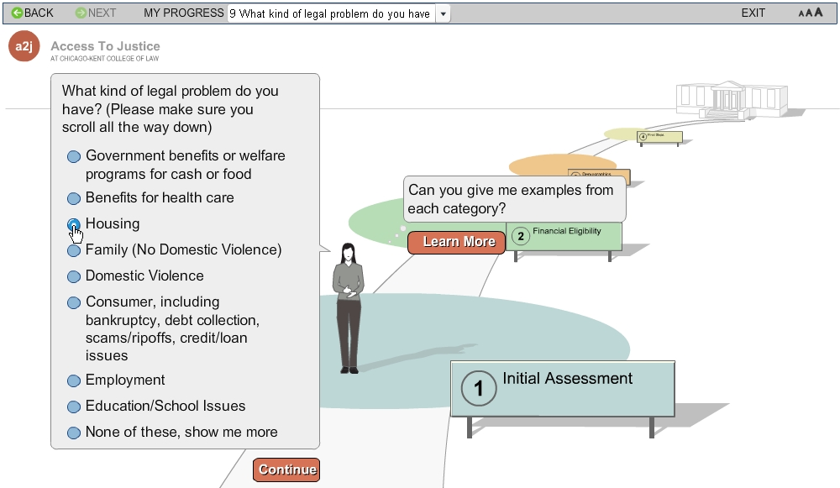
NJP’s model – A2J
Notes:
So the way we are doing our triage is different from NJP in several ways. The first is that their goal was to get high-priority cases to services faster. As I just described to you that is our goal as well, but we have the additional goal of diverting low-priority cases to other resources.
What you see on this slide is a screenshot from NJP’s triage system. It is designed in A2J Author, which provides a very user-friendly interface. After a series of introduction and disclaimer screens, they ask the user what kind of legal problem they have. This is another fundamental difference between our system and theirs. We don’t want to do this and here’s why.
Our website used to be designed as a drill down list. We started with broad legal categories and asked users to drill down to more and more discrete areas until they got to the information they were seeking. We did usability testing on this design and found that it didn’t work because many people do not know how to categorize their legal problem. So what we did instead was to create a search engine…

Slide 4
Branch Logic Allows for LPC and SLPC to be resolved. Leads to determination of next steps (who calls who) and correct referrals and resources

Slide 5
Triage and Callback Information

Slide 6
Answers to FAQ’s
All apps are reviewed by a human being so we do not ask:
Opposing party
Citizenship status
No text box for explanation of problem by design
Conflict searches are not performed on-line:
Conflict search of client name performed by screener before info is brought into NJP database
Screener can reject or allow import

Slide 7
Legal Server View

Slide 8
NJP Stats- First 9 mos.

Slide 9
NJP Lessons Learned
Plan ahead! What will you do with the 9000 apps.?
Read your User Surveys (760 completed)
Put instructions everywhere: website & application
Create an instructional video: 3000 views in 11 mos.
Staff communication: Make sure all staff understand how online intake works and the goal.
Community education: Be sure your process is very clearly started in all outreach materials.
Branch logic and structuring the questions will take much longer than you imagined

